Slide 1
Year 4 Maths
Time
Estimate and read time with increasing accuracy to the nearest minute; record and compare time in terms of seconds, minutes and hours

Slide 2

Recap from last week!
Day 1
Can you add am or pm to these sentences?
Troy played his basketball game at 2.30____.
At 8.15____, Gabriella left to go to school.
Sharpay had to warm up her voice before the show began at 9.30____.
The WildCats practised after school everyday at 4.00____.

Slide 3
Recap from last week!
Day 1
Can you add am or pm to these sentences?
Troy played his basketball game at 2.30 _pm_.
At 8.15_am_, Gabriella left to go to school.
Sharpay had to warm up her voice before the show began at 6.30_pm_.
The WildCats practised after school everyday at 4.00_pm_.

Slide 4
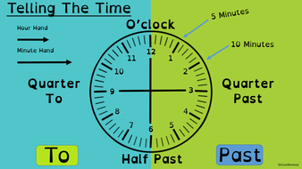
Reading time
Day 1
When we read a time, we usually say there are minutes past or to the hour.

Slide 5
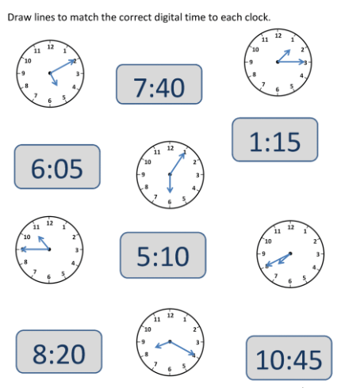
Can you read these clocks?
Day 1

Slide 6
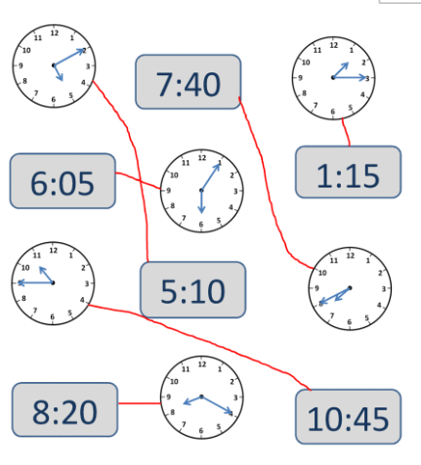
Answers!
Day 1

Slide 7
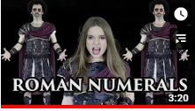
You might be asked to read the time from a clock with Roman Numerals!
Day 1
Remind yourself of the Roman Numerals we learned earlier this year with the video below!

Slide 8
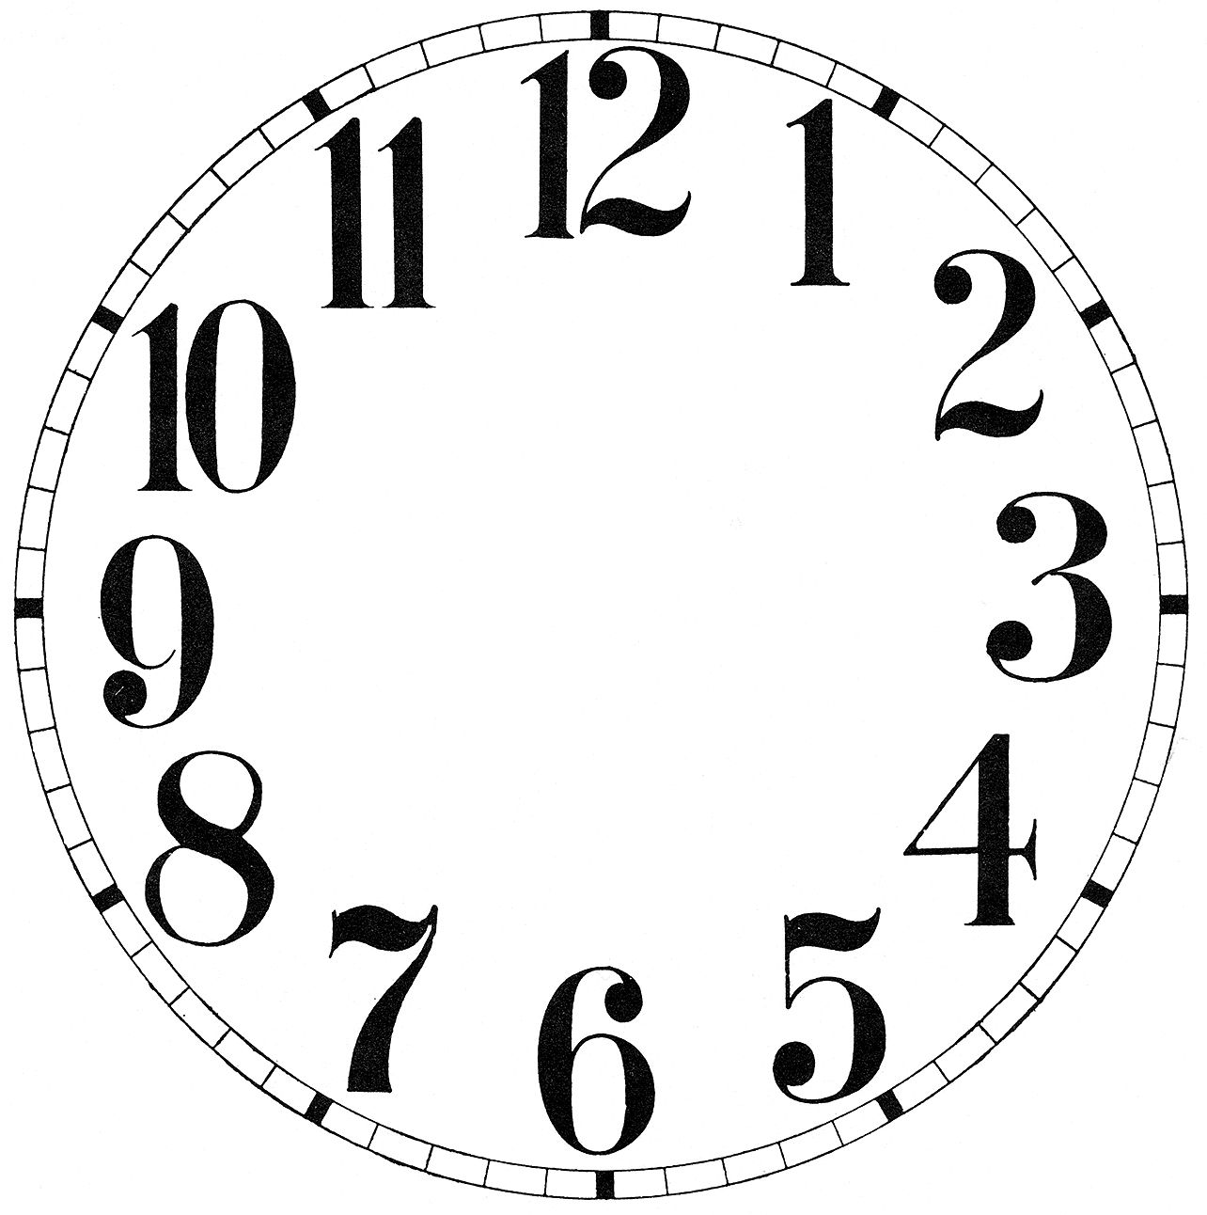
Can you fill in the Roman Numerals up to 12?
Day 1
XII
VII
I
VIII
II
III
IX
IV
X
V
VI
XI

Slide 9
Can you fill in the Roman Numerals up to 12?
Day 1
XII
XI
I
X
II
IX
III
VIII
IV
VII
Now have a go at Day 1’s questions!
V
VI

Slide 10
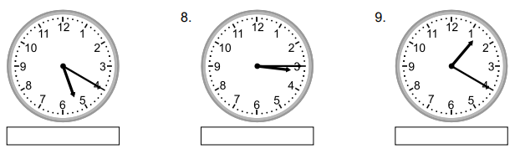
Day 2 – reading time to the nearest minute.
Recap! Can you read the time on these clocks?

Slide 11
Day 2 – reading time to the nearest minute.
Recap! Can you read the time on these clocks?
5:20
Twenty minutes past 5.
3:15
Fifteen minutes past 3 OR quarter past three.
.
1:20
Twenty minutes past 1.

Slide 12
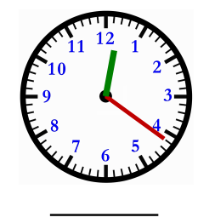
Now that you can confidently read time to the nearest 5 minutes, you can read it to the nearest minute too!
Day 2
I can see the hour (short) hand is between 12 and 1.
I can see the minute (long) hand in pointing at 21 minutes past the hour.
So, the time is 12:21 or twenty-one minutes past twelve!

Slide 13
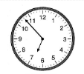
Now that you can confidently read time to the nearest 5 minutes, you can read it to the nearest minute too!
Day 2
I can see the hour (short) hand is between 6 and 7.
I can see the minute (long) hand in pointing at 53 minutes past the hour.
So, the time is 6:53 or seven minutes to seven!

Slide 14
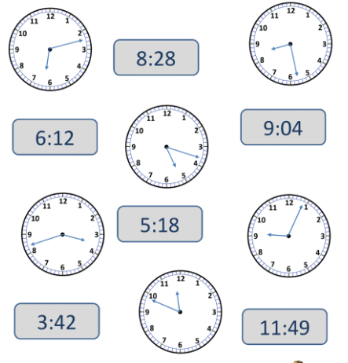
Day 2
Can you match the clock face and digital time?

Slide 15
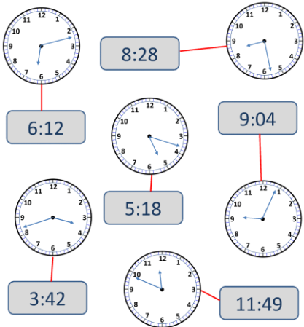
Day 2
Can you match the clock face and digital time?

Slide 16
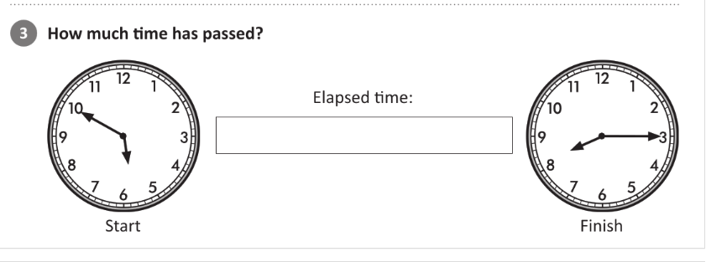
Using your time knowledge, have a go at this question.
Day 2

Slide 17
Using your time knowledge, have a go at this question.
Day 2
2 hours and 25 minutes
10 mins + 2 hours + 15 mins
To work this out, I saw there were 10 minutes until 6’oclock here.
Then I worked out there are 2 hours between 6 o’clock and 8 o’clock.
Then added on the 15 minutes after 8 o’clock.

Slide 18
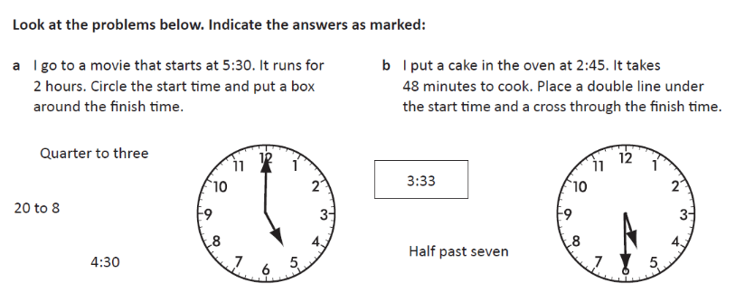
Now that you are confident in reading a clock, you can also answer questions that relate to how long something takes!
Day 2

Slide 19
Answers!
Day 2
Now do Day 2’s questions!

Slide 20
Day 3
Have a go at the reasoning and problem solving questions!

