Slide 1
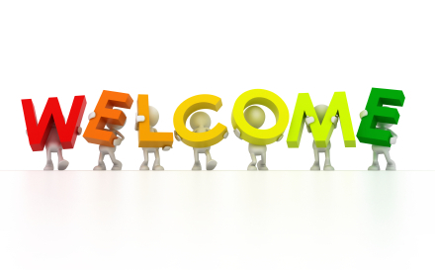
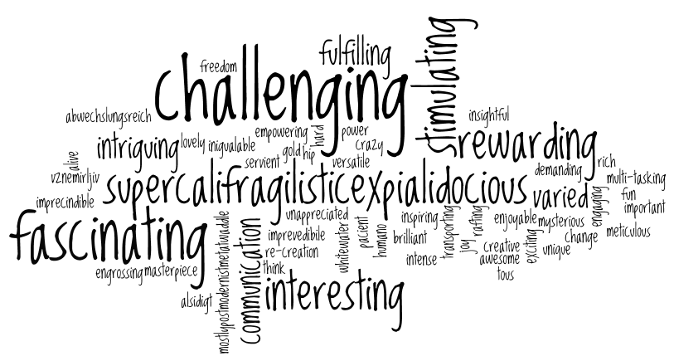
Welcome back to Home Learning Spellings with Mrs Andrews

Slide 2


I hope you had a good week! I did!
and now … it is time to do some spellings!

Slide 3
This half term, is recap half term!
This half term, we are going to recap the spelling principles that you either learnt with your class teachers or with me during your Home Learning. I will be referring you back to the previous Home Learning power points when we are discussing the spelling principles.
This week we are going to focus on the prefixes ‘super’ and ‘auto’ which you learnt with your class teachers in February.

Slide 4

Prefixes
So we know from last time that a prefix is a letter or a group of letters added to the front of a root word to change the meaning of the word.
They are not words in their own right!
The root word always stays the same when the prefix is added to the front.
What do the prefixes ‘super’ and ‘auto’ do the meaning of the word when they are added to the front of the root word?

Slide 5
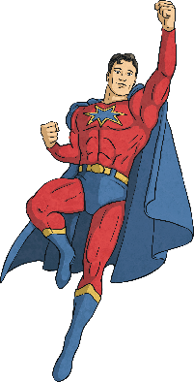
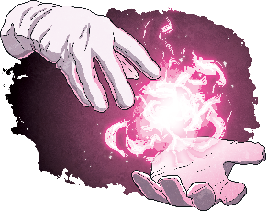
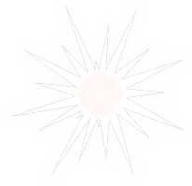
The Prefix super-
Below are some examples of words that use the prefix super-. Using their definitions, can you figure out what the prefix super- must mean?
supernatural
superhero
supernova
A star that suddenly increases greatly in brightness because of a large explosion.
Something that has greater than normal natural powers.
Cartoon characters who have extraordinary powers.
From these examples, what does the prefix super- mean?
Can you think of any other examples of words that use the prefix super-?

Slide 6

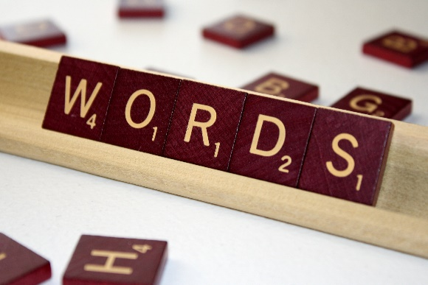
Prefix ‘super’
The prefix super- means ‘better than’, ‘greater’, ‘more than’ or above or ‘surface’.
E.G.
Prefix ‘super’ + root word ‘man’ = new word ‘superman’
For example:
superwoman, superwoman, superior, supernatural,
supermarket, superstar

Slide 7
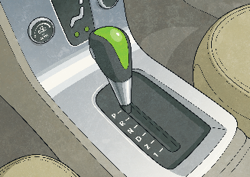
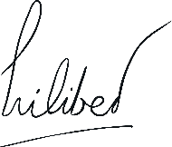
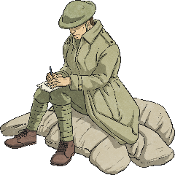
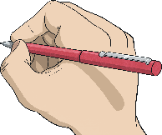
The Prefix auto-
Below are some examples of words that use the prefix auto-. Using their definitions, can you figure out what the prefix auto- must mean?
automatic
autograph
autobiography
The history of a person which is written by the person themselves.
Something that works by itself with little or no direct human control.
Something which is written by the author themselves.
From these examples, what does the prefix auto- mean?
Can you think of any other examples of words that use the prefix auto-?

Slide 8
Prefix ‘auto’
The prefix auto- means ‘self or ‘own’’.
E.G.
Prefix ‘auto’ + root word ‘graph’ = new word ‘autograph’
For example:
Automatic and autobiography

Slide 9
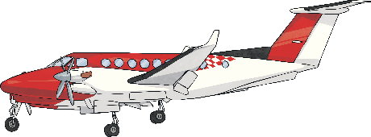
The Human Dictionary Challenge
Now that you know the meaning of these prefixes, can you use your knowledge to figure out what the following words must mean?
superhuman
He had superhuman strength.
autopilot
The captain turned on the autopilot.
Superhuman means having exceptional ability or powers; more than any normal human would have.
Autopilot is a device which keeps an aeroplane flying the right way, without the pilot controlling it.

Slide 10
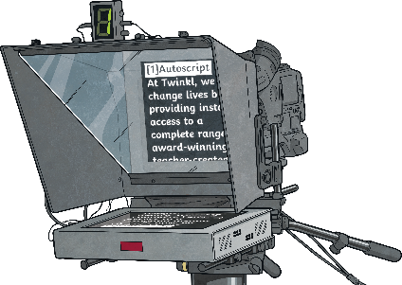
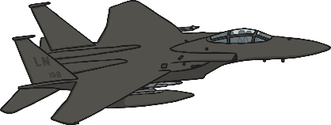
The Human Dictionary Challenge Part 2
This time, you’ve been given the meaning of a word. Using its meaning, can you figure out which prefix the word must start with?
____cue
He read off the ____cue.
____sonic
Concorde was the first ____sonic passenger plane.
An ____cue is a device that projects words onto a screen so that people can read them whilst being filmed.
If something is ____sonic, it travels at a speed which is greater than the speed of sound.

Slide 11
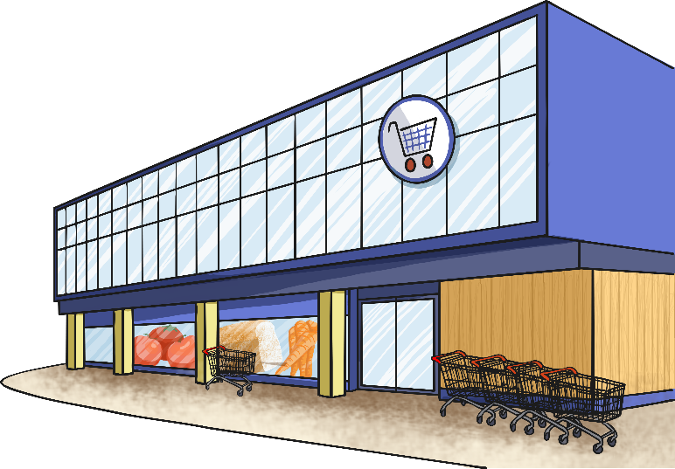
super- or auto- Quick Quiz
Take a quiz to see if you are an expert!
Which is correct?
supermarket
automarket

Slide 12

super- or auto- Quick Quiz
Take a quiz to see if you are an expert!
Which is correct?
superpilot
autopilot

Slide 13
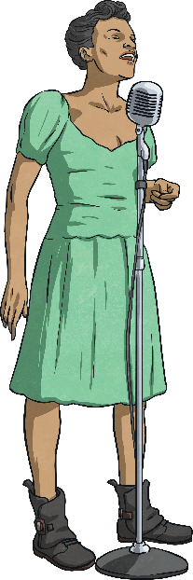
super-, auto- Quick Quiz
Take a quiz to see if you are an expert!
Which is correct?
superstar
autostar

Slide 14
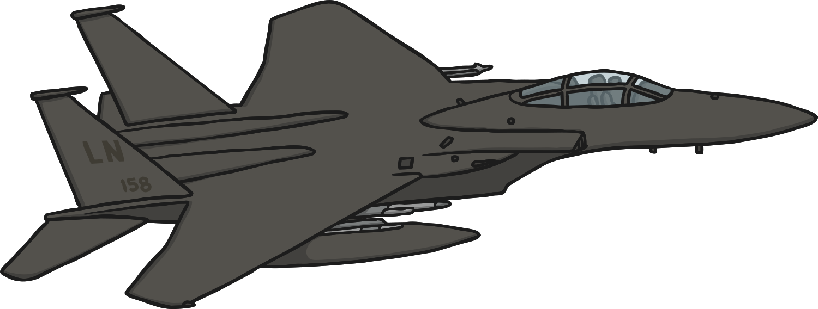
super- or auto- Quick Quiz
Take a quiz to see if you are an expert!
Which is correct?
supersonic
autosonic

Slide 15
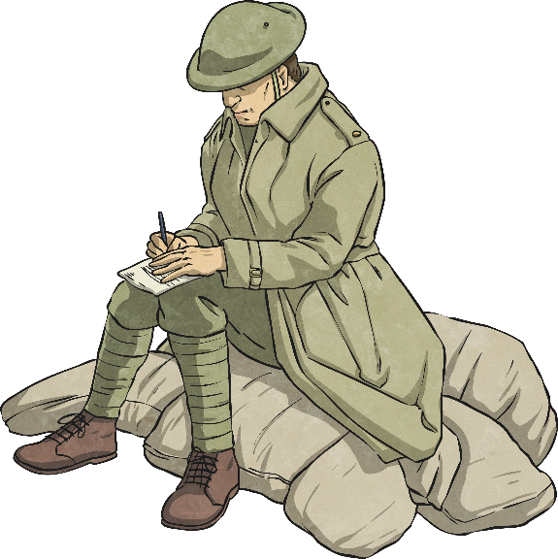
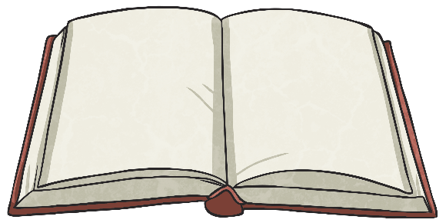
super- or auto- Quick Quiz
Take a quiz to see if you are an expert!
Which is correct?
superbiography
autobiography

Slide 16

Your 10 ‘super’ and ‘auto’ Spelling Words…
autobiography
automobile
autopilot
autograph
automatic
supermarket
superwoman
superstar
superficial
supernatural

Slide 17

Your turn to do some spelling activities.
Prefixes, Root words and Definitions
Across and Down
Cut out each section and add the prefix to the correct root and the definition
Answers attached
Write each of your 10 spelling words across and then down
(Starting with the first letter).
Examples-
s u p e r s t a r
u
p
e
r
s
t
a
r

Slide 18
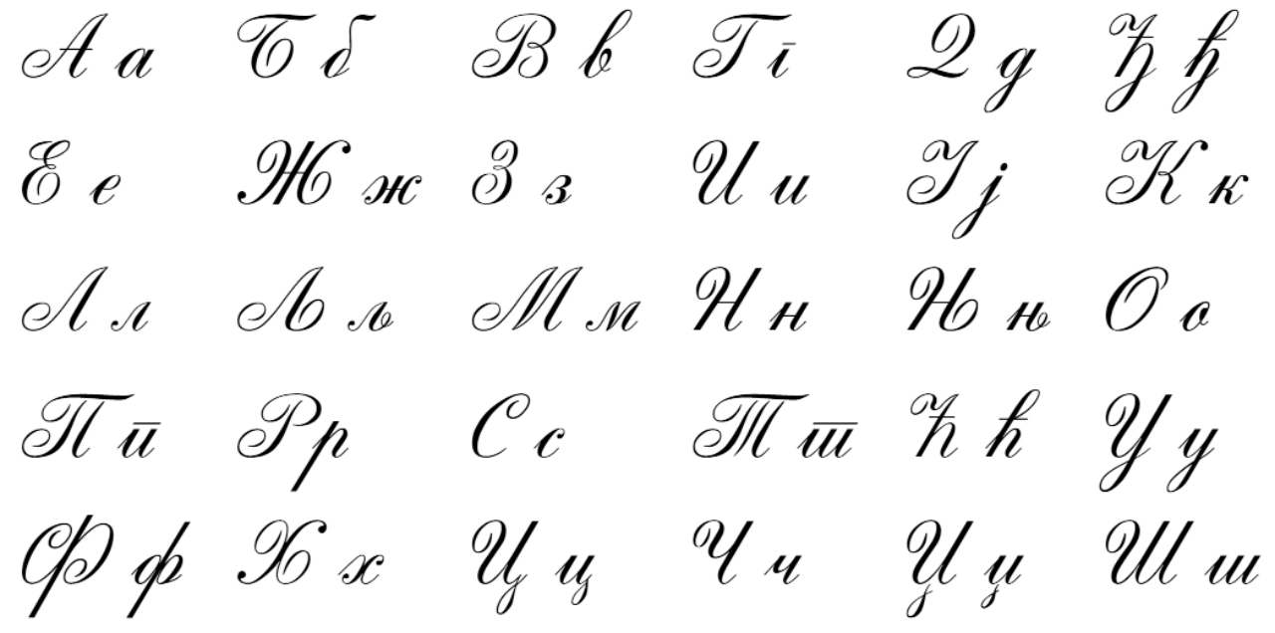
Your turn to do your handwriting task
On a sheet of paper, choose 6 tricky spelling words, and put them into a sentence so you can practise your handwriting as well as writing sentences that make sense.
autobiography
automobile
autopilot
autograph
automatic
supermarket
superwoman
superstar
superficial
supernatural

Slide 19


