Slide 1

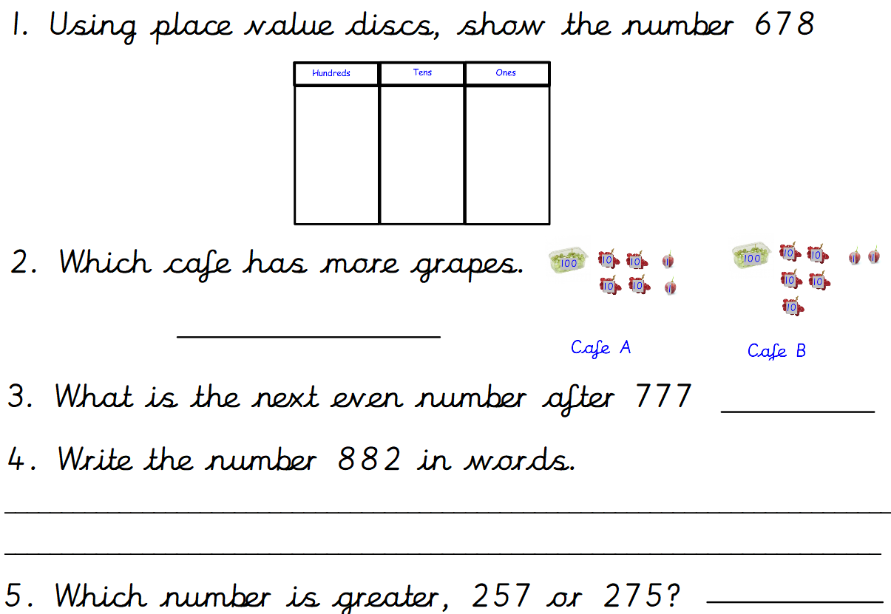
Day 1
Maths- 5 a day

Slide 2
Day 1
Maths- 5 a day
ANSWERS
Café A
778
Eight hundred and eighty two.
275

Slide 3
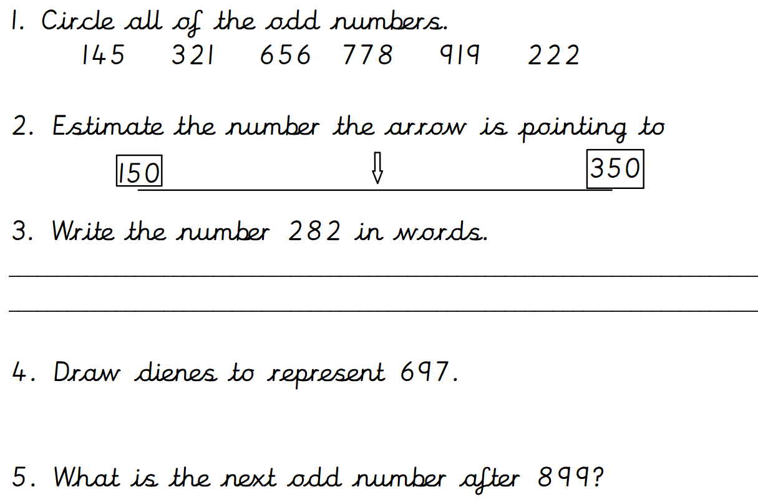
Day 2
Maths- 5 a day

Slide 4

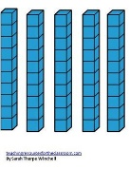

Day 2 ANSWERS
Maths- 5 a day
250
Two hundred and eighty two.
12
901

Slide 5
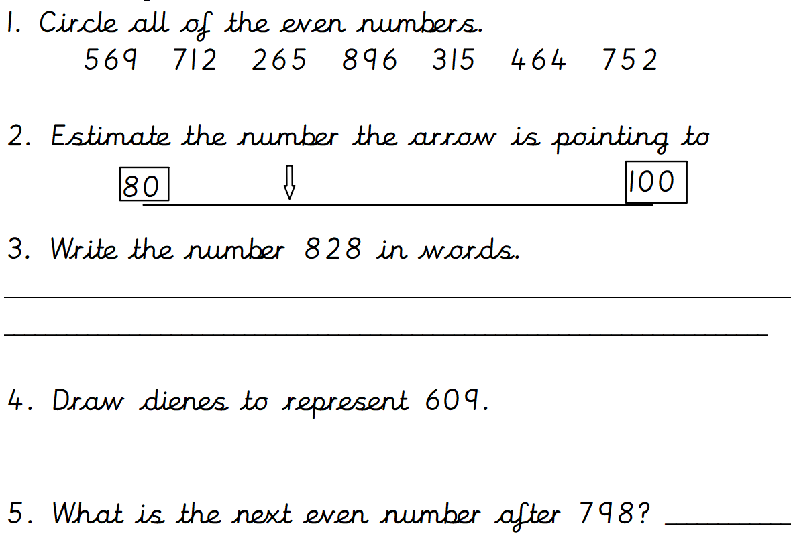
Day 3
Maths- 5 a day

Slide 6
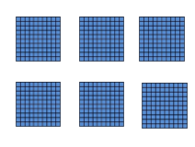

Day 3 ANSWERS
Maths- 5 a day
85
Eight hundred and twenty eight.
800

Slide 7
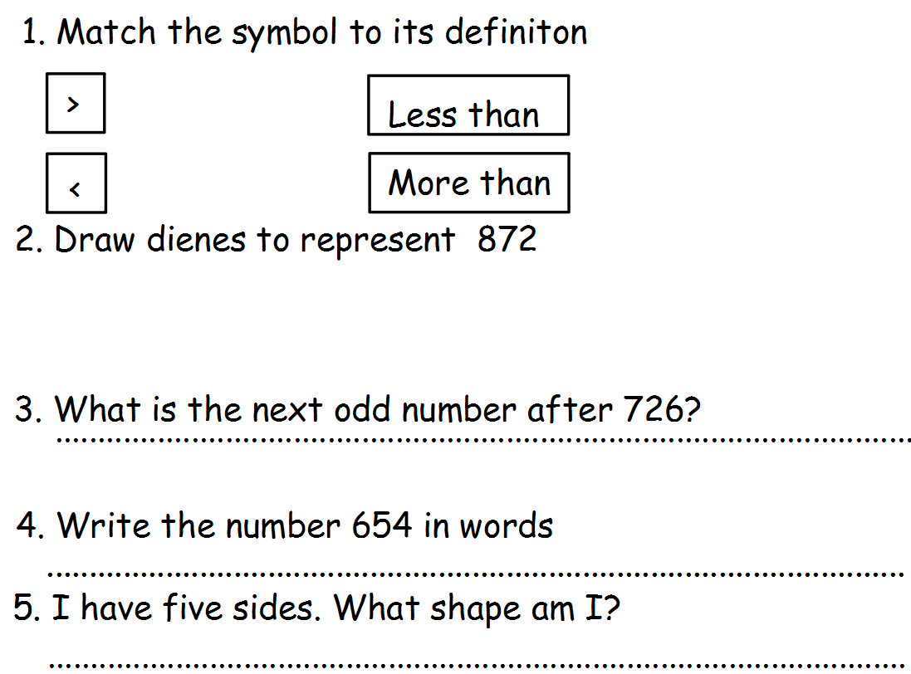
Day 4
Maths- 5 a day

Slide 8
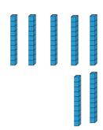
Day 4 ANSWERS
Maths- 5 a day
728
Six hundred and fifty four.
Pentagon.

Slide 9
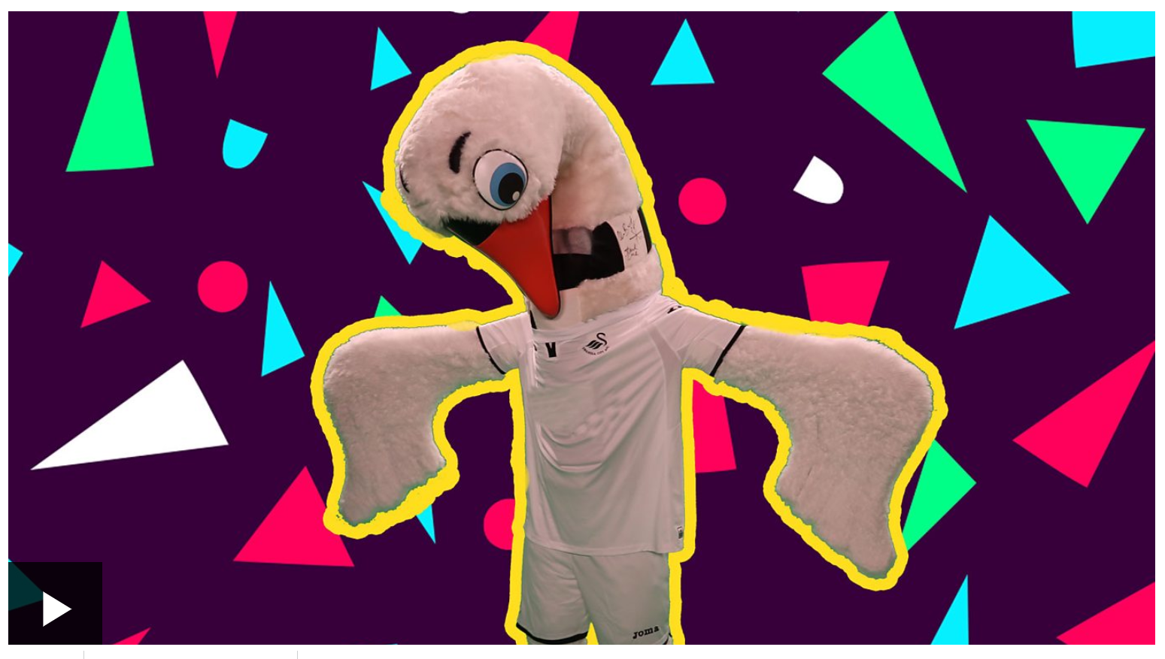
Day 5
Maths- 5 a day
Watch this Supermovers video to practise the 4 times table.
Click on the picture below or use the link.
https://www.bbc.co.uk/teach/supermovers/ks1-maths-the-4-times-table-with-cyril-the-swan/zmsw382

Slide 10
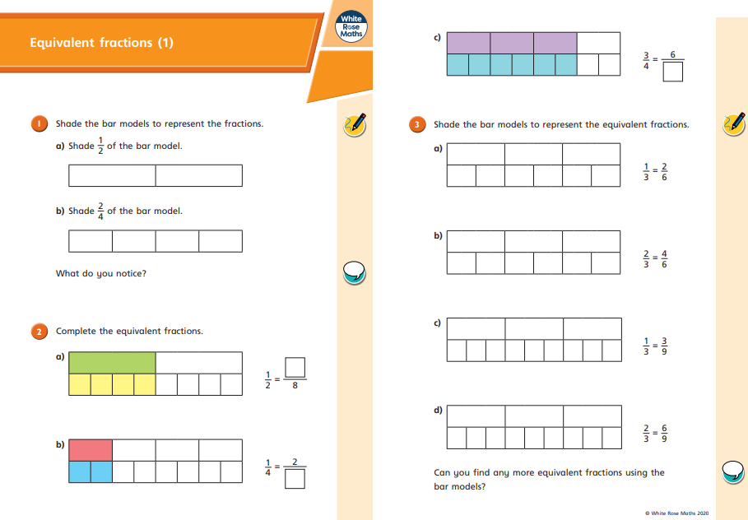
Y3 Equivalent Fractions
Lesson 1
Watch this video about equivalent fractions: https://vimeo.com/425556607
Now, try these questions:

Slide 11
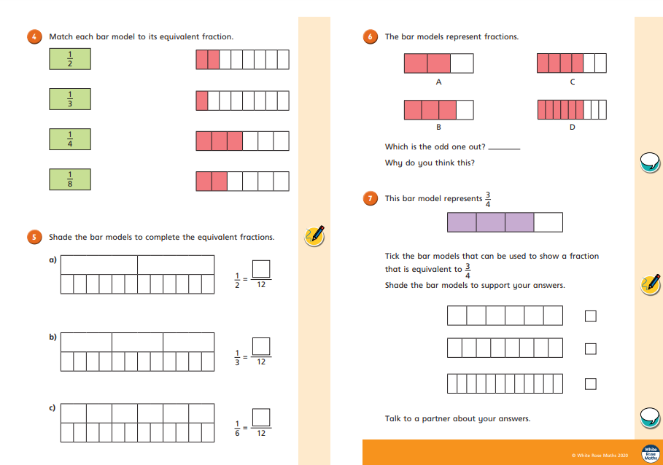

Slide 12
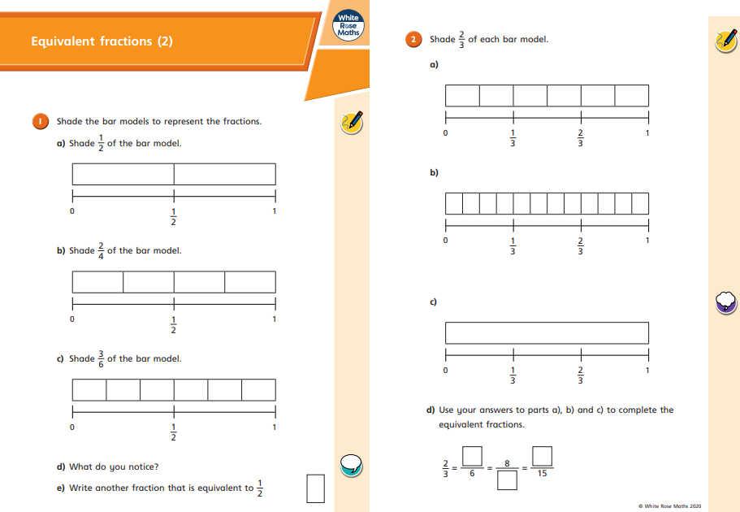
Lesson 2
Watch this video: https://vimeo.com/425556750
Now, try these questions:

Slide 13
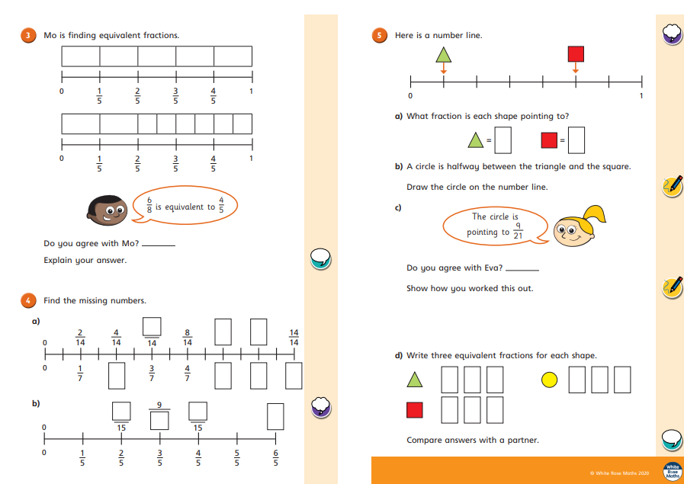

Slide 14
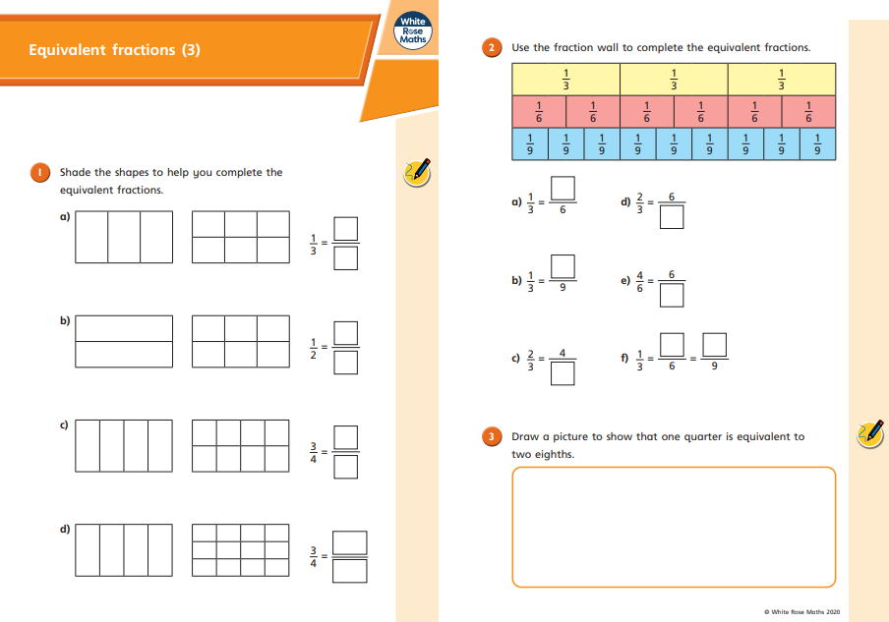
Lesson 3
Watch this video: https://vimeo.com/425556923
Now try these questions:

Slide 15
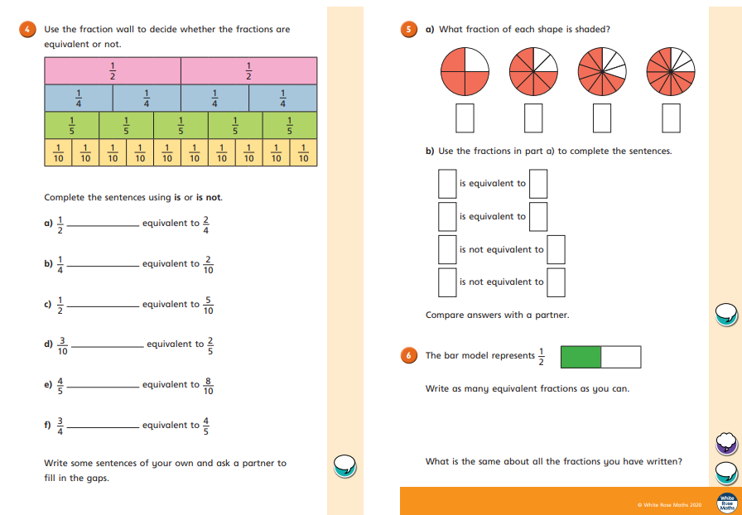

Slide 16
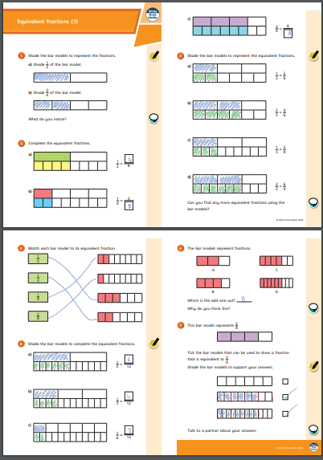
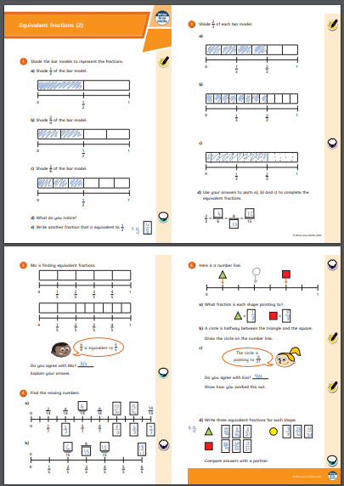
ANSWERS Lesson 1
ANSWERS Lesson 2

Slide 17
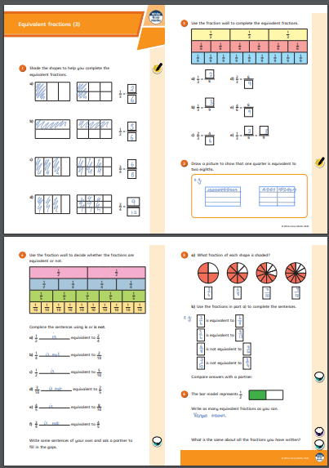
ANSWERS Lesson 3

