Slide 1

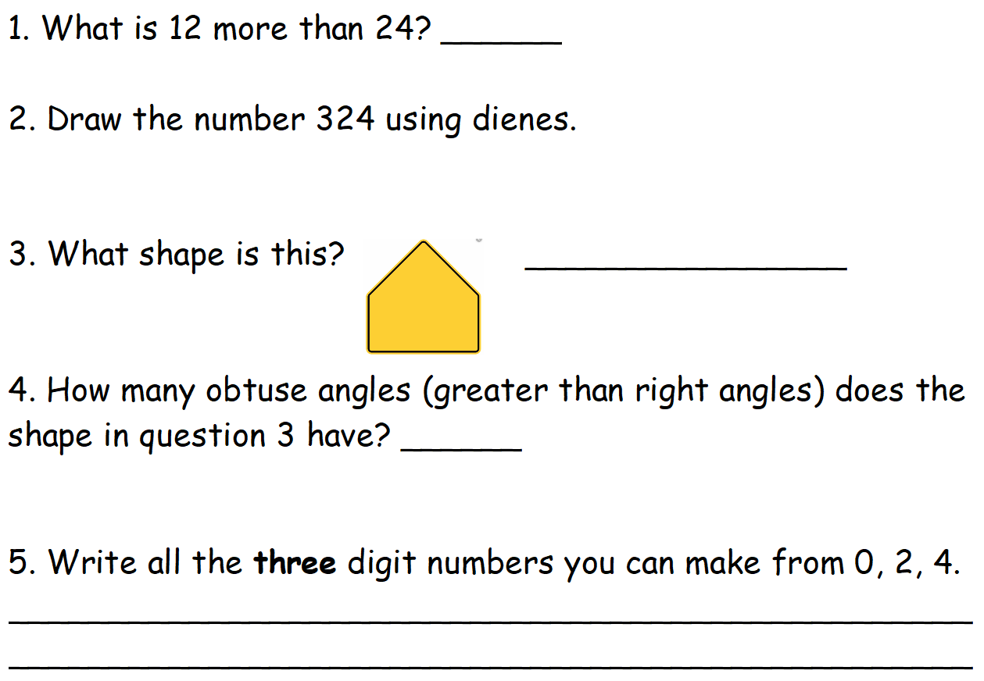
Day 1
Maths- 5 a day

Slide 2
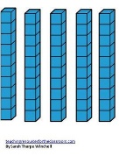


Day 1 ANSWERS
Maths- 5 a day
36
Regular pentagon
2
240 204 420 402

Slide 3
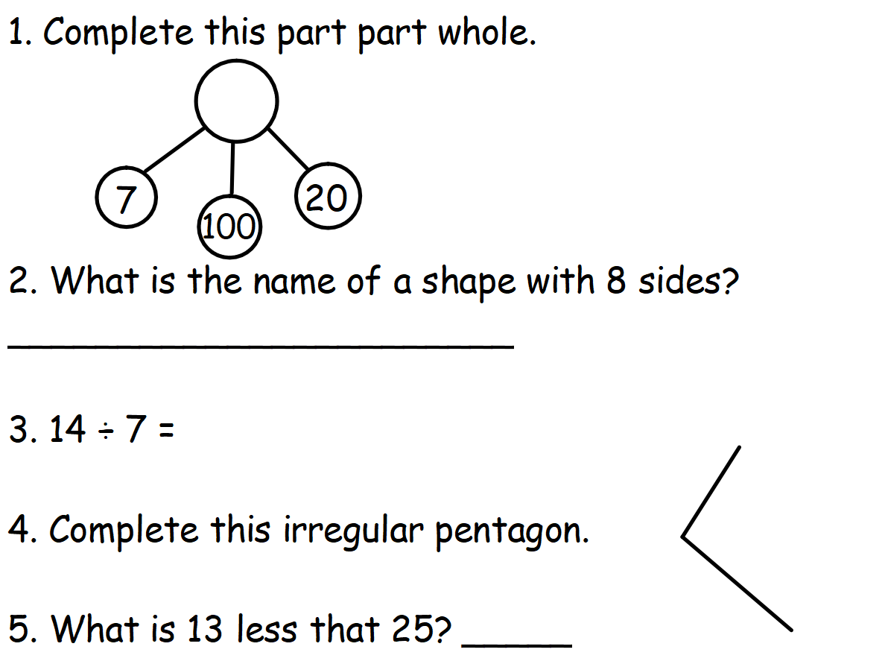
Day 2
Maths- 5 a day

Slide 4
Day 2 ANSWERS
Maths- 5 a day
127
Hexagon
2
3 more lines to make a total of 5
12

Slide 5
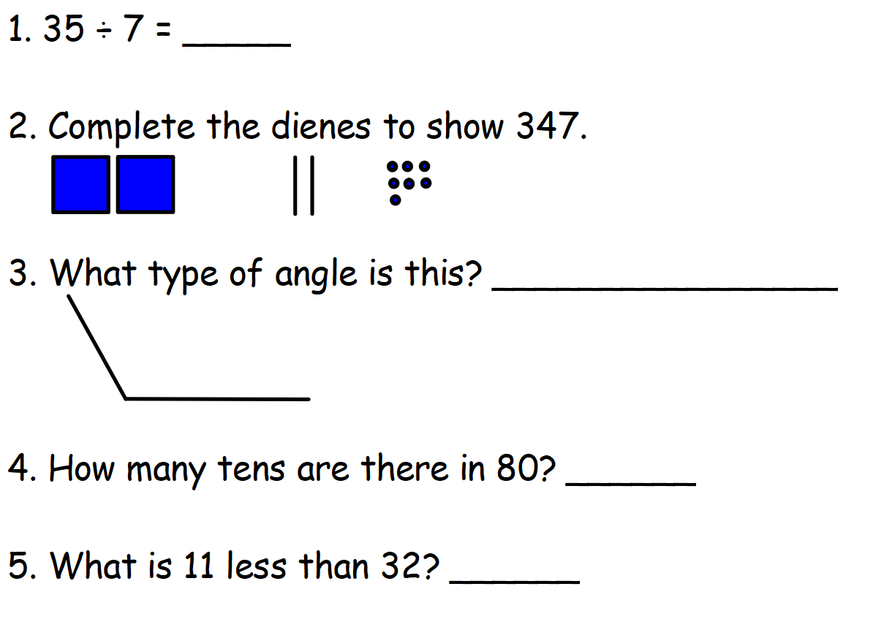
Day 3
Maths- 5 a day

Slide 6


Day 3 ANSWERS
Maths- 5 a day
5
obtuse
8
21

Slide 7
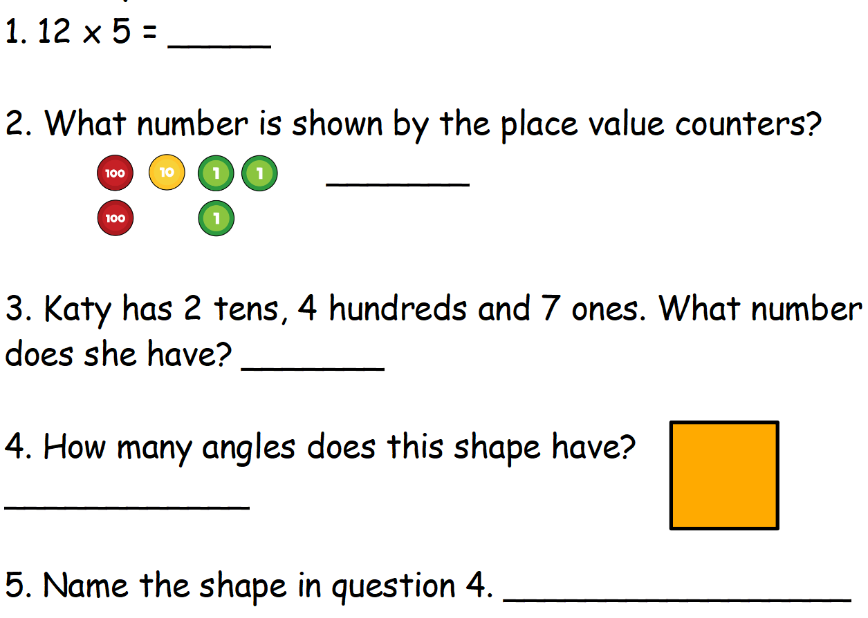
Day 4
Maths- 5 a day

Slide 8
Day 4 ANSWERS
Maths- 5 a day
5
213
427
4
Square (make sure you have spelt it correctly!)

Slide 9

Day 5
Maths- 5 a day
Watch this Supermovers video to practise the 3 times table.
Click on the picture below or use the link.
https://www.bbc.co.uk/teach/supermovers/ks2-maths-the-3-times-table/z6sw382

Slide 10
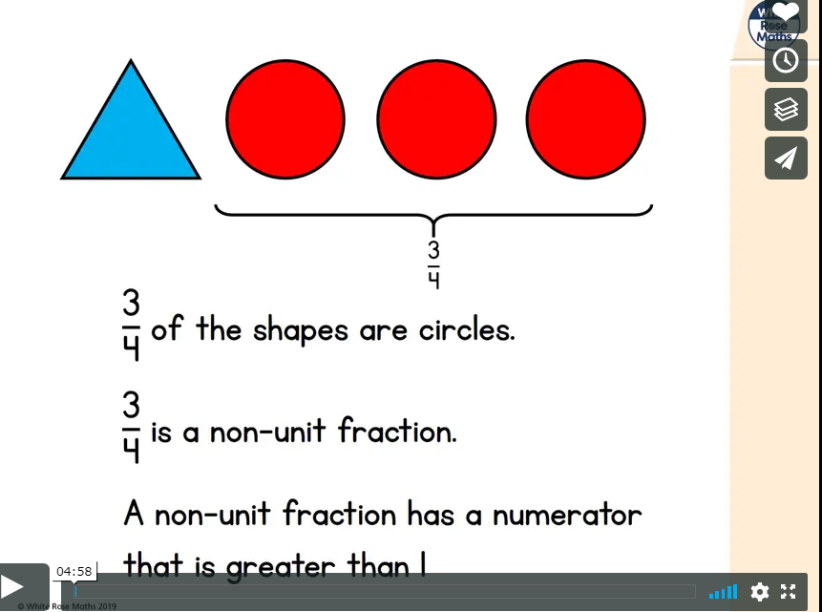
Year 3 Fractions
Lesson 1
Watch this video about unit and non-unit fractions:
https://vimeo.com/418151464
Now, try the questions on the following slides:

Slide 11
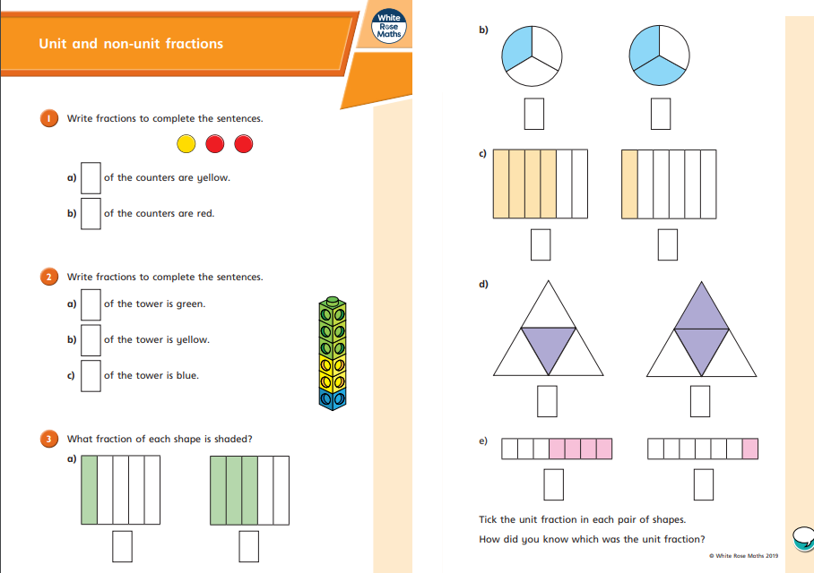

Slide 12
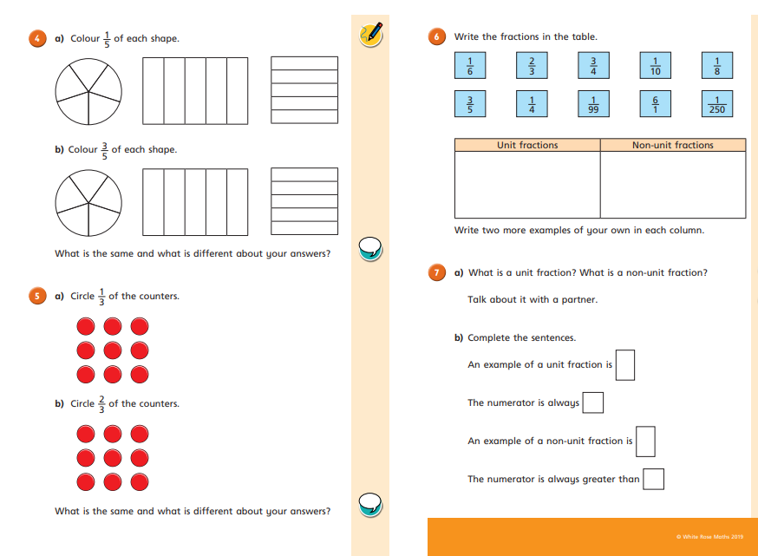

Slide 13
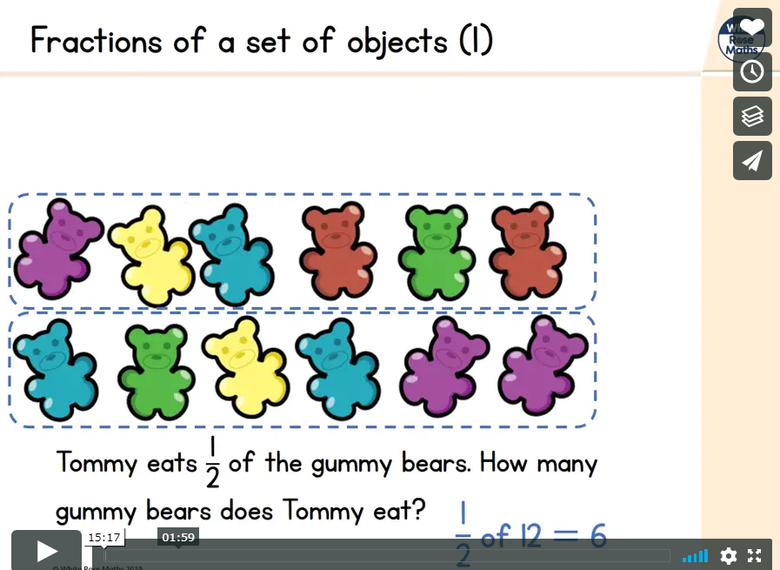
Lesson 2
Now, watch this video about finding fractions of amounts: https://vimeo.com/420723178
Now, try the questions on the following slides:

Slide 14
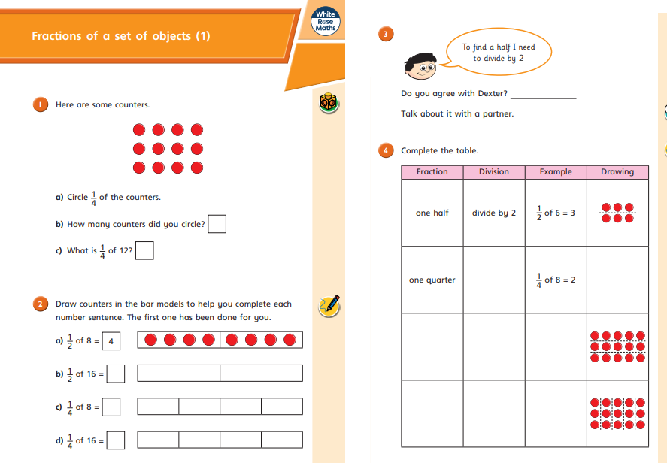

Slide 15
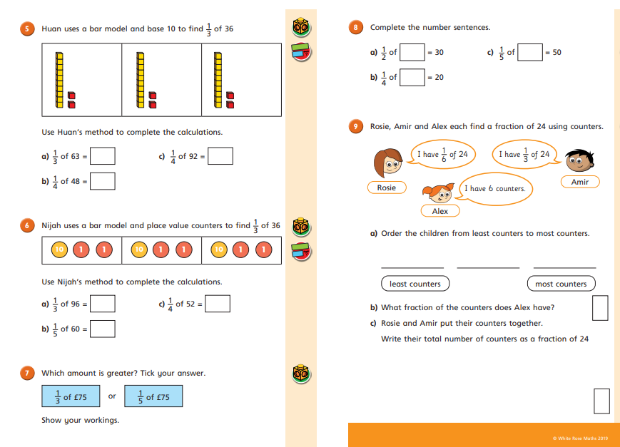

Slide 16
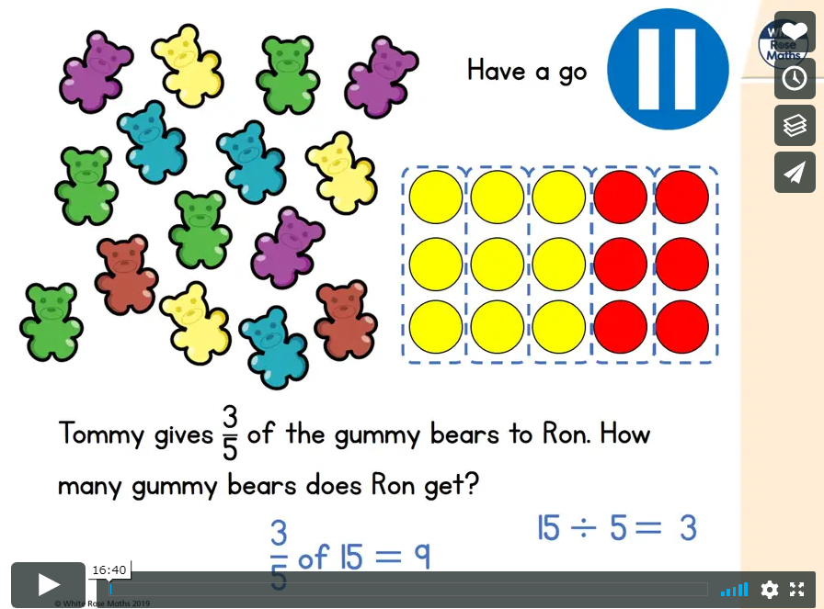
Lesson 3
Now, watch this video about finding fractions of amounts:
https://vimeo.com/420723744
Now, try the questions on the following slides:

Slide 17
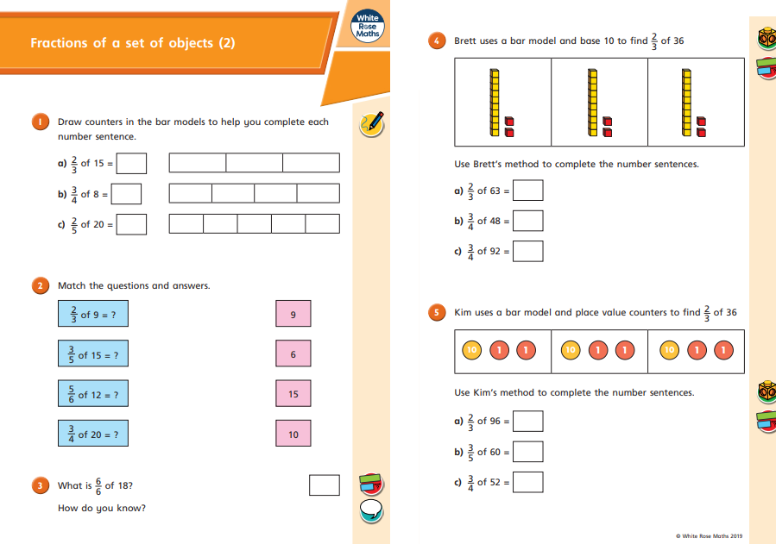

Slide 18
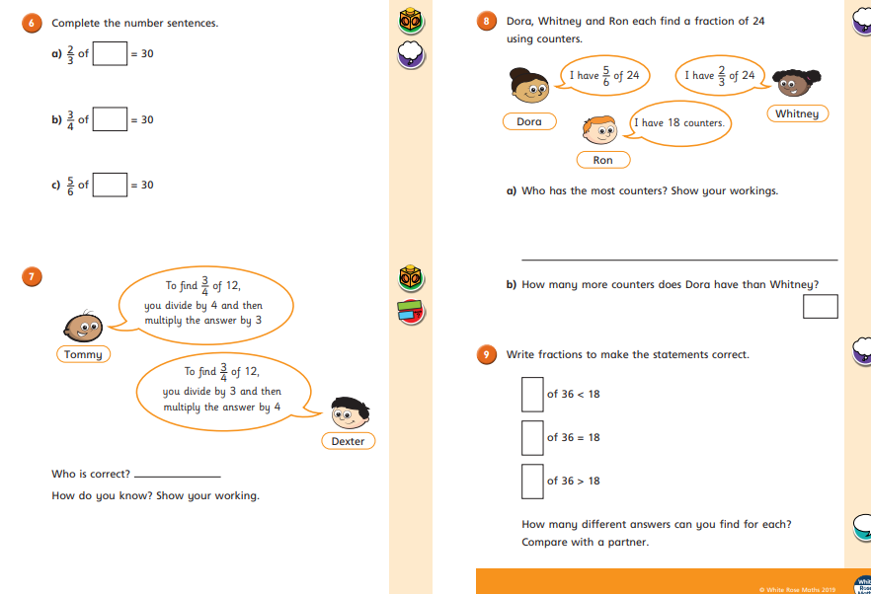

Slide 19
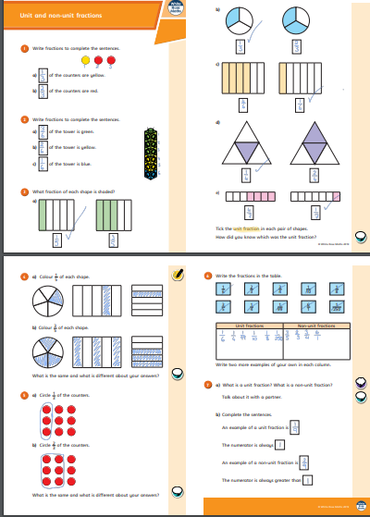
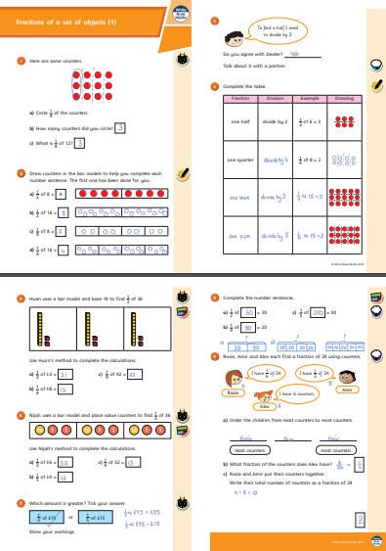
Lesson 1 Answers
Lesson 2 Answers

Slide 20
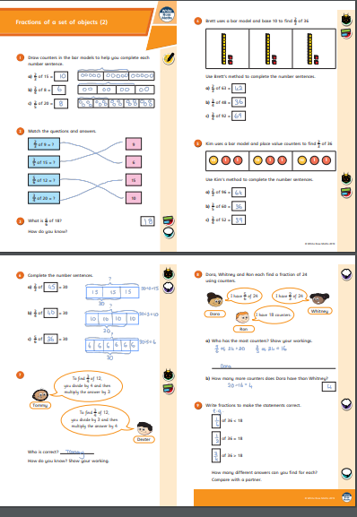
Lesson 3 Answers

