Slide 1

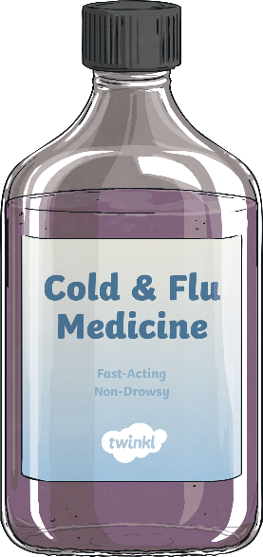


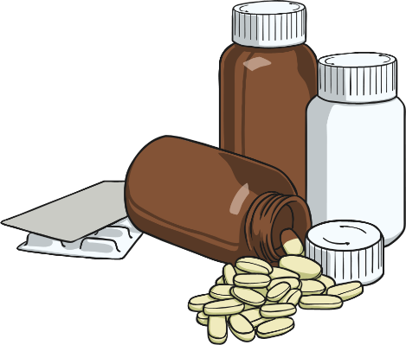

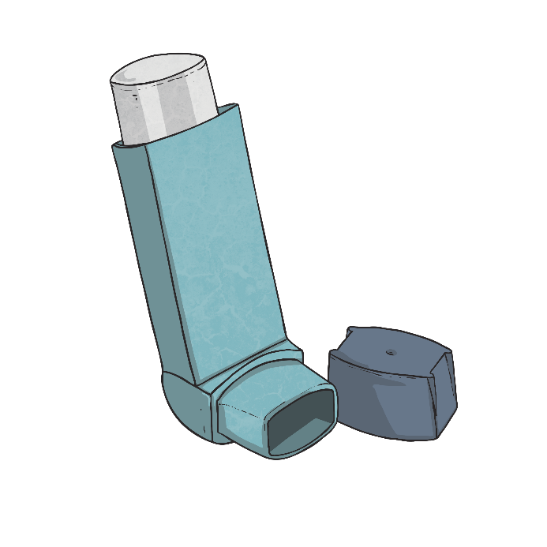
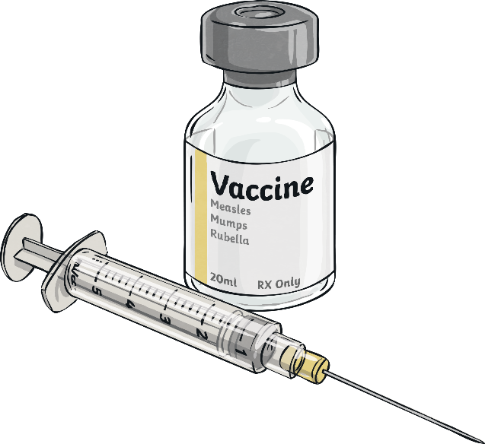
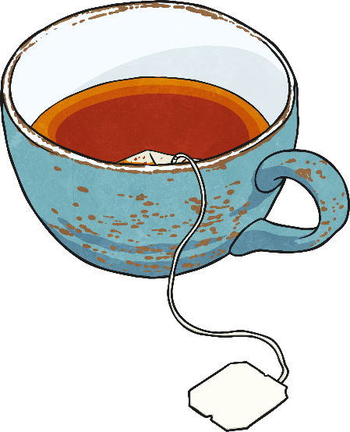
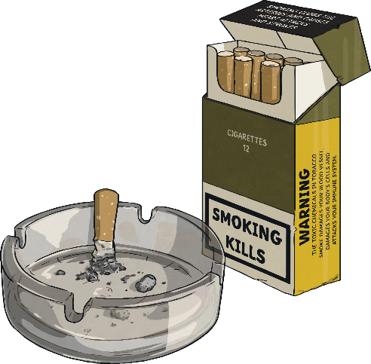
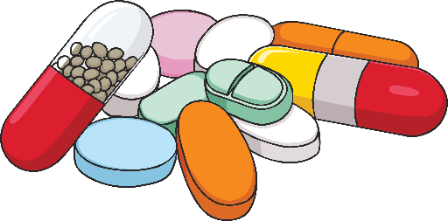
What Is a Drug?

Slide 2

What Is a Drug?
Which pictures did you think showed drugs or things with a drug in them?
You might be surprised to know that all the pictures were either a drug or contained a drug!
Even some drinks, such as cola, tea and coffee contain a drug called caffeine. Caffeine is labelled a drug because it stimulates the central nervous system and gives people a short-term energy boost .

Slide 3

What Is a Drug?
A lot of people think of the word ‘drug’ as always being a bad thing.
However, not all drugs are harmful if taken appropriately. Some drugs can actually help our health and wellbeing.
The definition of a drug is ‘a substance that causes a physiological
change on the body when it enters the body’.
This means that drugs affect the way we think, feel or behave.
Can you think how the things in the pictures might cause a change in the body or affect the body? Let’s take another look…

Slide 4


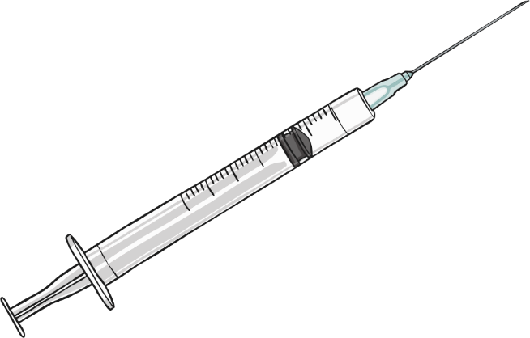
Are All Drugs Dangerous?
When we take medicines prescribed by our doctor,
we want the drug in the medicine to cause a physiological change in our body. That change
might be that we want to stop pain, stop a cough
or fight an infection.
We might take a drug as a pill or an injection to prevent us from getting ill. For example, when people travel to certain countries, they have vaccines to stop them from contracting an illness when abroad.
Some people have an illness called diabetes.
They take a drug called insulin to prevent them from getting ill.
Other people take a drug in their asthma inhaler to prevent them from having an asthma attack.

Slide 5
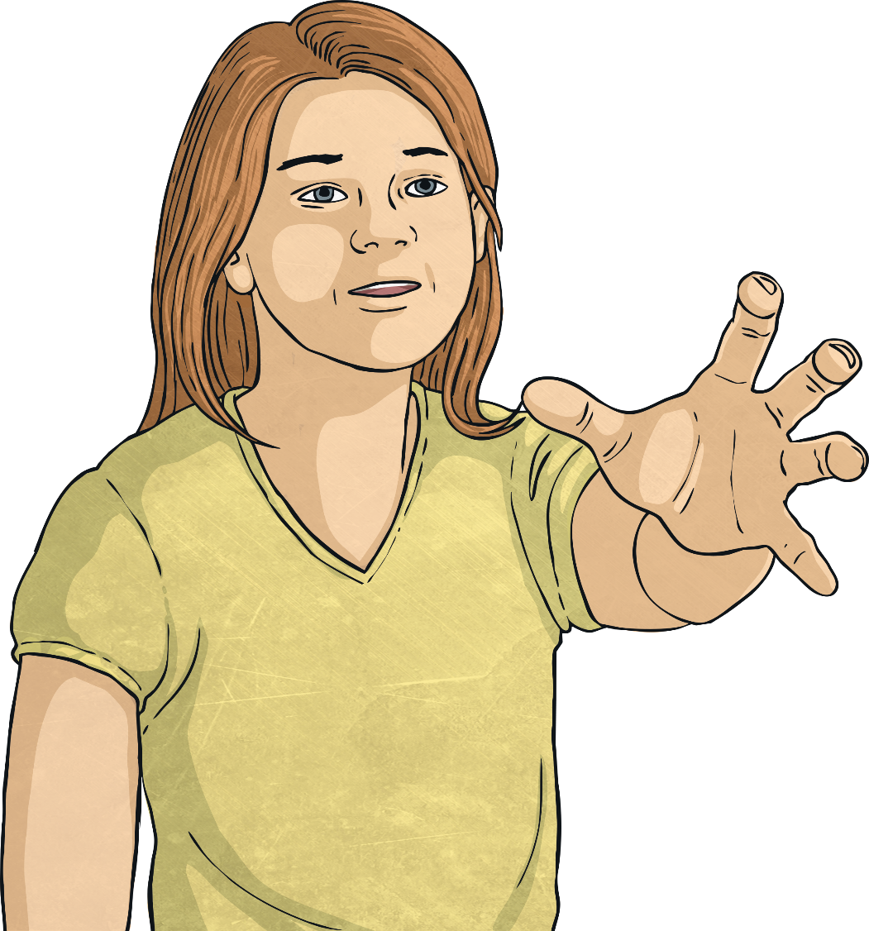
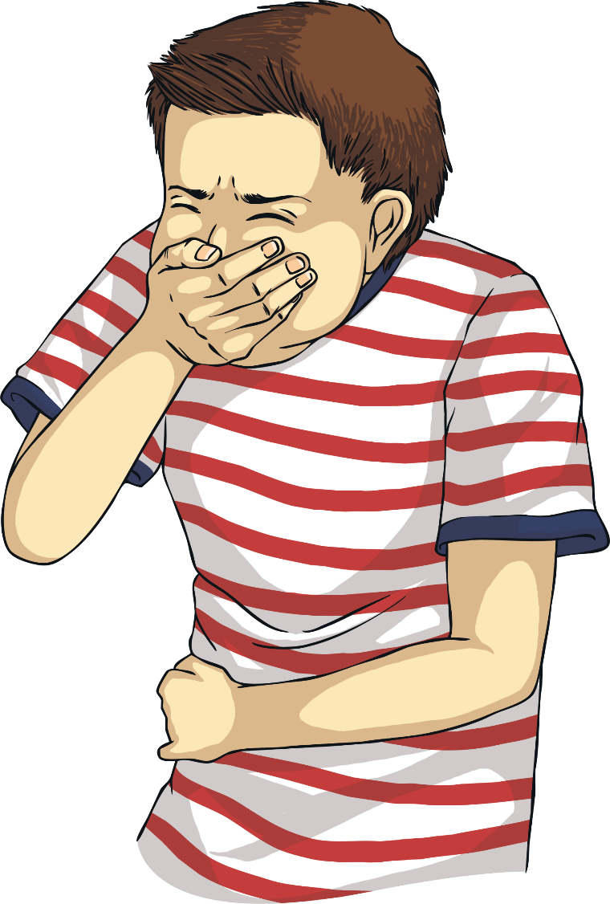
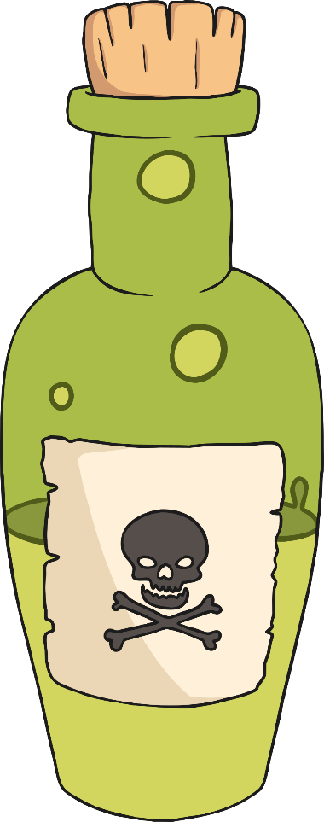


Are All Drugs Dangerous?
All drugs can be dangerous if they are
taken incorrectly.
People must never have someone else’s
medication if a doctor hasn’t prescribed it
for them.
Having too much of a drug, even a medicine
to make you feel better, can make you very
poorly. That is why it is important to always
check the instructions and take the right dose.

