Slide 1
Year 4 Maths
Time

Slide 2
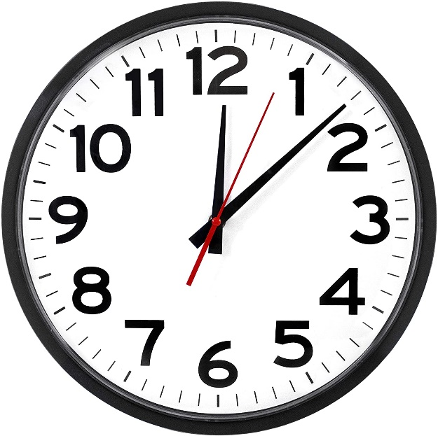
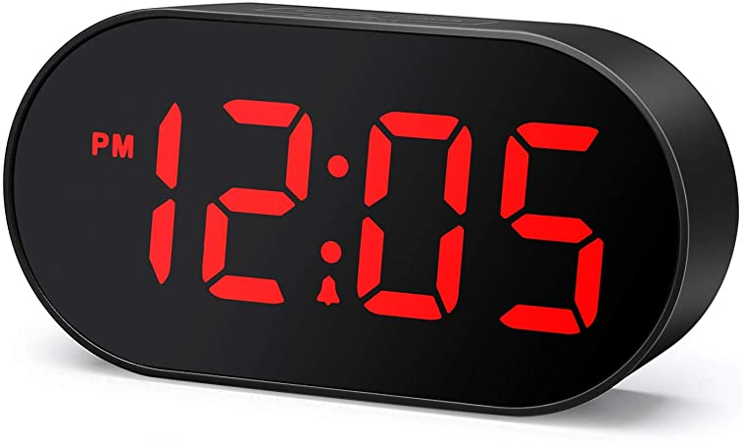
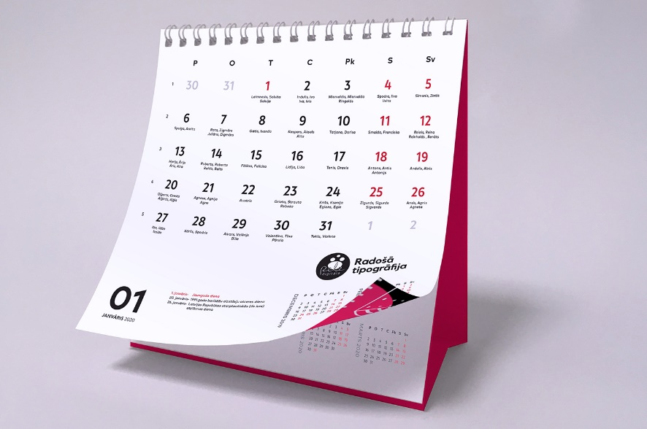
What is time measured in?
Day 1
Seconds
Minutes
Hours
Days
Weeks
Months
Years

Slide 3
Can you fill in the blanks?
Day 1
There are _________ seconds in a minute.
There are _________ minutes in an hour.
There are _________ hours in a day.
There are _________ days in a week.
There are _________ days in a year.
There are _________ weeks in a year.

Slide 4
Can you fill in the blanks?
Day 1
There are _60______ seconds in a minute.
There are _60______ minutes in an hour.
There are _24______ hours in a day.
There are _7 ______ days in a week.
There are _365______ days in a year.
There are _52______ weeks in a year.

Slide 5
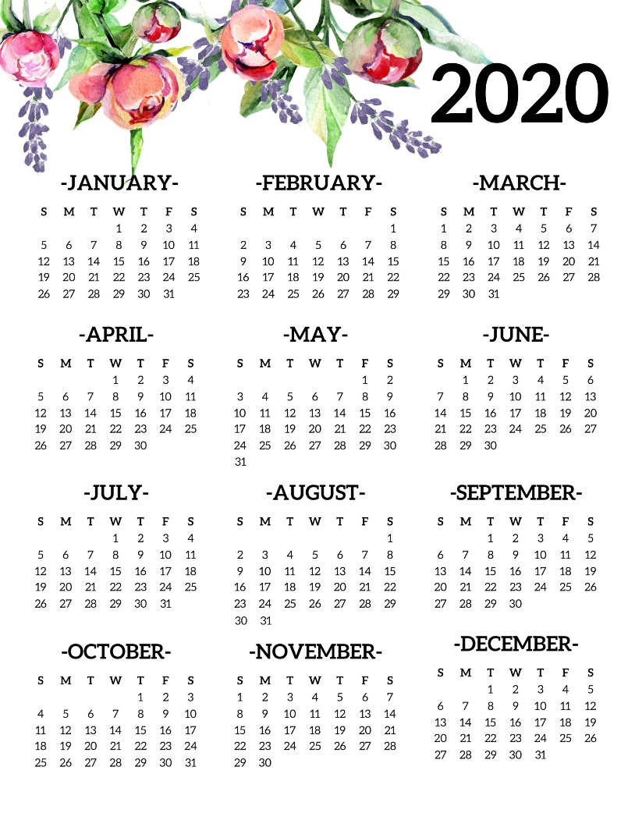
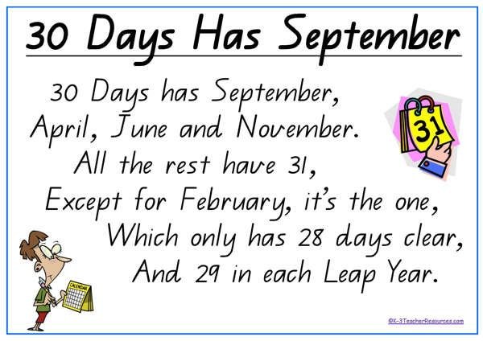
Months of the Year
Day 1
Not every month has the same number of days!
Here is a traditional rhyme to help you remember how many days are in each month – click the link for a rap!

Slide 6
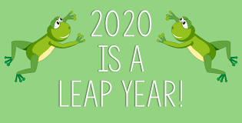
What is a leap year?
Day 1
A leap year is something very special that happens once every 4 years!
Watch this video for an explanation!

Slide 7
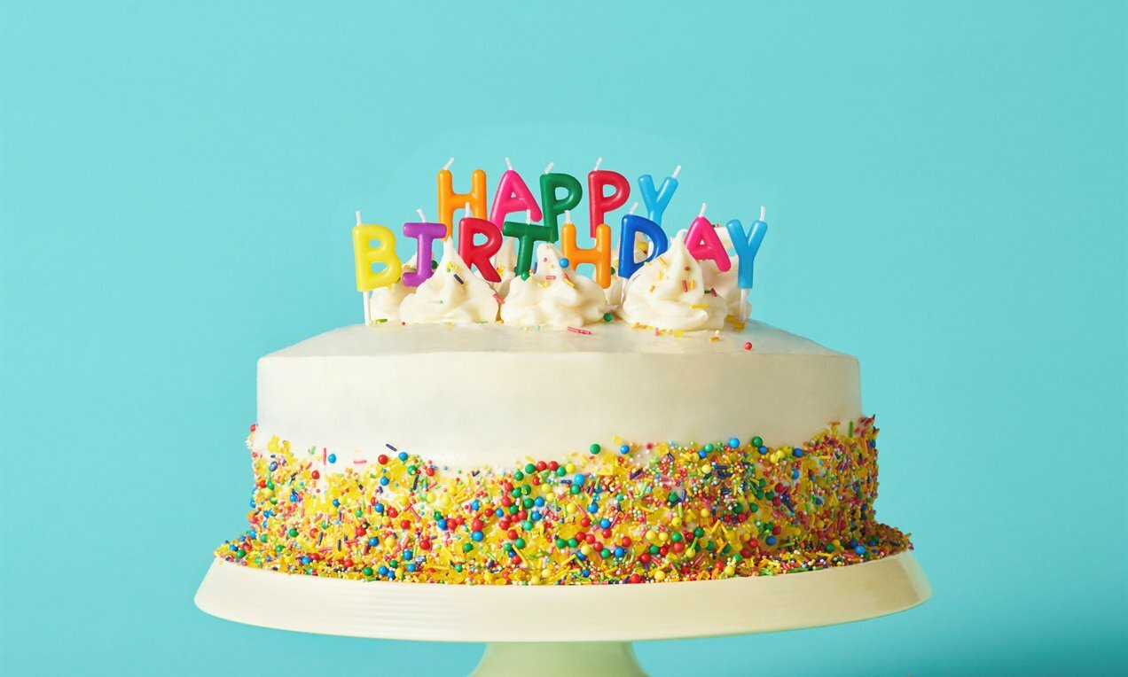
How many days are in your birthday month?
Day 1
Use the rhyme to help you remember!
Miss Blake’s birthday is in January, and there are 31 days in her birthday month.
My birthday is in _______________, and there are _____ days in my birthday month.

Slide 8
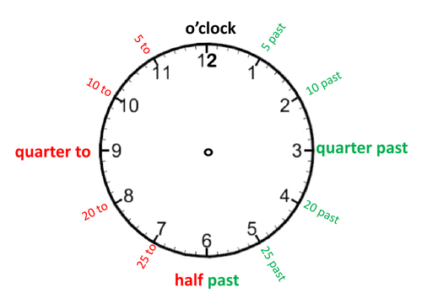
On an analogue clock (like below), 1 whole rotation of the clock face is 60 minutes. That means there are 5 minutes between each number on the clock.
Day 1
How many minutes pass between O’clock and quarter past the hour? ______________
How many minutes pass between O’clock and half past the hour? ________________
How many minutes pass between O’clock and quarter to the hour? ____________________
How many minutes pass between 20 past and 20 to the hour? _________________

Slide 9
On an analogue clock (like below), 1 whole rotation of the clock face is 60 minutes. That means there are 5 minutes between each number on the clock.
Day 1
How many minutes pass between O’clock and quarter past the hour? _____15_____
How many minutes pass between O’clock and half past the hour? _______30______
How many minutes pass between O’clock and quarter to the hour? _______45__________
How many minutes pass between 20 past and 20 to the hour? _____20_________

Slide 10
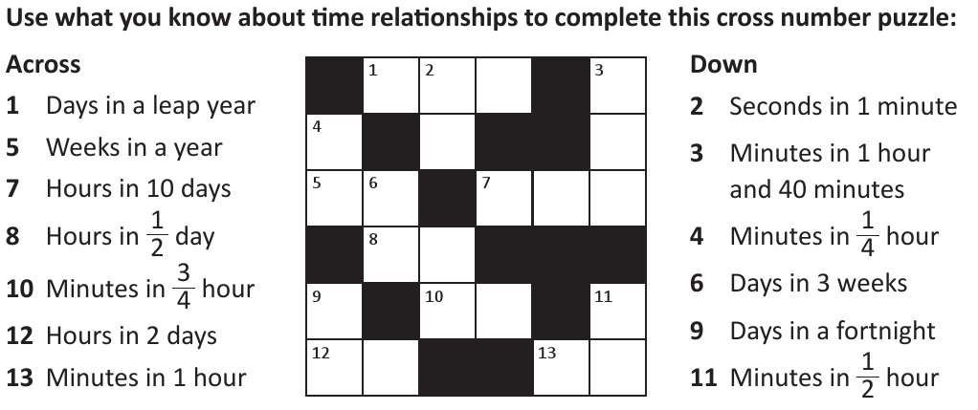
Have a go at this crossword using your time knowledge!
Day 1

Slide 11
Have a go at this crossword using your time knowledge!
Day 1
3
6
6
1
1
0
0
5
2
2
4
0
1
2
1
4
5
3
4
8
6
0
Now have a go at Day 1’s activities!

Slide 12
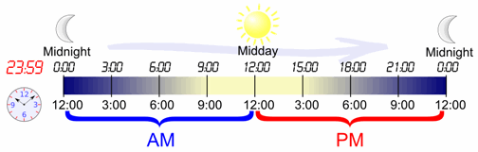
Day 2

Slide 13
Time can be told in the 12 hour and 24 hour clock.
Day 2
When using the 12 hour clock, we distinguish between morning and night by using am and pm.
am = morning pm = afternoon

Slide 14
Use am or pm to finish these sentences.
Day 2
Tabby wakes Miss Blake up for her breakfast at 5.15_____.
I had my dinner at 5.15_____.
I leave for school at 8.20_____.
I brush my teeth and go to bed at 8.30_____.

Slide 15
Use am or pm to finish these sentences.
Day 2
Tabby wakes Miss Blake up for her breakfast at 5.15_am__.
(and what a pest she is!!!)
I had my dinner at 5.15 pm__.
I leave for school at 8.20_am__.
I brush my teeth and go to bed at 8.30_pm__.

Slide 16
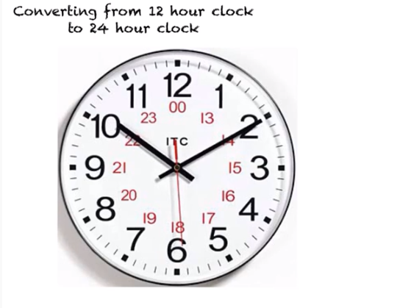
24 hour time
Day 2
When you use the 24 hour clock, you don’t need to use am/pm.
Watch this video for an explanation of the 24 hour clock.

Slide 17
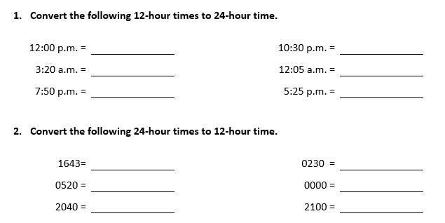
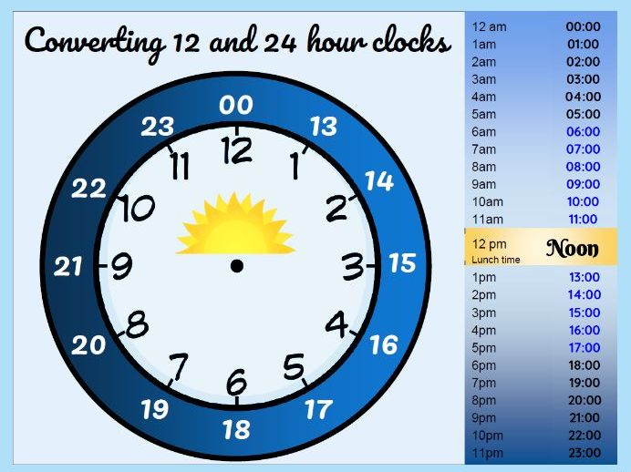
Now have a go at converting these times!
Day 2

Slide 18
Now have a go at converting these times!
Day 2
12:00
22:30
03:20
00:05
19:50
17:25
4:43pm
2:30am
5:20am
12:00am
8:40pm
9:00pm
Now have a go at Day 2’s questions!

Slide 19
Day 3
Answer the reasoning and problem solving questions!
Don’t forget to explain your answers!

