Slide 1

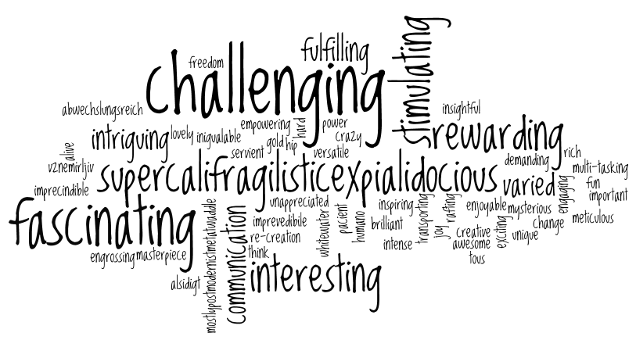
Welcome back to Home Learning Spellings with Mrs Andrews

Slide 2


I hope you had a good week! I did!
and now … it is time to do some spellings!

Slide 3
This half term, is recap half term!
This half term, we are going to recap the spelling principles that you either learnt with your class teachers or with me during your Home Learning. I will be referring you back to the previous Home Learning power points when we are discussing the spelling principles.
This week we are going to focus on the prefixes ‘mis’ and ‘re’ which you learnt with your class teachers after Christmas.

Slide 4
Prefixes
So we know from last week that a prefix is a letter or a group of letters added to the front of a root word to change the meaning of the word.
They are not words in their own right!
The root word always stays the same when the prefix is added to the front.
There are many prefixes. In the Spring term you looked at many prefixes with your class teachers.
What do the prefixes ‘mis’ and ‘re’ do the meaning of the word when they are added to the front of the root word?

Slide 5
Let’s watch a couple of clips to remind ourselves.
Look at video ‘mis’ prefix – were you right?
https://www.youtube.com/watch?v=x6xHyKmRuhY
Look at the clip ‘re’ up to 1 min 35 seconds (if you would like to recap ‘un’ ‘dis’ ‘bi’ then please watch to the clip to the end).
https://www.youtube.com/watch?v=txNARc6bCxI

Slide 6


Prefix ‘mis’
The prefix mis – a negative meaning.
The prefix mis means wrong.
For example, mistake or misunderstand.
mis–: misbehave and misspell (mis + spell… look 2 ‘ss’!)
Can you think of any words which start with the prefixes ‘mis’?
Tell your adult.
For example. misbehave means the opposite of behave (or not to behave)
prefix ‘mis’ + root word ‘behave’ = new word ‘misbehave’

Slide 7
Did you think of these words? What do they mean?
misbehave, mislead, misspell
mistake, misread, mishear
misunderstanding, misuse and misplace

Slide 8
What does the prefix ‘mis’ mean?
misbehave means to have the wrong understanding.
mislead means make someone have the wrong idea or opinion.
misspell means to have spelt a word wrong.
mistake means to have done something wrong.
misunderstanding to wrongly understand something.

Slide 9
Prefix ‘re’
The prefix re – ‘again’ or ‘back’.
re–: redo, refresh, return, reappear, redecorate (re + root word)
Often the tricky bit to spell is the root word!
Can you think of any words which start with the prefixes ‘re’?
Tell your adult.
For example: rebuild means to build it again
prefix ‘re’ + root word ‘build’ = new word ‘rebuild’

Slide 10
Did you think of these words? What do they mean?
reappear
redo
rebuild
rewrite
redecorate
refresh
rearrange
return

Slide 11
What does the prefix ‘re’ mean?
redo
– to do again
rebuild
– to build again
rewrite
– to write (a thing) again
reappear
– to appear again
‘re’ means again’

Slide 12

Your 10 ‘mis’ and ‘re’ Spelling Words…
mistake
misbehave
misspell
misunderstanding
mishear
redo
redecorate
refresh
return
reappear

Slide 13

Your turn to do some spelling activities.
Prefix Pairs
Lego Writing
Cut out each word and the prefixes ‘mis’ and ‘re’ and match the prefixes to the correct words.
Answer Sheet attached
Arrange lego or other objects such as pasta, stones, building blocks to form your focus spelling words and take a photograph to send to your teachers.

Slide 14
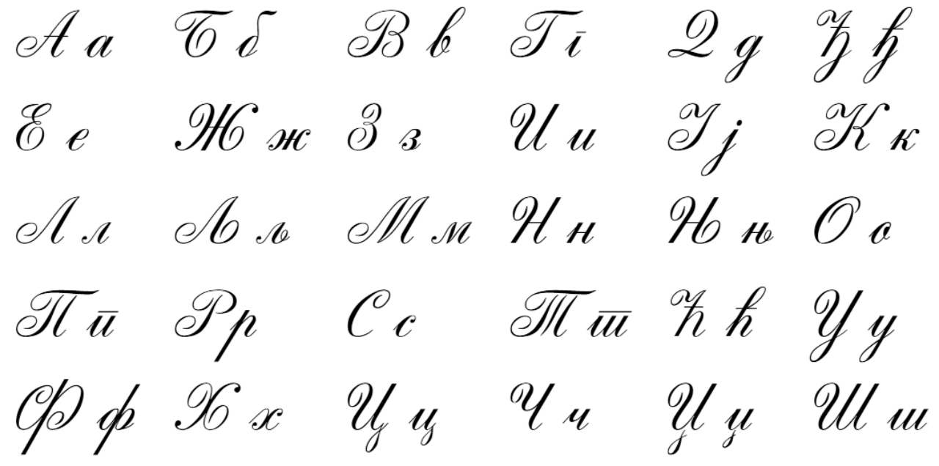
Your turn to do your handwriting task
On a sheet of paper, choose 5 tricky spelling words, and put them into a sentence so you can practise your handwriting as well as writing sentences that make sense.
mistake
misbehave
misspell
misunderstanding
mishear
redo
redecorate
refresh
return
reappear

Slide 15


