Slide 1

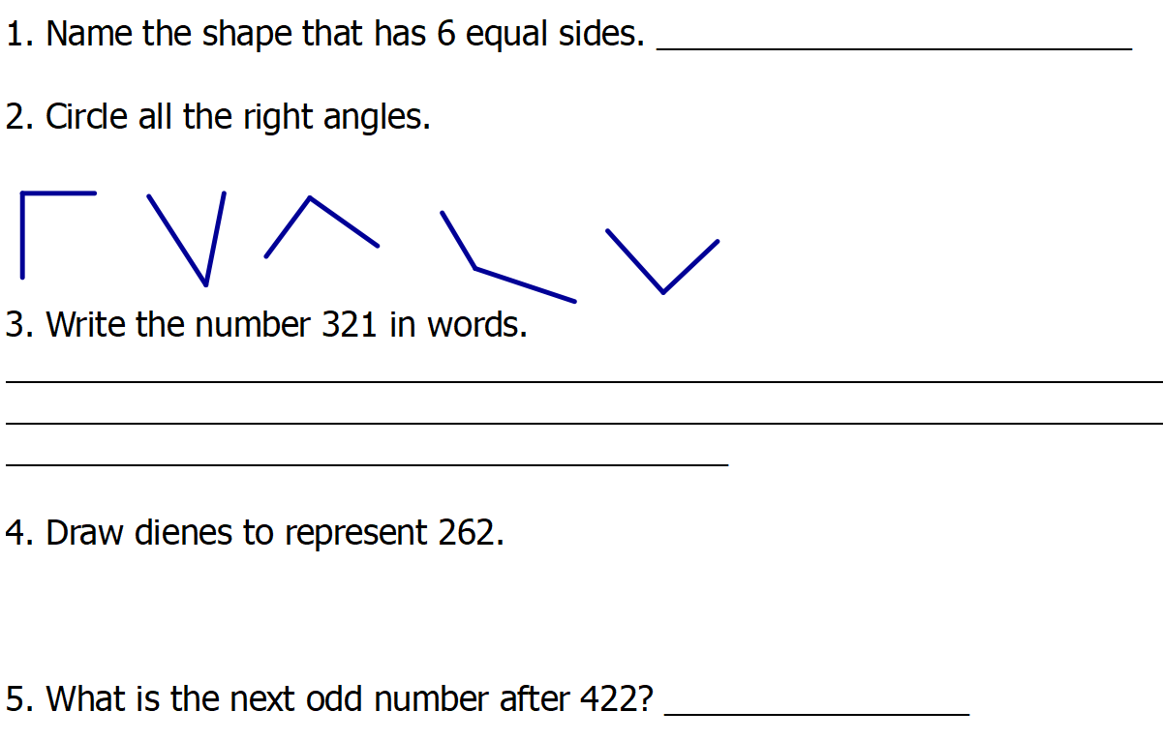
Day 1
Maths- 5 a day

Slide 2

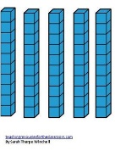

Day 1 ANSWERS
Maths- 5 a day
Regular hexagon
Three hundred and twenty one.
423

Slide 3
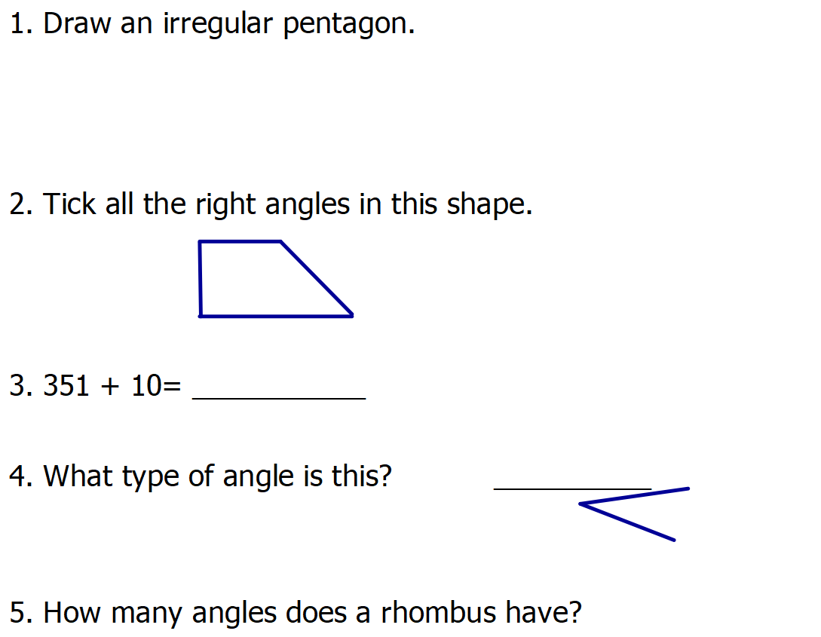
Day 2
Maths- 5 a day

Slide 4
Day 2 ANSWERS
Maths- 5 a day
Any 5 sided shape that has different length sides.
341
acute
4

Slide 5
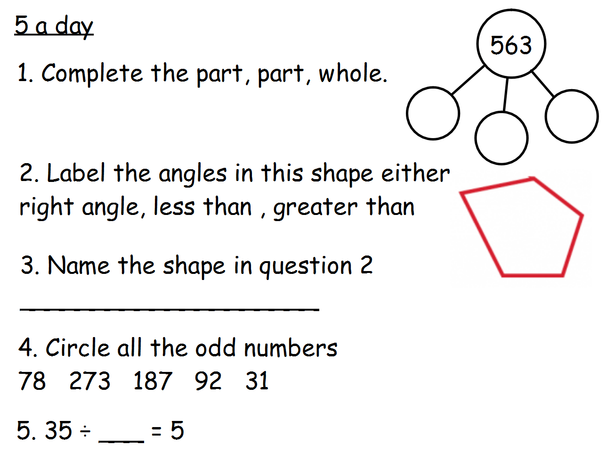
Day 3
Maths- 5 a day

Slide 6
Day 3 ANSWERS
Maths- 5 a day
500
3
60
More than
Less than
More than
More than
More than
Irregular pentagon
7

Slide 7
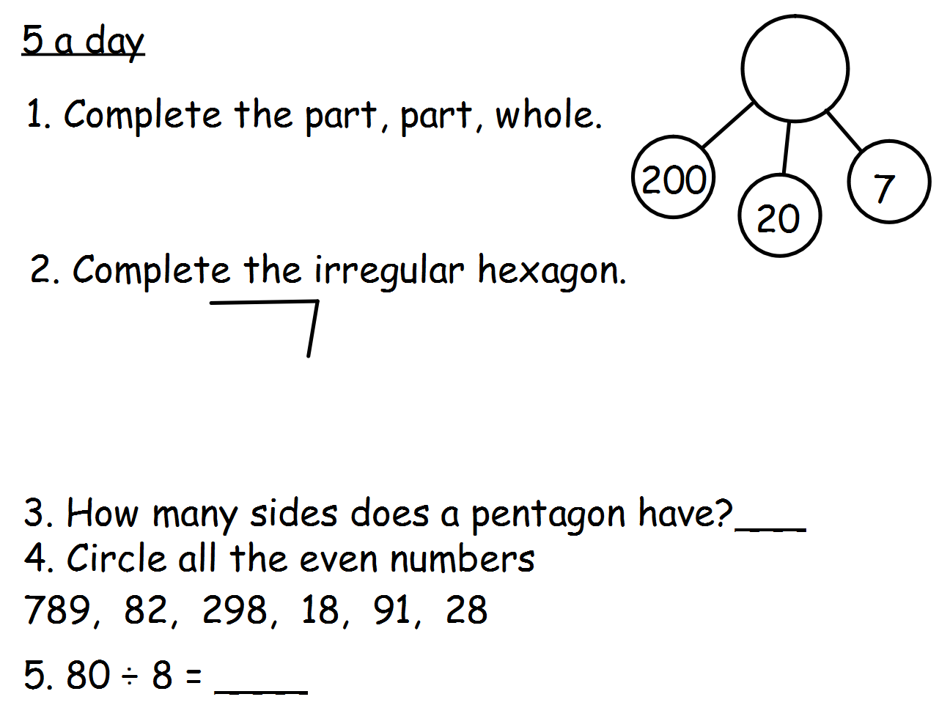
Day 4
Maths- 5 a day

Slide 8
Day 4 ANSWERS
Maths- 5 a day
227
One example
5
10

Slide 9
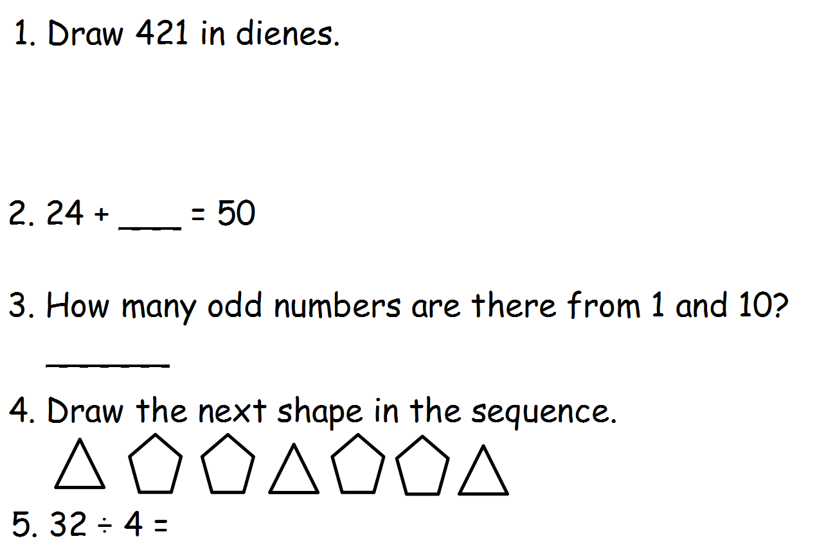
Day 5
Maths- 5 a day

Slide 10

Day 5 ANSWERS
Maths- 5 a day
26
5
8

Slide 11
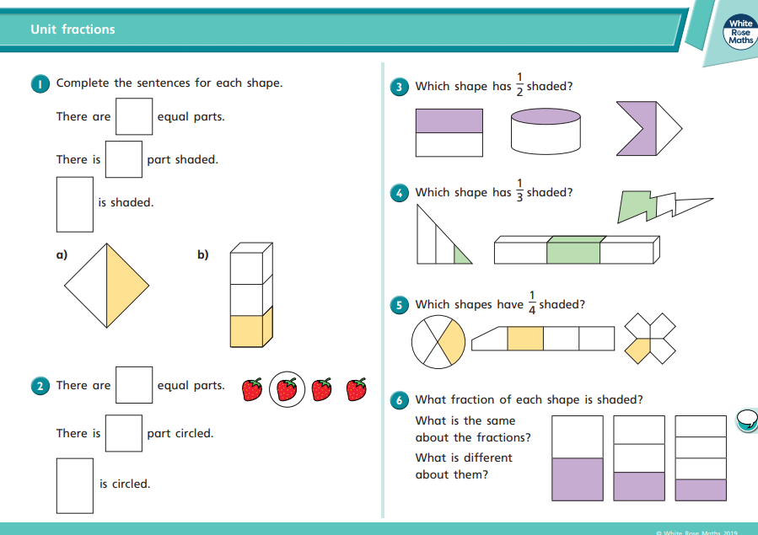
Year 3 Summer 2 Week 4
Fractions
Lesson 1
Visit this website
https://www.bbc.co.uk/bitesize/articles/z4j83j6
and watch the video about fractions.
Also watch the Supermovers fraction video in Activity 1

Slide 12
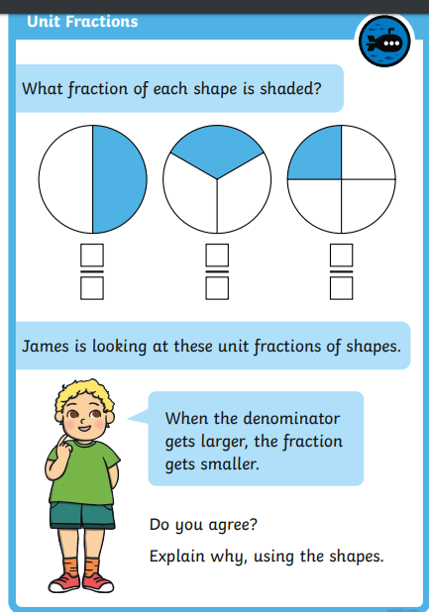
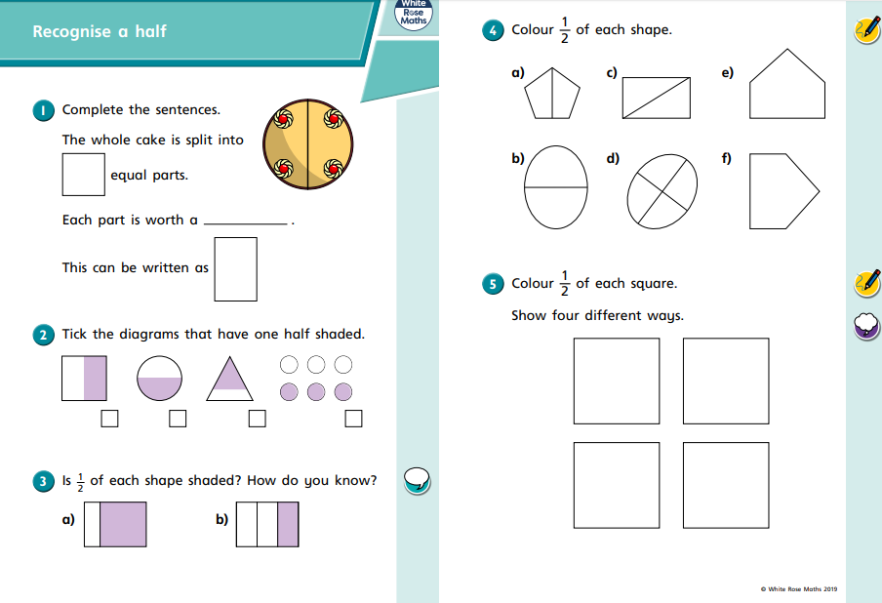
Lesson 2
Visit this website
https://www.bbc.co.uk/bitesize/articles/zwphjsg
and watch the video about halves.

Slide 13
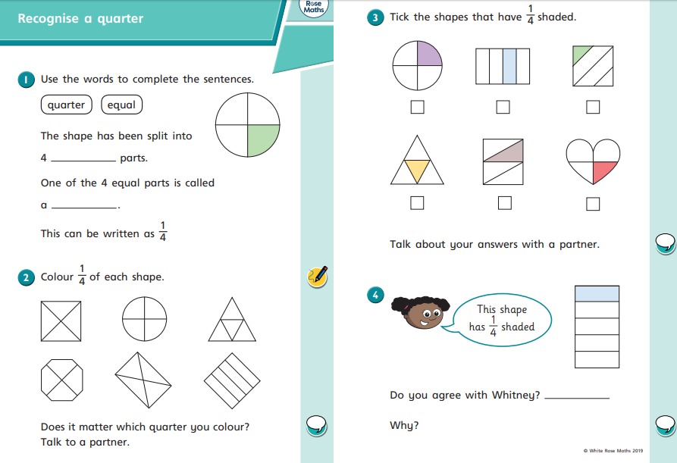

Slide 14
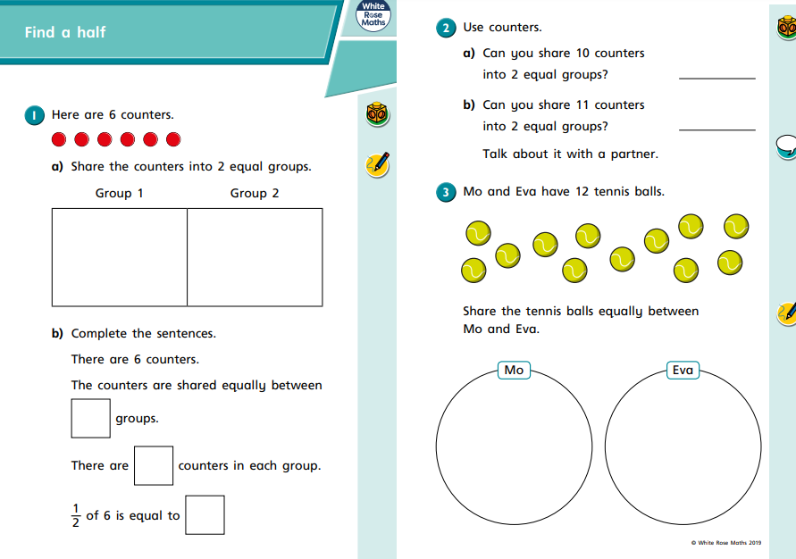
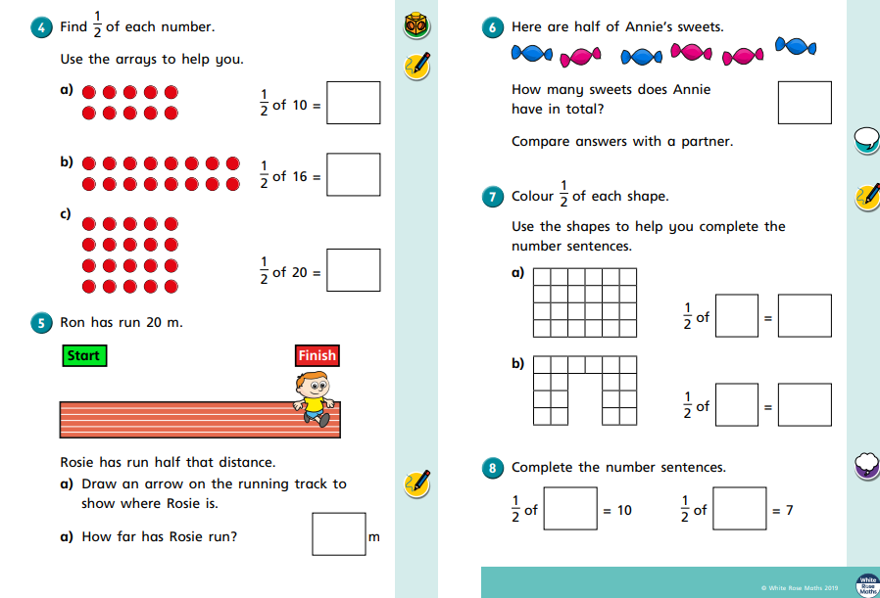
Lesson 3

Slide 15
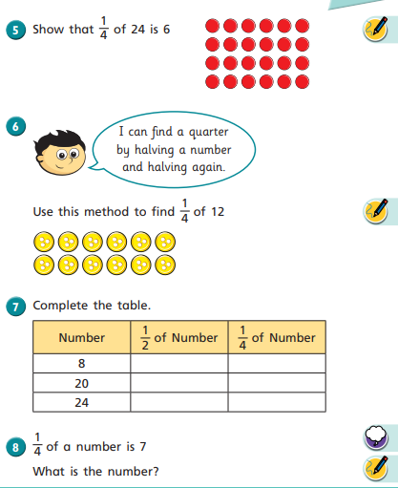
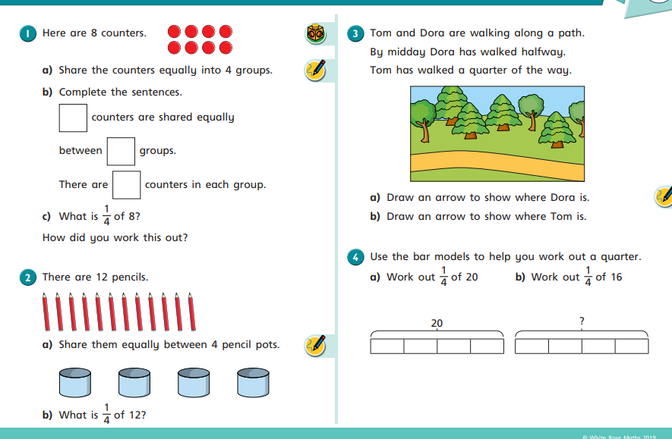

Slide 16
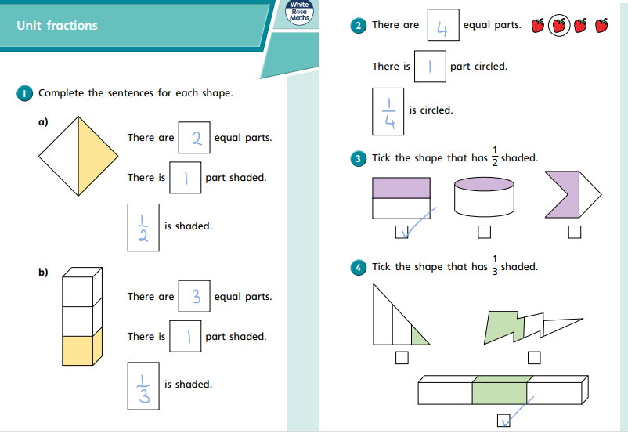
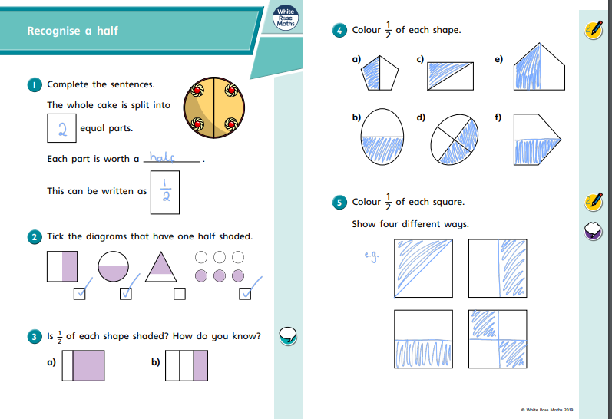
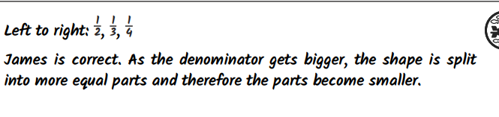
Lesson 1 ANSWERS
Lesson 2 ANSWERS

Slide 17
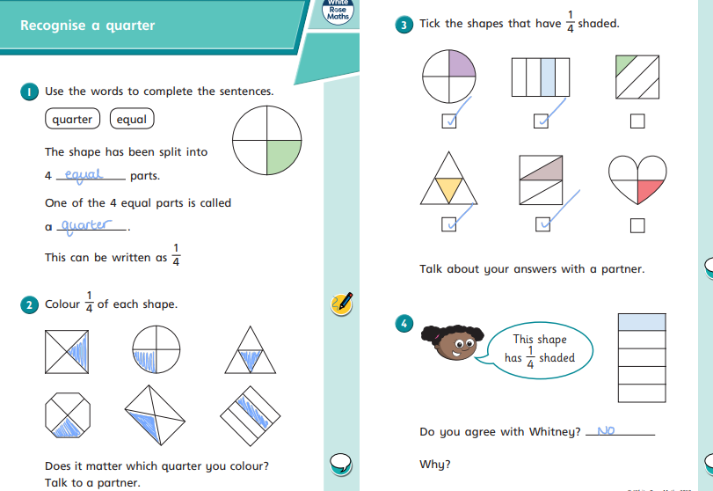
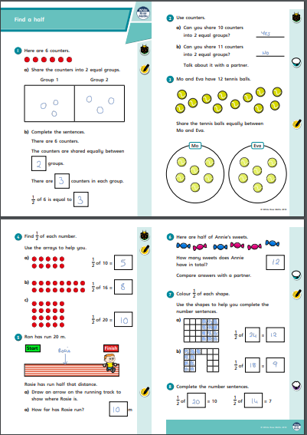

Slide 18
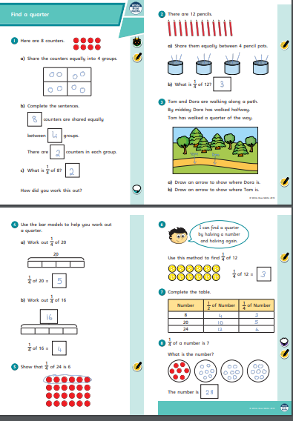
Lesson 3 ANSWERS

