Slide 1

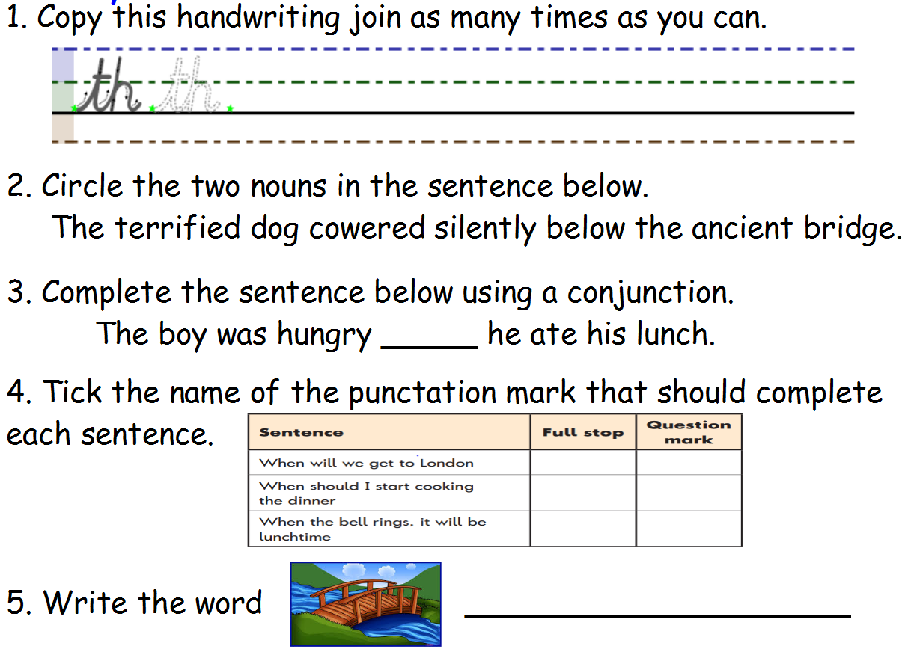
Day 1
Y3 English
5 a day

Slide 2

Day 1
Y3 English
5 a day
ANSWERS
so
bridge

Slide 3

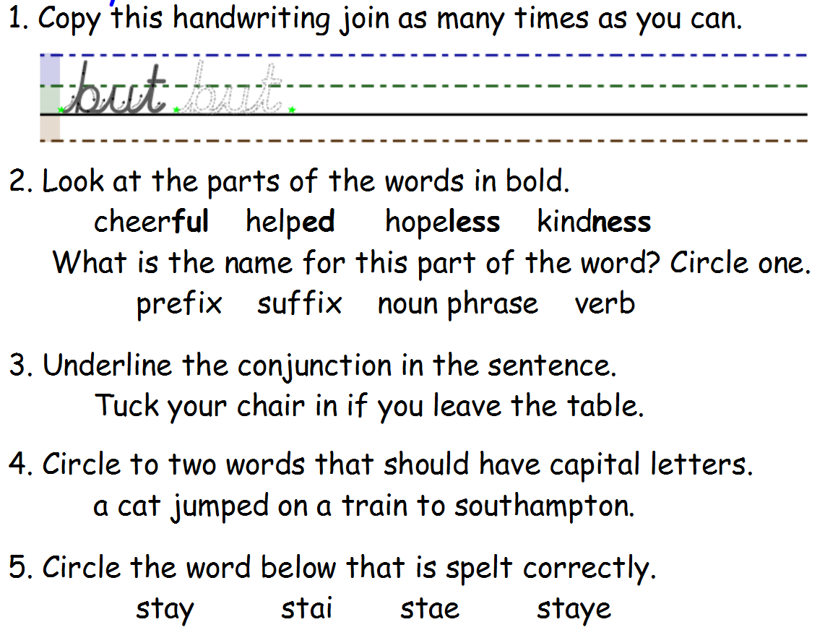
Day 2
Y3 English
5 a day

Slide 4
Day 2
Y3 English
5 a day
ANSWERS

Slide 5
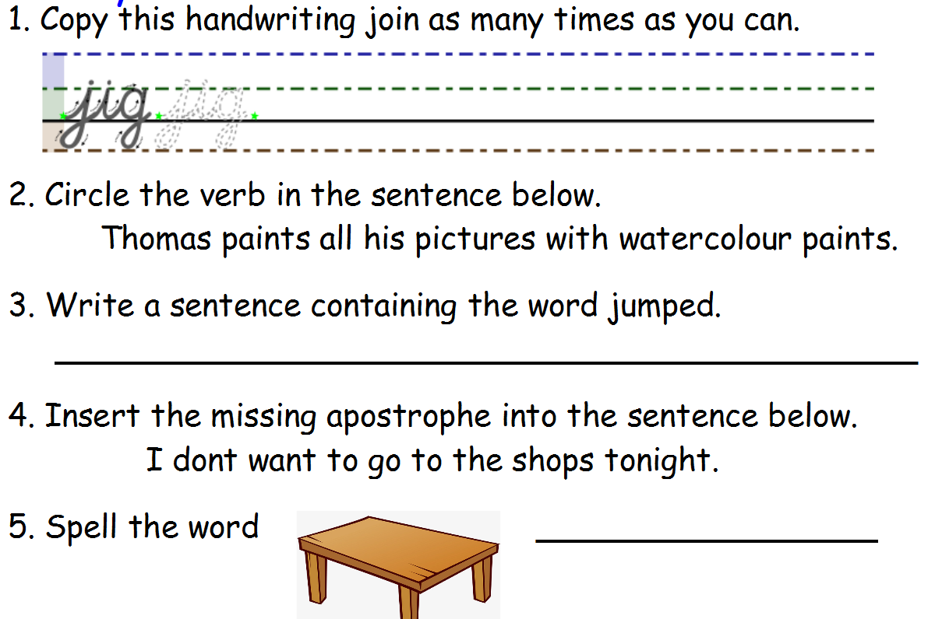
Day 3
Y3 English
5 a day

Slide 6
Day 3
Y3 English
5 a day
ANSWERS
Various answers – make sure you have a capital letter and a full stop.
‘
table

Slide 7
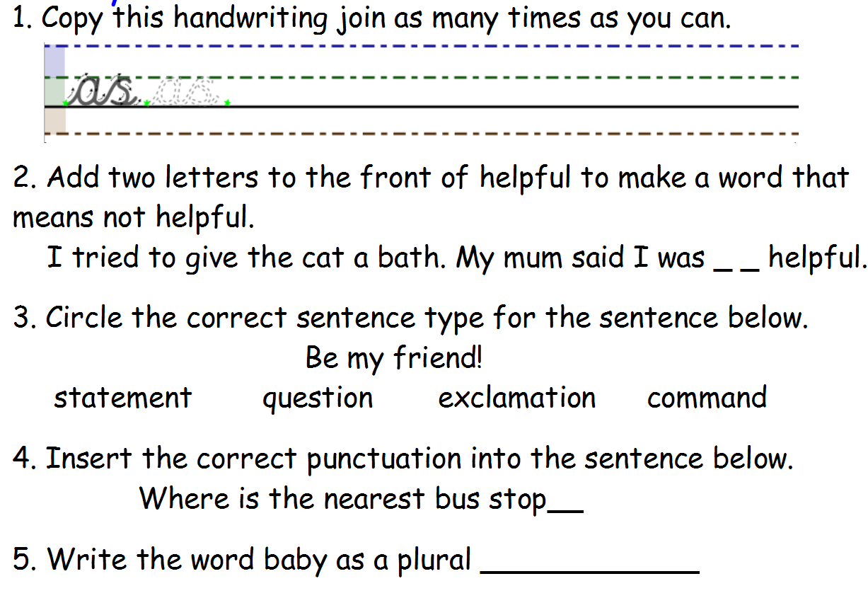
Day 4
Y3 English
5 a day

Slide 8
Day 4
Y3 English
5 a day
ANSWERS
un
?
babies

Slide 9
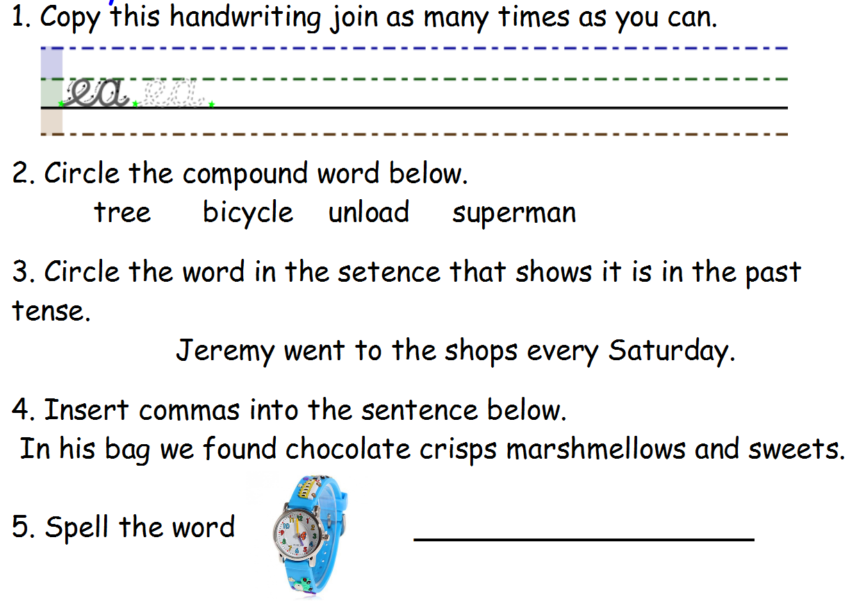
Day 5
Y3 English
5 a day

Slide 10
Day 5
Y3 English
5 a day
ANSWERS
,
,
watch

Slide 11
Summer 2 Week 4
Poetry
Lesson 1
There are lots of different types of poetry, but they often contain similar ingredients.
Visit this website
https://www.bbc.co.uk/bitesize/articles/z9jhqfr
and watch the short clip to learn about what to include when you write a poem.
All poems are made up of words. Poems can tell a story or be about a thought or a feeling. They can be serious or silly, but they always have to use words.
Poems often have a rhythm, which is like a beat in music. The rhythm is quick or slow depending on the words the poet chooses.
Poems can use rhyme, which means that certain words have similar end sounds.
For example: ‘Break’ and ‘lake’ ; ‘cat’ and ‘mat’ ; ‘loud’ and ‘proud’ .
Poems can also use alliteration, which is when more than one word starts with the same first letter or sound.
For example: The slimy, sneaky snake slithered silently.

Slide 12
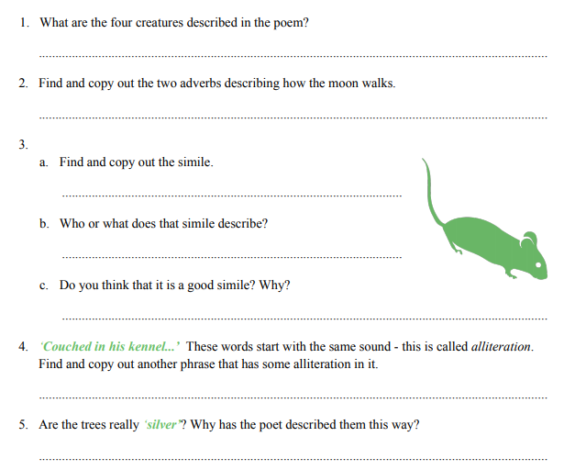
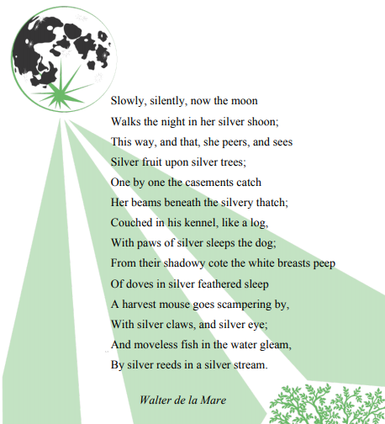
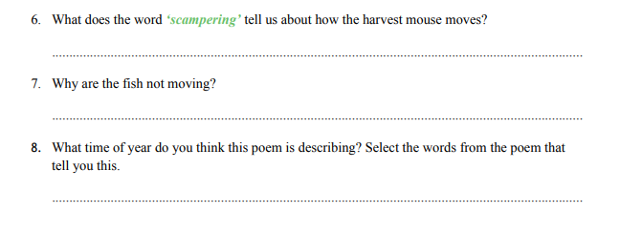

Slide 13
Lesson 2
Imagine you are standing in your garden, or looking out of the window, in the middle of the night.
Write six descriptive sentences about what you can see, hear and feel around you.
Top tip!
Use interesting adjectives and verbs.
Try using alliteration if you can.
For example:
A stray cat screeches like a baby crying.
The street lamps are big balls of glowing fire.

Slide 14
Lesson 3
Now use your descriptive sentences to write your own poem about the night.
Remember, poems can rhyme, but they don’t have to.
Aim to write four lines.
Top tip!
You could start by using the same words as Walter de la Mare: ‘Slowly, silently…’
For example:
Slowly, silently, the stars sparkle in the sky.
The street lamps are big balls of fire glowing brightly.
A stray cat screeches like a baby’s cry
And the moon watches over the world with a smile
When you have finished your first draft of your poem, you need to check all the spellings. You could do this by typing it up and looking out for the red squiggly lines, asking an adult or even asking Alexa!
Check that every line of your poem starts with a capital letter.
Now, you can publish and illustrate your poem. We would love to see them!

Slide 15


