Slide 1
Year 4 Maths
Fractions
(Including adding and subtracting fractions with the same denominator)

Slide 2
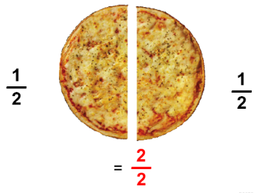
What is a fraction?
Day 1
A fraction is a way of representing part of a whole.
It is written with a numerator
(which shows us how many
pieces you have)
And a denominator
(which shows how many equal
sized pieces the whole is broken
into)
1
2

Slide 3
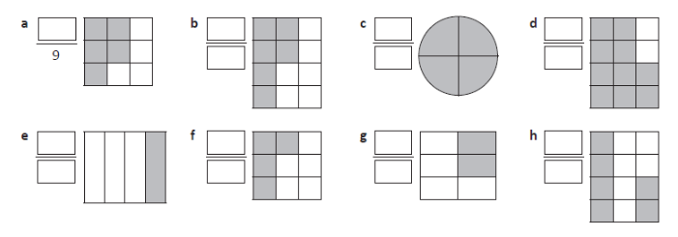
Can you write the fraction of the shape that is shaded?
Day 1
Remember – the denominator (bottom number) is the number of equal pieces the whole has been broken into.
The numerator (top number) is the number of shaded pieces.

Slide 4
Can you write the fraction of the shape that is shaded? ANSWERS!
Day 1
Remember – the denominator (bottom number) is the number of equal pieces the whole has been broken into.
The numerator (top number) is the number of shaded pieces.
5
6
4
10
12
4
12
1
4
2
6
4
9
6
12

Slide 5
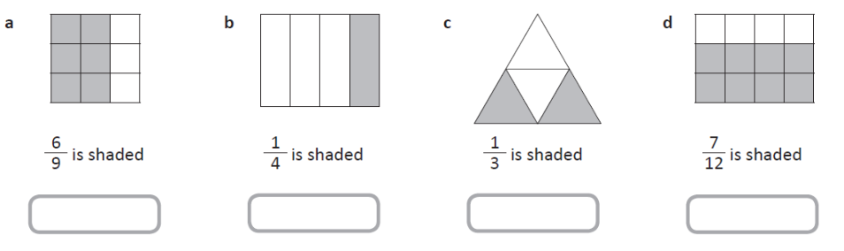
Are these statements true or false? Explain how you know!
Day 1

Slide 6
Are these statements true or false? Explain how you know!
Day 1
True
True
False
False
The shape is divided into 4 equal pieces, and 2 are shaded in so the statement should be 2/4 is shaded.
The shape is divided into 12 equal pieces, but 8 are shaded in so the statement should be 8/12 is shaded.
The shape is divided into 9 equal pieces, and 6 are shaded in.
The shape is divided into 4 equal pieces, and 1 is shaded in.

Slide 7
You can also find fractions of a group of items.
Day 1
What is 3 of the stars?
5

Slide 8
To answer this, you need to look carefully at the fraction.
Day 1
What is 3 of the stars?
5
The denominator (bottom number) tells you that you need to split the group into 5 equal sized groups

Slide 9
To answer this, you need to look carefully at the fraction.
Day 1
What is 3 of the stars?
5
Each of these boxes represent 1 , so you need to add 3 of them together.
5
1 + 1 + 1
5 5 5

Slide 10
To answer this, you need to look carefully at the fraction.
Day 1
What is 3 of the stars?
5
1 + 1 + 1
5 5 5
So, the answer is 9!

Slide 11
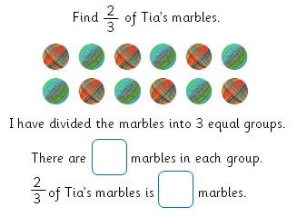
Now it’s time for you to have a go!
Day 1

Slide 12
Answer!
Day 1
4
8
Now have a go at Day 1 tasks

Slide 13
Day 2
Adding and subtracting fractions with the same denominator

Slide 14
Day 2
When adding and subtracting fractions with the same denominator (bottom number), you will only ever need to worry about the numerator.
= ?
2 + 3
6 6

Slide 15
Day 2
You can find you answer by using a shape divided into the same number of sections as your denominator!
2 + 3
6 6

Slide 16
Day 2
So, your answer is the number of shaded pieces!
=
2 + 3
6 6
5
6

Slide 17
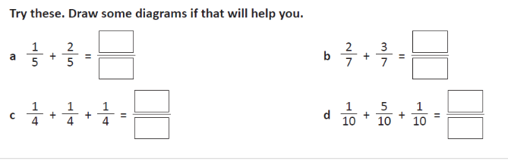
You have a go at these questions!
Day 2

Slide 18
Answers!
Day 2
3
5
5
7
3
7
4
10

Slide 19
Subtracting fractions is just as straightforward!
Day 2
- 2
9 9

Slide 20
You just need to subtract the numerators – the denominator will stay the same.
Day 2
- 2
9 9

Slide 21
You then just need to count how many filled in sections you have left!
Day 2
=
- 2
9 9
6
9

Slide 22
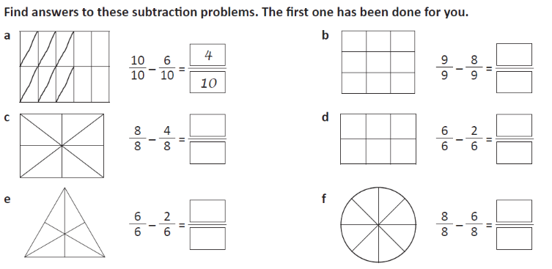
Now it’s your turn!
Day 2

Slide 23
Now it’s your turn!
Day 2
1
9
4
4
8
6
4
2
6
8
Now do Day 2’s questions!

Slide 24
Day 3 tasks
Have a go at the problems for Day 3.

