Slide 1


Welcome back to Year 4 Home Learning Spellings with Mrs Andrews

Slide 2


I hope you have had a good week
and now … it is time to do some spellings!

Slide 3

Every Week
I will send you:
a Power Point which will be linked to your Year 4 main focus words and spelling principle.
1 task worksheet (with an answer sheet if appropriate) AND
If possible on a PC, tablet or smart phone, an on-line task such as spellingframe.co.uk/spelling-rule OR another task.
If at all possible, please do both tasks because the more you do, the better you will become at spelling, reading and writing!

Slide 4
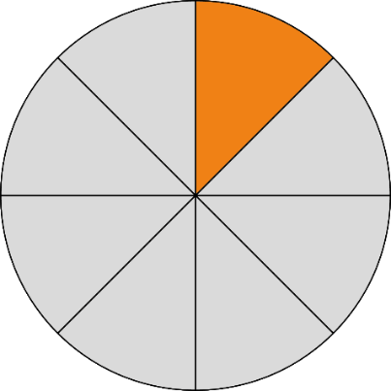
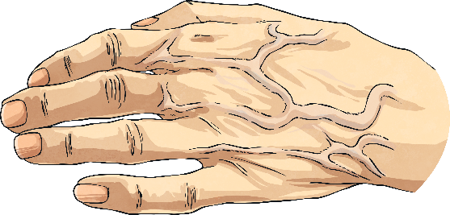


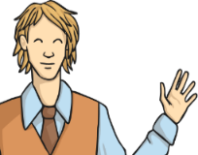

Last weeks learning
Last week we looked at making a long /a/ sound using which letter pattern?
vein
eighth
neighbour

Slide 5
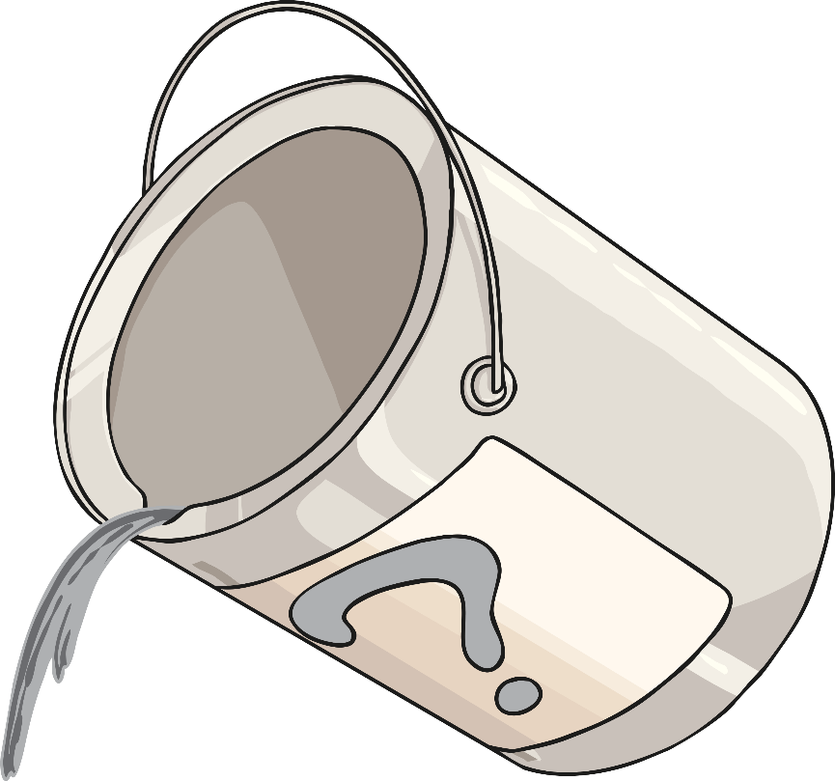
This week we are going to look at …
grey
Which letters make the long vowel sound /a/ in this word?

Slide 6
Yes , it is the ‘ey’ in the word grey.
grey

Slide 7

Can you think of any words which include –ey?
Tell your adult or write them down (apart from grey).

Slide 8
How many did you think of?
ey
they
obey
disobey
convey
prey
hey
Can you say these words out loud?

Slide 9

Lets look at what some of these words mean.
survey
You may do one of
these in maths
or science?
Do you like…
Yes No
bananas?
pineapple?
raspberries?
coconut?
mango?

Slide 10
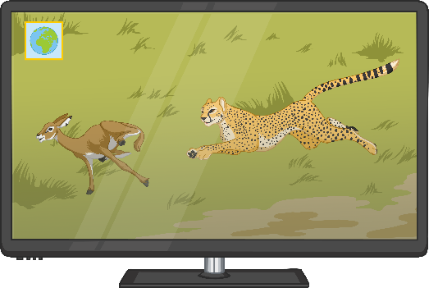
With an adult, talk about the word…
prey
Now use the word and say it in a sentence. Be careful because it is a homophone.
For example: While watching the wildlife programme, I watched the cheetah chase its prey.
Top Tip: A homophone is a word that sounds the same as another word but has a different spelling and different meaning.
prey and pray are homophones

Slide 11

With an adult, now talk about the word…
hey
When might you hear this word used? Tell your adult when you could use this word?
Such as in a diary or speech in a story.
For example. “Hey! Good to see you!”
shouted the girl cheerfully to her
old friend.
‘Hey’ is an informal word that is often used in speech to greet people.

Slide 12
With an adult, now talk about the words…
obey and disobey
Obey means to follow commands or orders or rules.
What does ‘disobey’ mean? Think back to when
You did prefixes such as dis.
For example. The child disobeyed his mum’s request to lay the table ready for tea.
The prefix ‘dis’ means not.

Slide 13

Your Focus Words from last week and this week. Say them all out loud.
This week
they
obey
disobey
survey
convey
prey
hey
Last Week
eight
eighth
eighty
weight
weigh
neighbour
sleigh
vein
veil
beige
reign

Slide 14

Your Turn
Vowel Circle and Mnemonic
On-line Spelling Frame
Write each of your ‘ey’ focus spelling words.
Then go back and circle all of the vowels in your spelling words!
Don’t forget to write neatly!
Then write a mnemonic for one of the ‘ey’ words you find tricky to remember. (You are good at these!)
Either, cut and paste this link into your browser
https://spellingframe.co.uk/spelling-rule/22/19-Words-with-the-sound-spelt-ei-eigh-or-ey
OR
Go onto your browser
Type in Spelling Frame
Select Year 3 and 4
Select Rule 19 words spelt ei, eigh, ey
Select Spelling Tiles
Select Segment Puzzle and try the free game.

Slide 15


