Slide 1

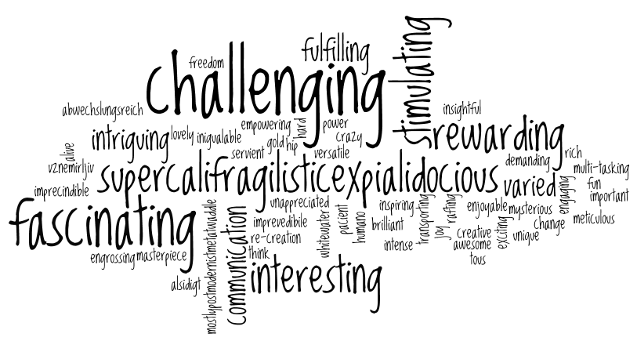
Welcome back to Home Learning Spellings with Mrs Andrews

Slide 2


I hope you had a good half term holiday! I did!
and now … it is time to do some spellings!

Slide 3
This half term, is recap half term!
This half term, we are going to recap the spelling principles that you either learnt with your class teachers or with me during your Home Learning. I will be referring you back to the previous Home Learning power points when we are discussing the spelling principles.
This week we are going to focus on the prefixes ‘dis’ and ‘un’.

Slide 4
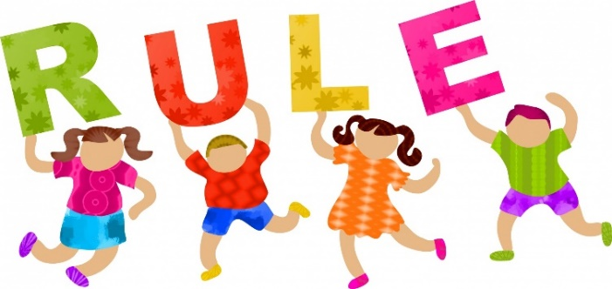

What is a prefix?
Let’s remind ourselves what are prefixes by watching this BBC Bitesize clip.
https://www.bbc.co.uk/bitesize/topics/z8mxrwx/articles/z9hjwxs

Slide 5
Prefixes
So a prefix is a letter or a group of letters added to the front of a root word to change the meaning of the word.
They are not words in their own right!
The root word always stays the same when the prefix is added to the front.
There are many prefixes. In the Spring term you looked at many prefixes with your class teachers.
What do the prefixes ‘dis’ and ‘un’ do the meaning of the word when they are added to the front of the root word?

Slide 6


Prefixes ‘dis’ and ‘un’
The prefixes un- and dis- either change the meaning of the root word to the exact opposite of its original meaning or mean not.
REMEMBER: If the root word starts with the same letter as the end of the prefix the letter will be doubled.
Can you think of any words which start with the prefixes ‘un and ‘dis’?
Tell your adult.
For example. disobey means the opposite of obey (or not to obey)
prefix ‘dis’ + root word ‘obey’ = new word ‘disobey’
unhappy means not happy
prefix ‘un’ + root word ‘happy’ = new word ‘unhappy’

Slide 7
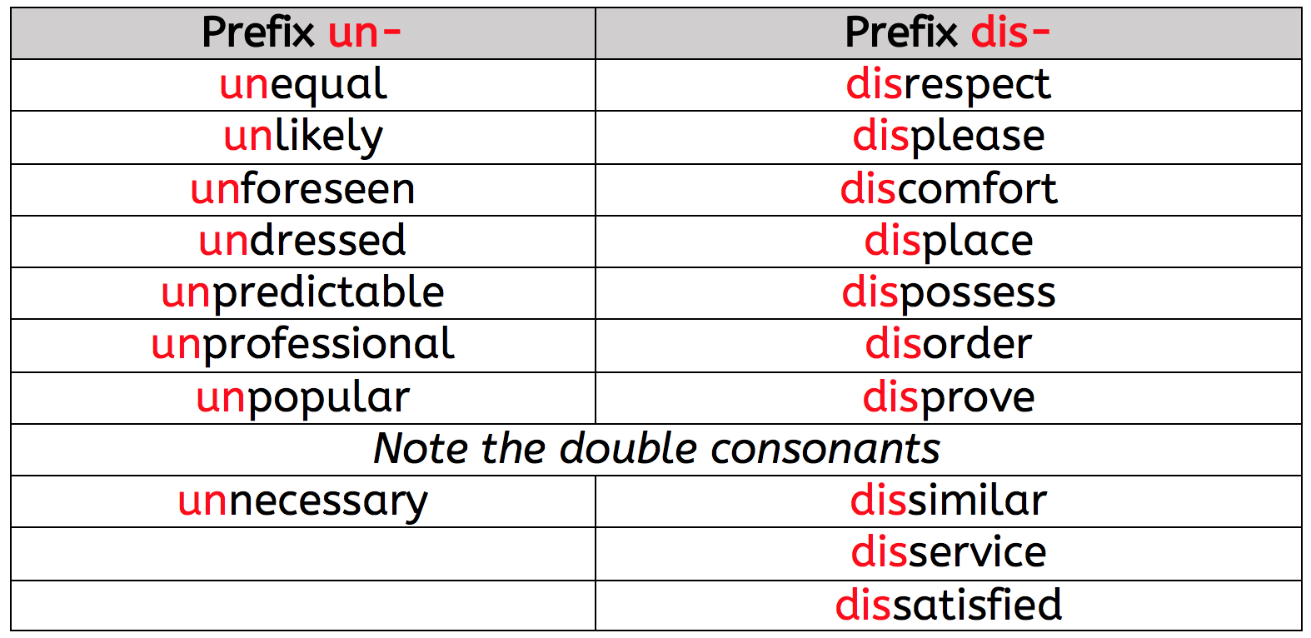
‘dis’ and ‘un’ Prefix Words

Slide 8
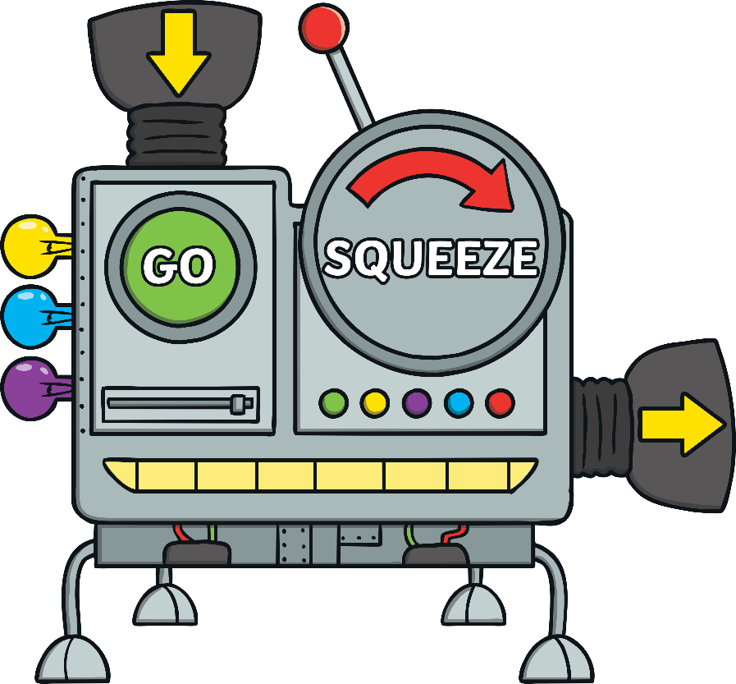
Can you work out this word?
t d o s c I f m r i

Slide 9
Answer is…
discomfort

Slide 10
Can you work out this word?
i u k n I y e l

Slide 11
Answer is…
unlikely

Slide 12

Your 10 ‘un’ and ‘dis’ Spelling Words…
unhappy
unlucky
dislike
unusual
dishonest
untie
disappear
disagree
unwell
disobey

Slide 13

Your turn to do some spelling activities.
Word Sort
Definitions
Draw 2 columns for ‘un’ and ‘dis’ and sort the words into the correct columns.
Answer sheet attached.
Write the definitions for the 10 words.
Answer sheet attached.

Slide 14
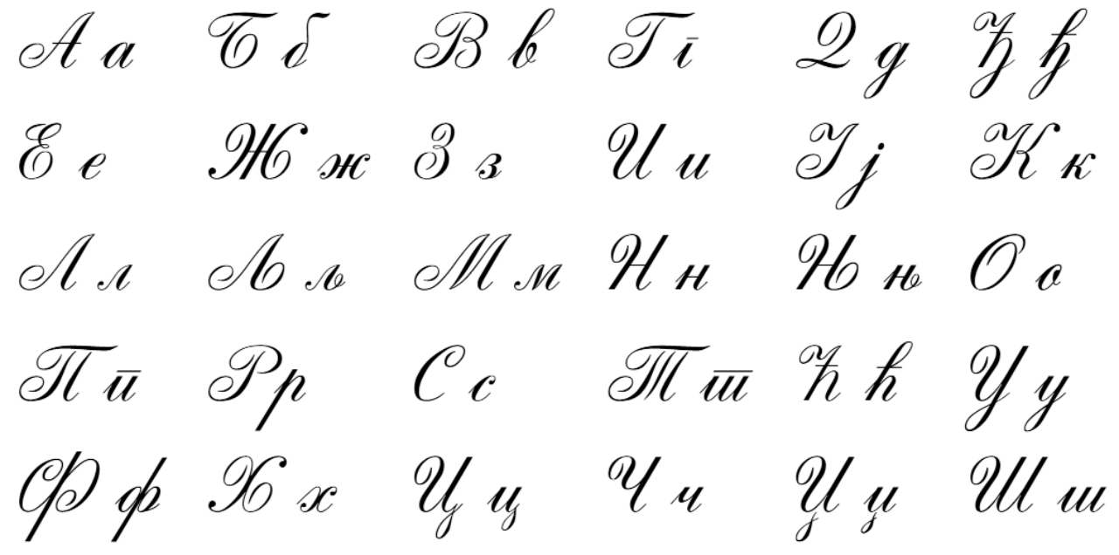
Your turn to do your handwriting task
On a sheet of paper, choose 5 tricky spelling words, and put them into a sentence so you can practise your handwriting as well as writing sentences that make sense.
unhappy
unlucky
dislike
unusual
dishonest
untie
disappear
disagree
unwell
disobey

Slide 15


