Slide 1

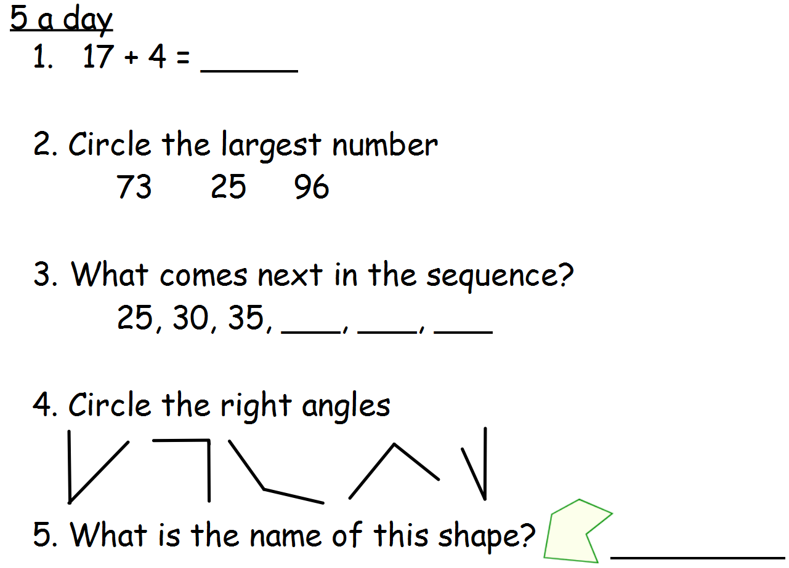
Day 1
Maths- 5 a day

Slide 2
Day 1 ANSWERS
Maths- 5 a day
21
40 45 50
Irregular hexagon

Slide 3
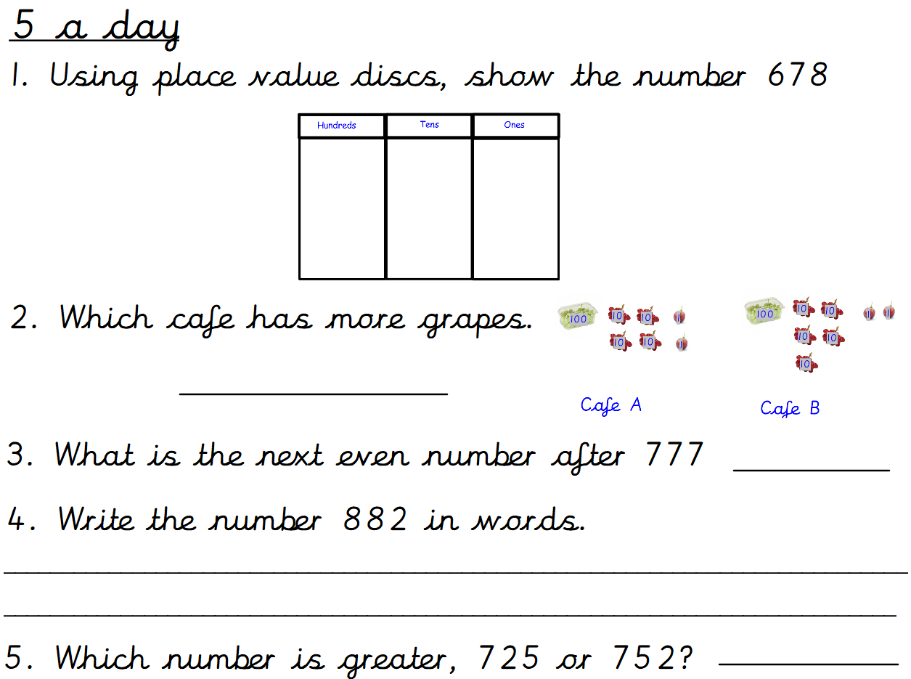
Day 2
Maths- 5 a day

Slide 4
Day 2 ANSWERS
Maths- 5 a day
Cafe A
778
Eight hundred and eighty two.
752

Slide 5
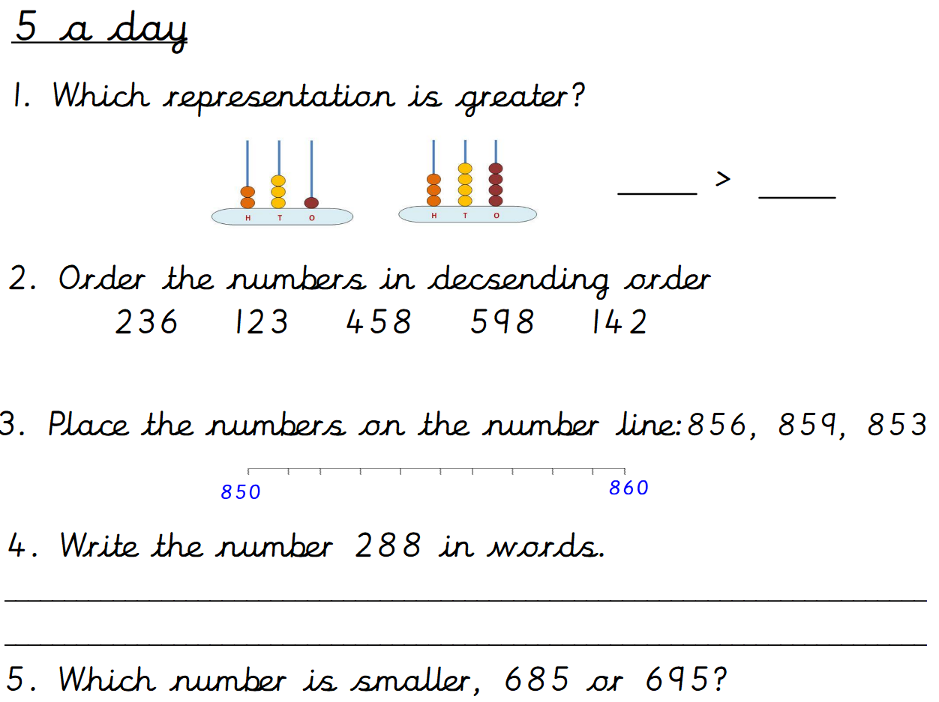
Day 3
Maths- 5 a day

Slide 6


Day 3 ANSWERS
Maths- 5 a day
344
231
598 458 236 142 123
853
856
859
Two hundred and eighty eight.
685

Slide 7
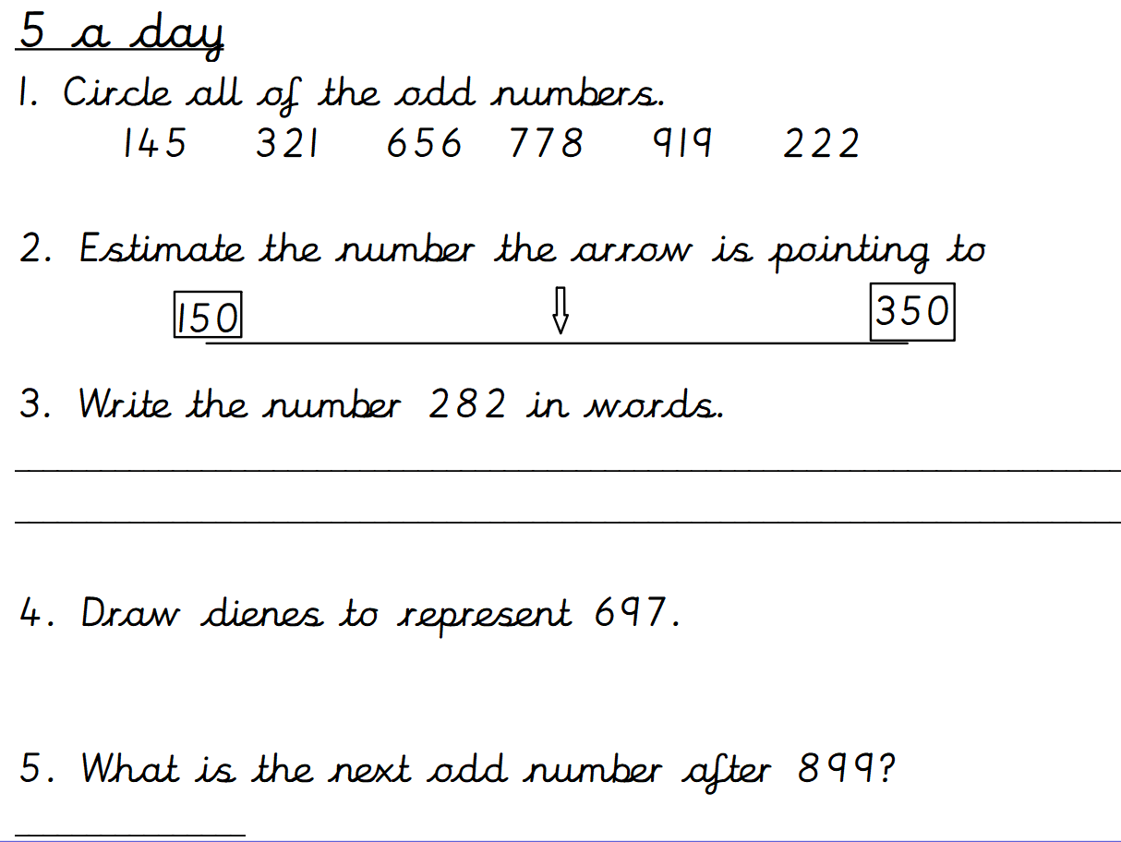
Day 4
Maths- 5 a day

Slide 8

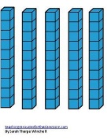

Day 4 ANSWERS
Maths- 5 a day
250
Two hundred and eighty two.
901

Slide 9
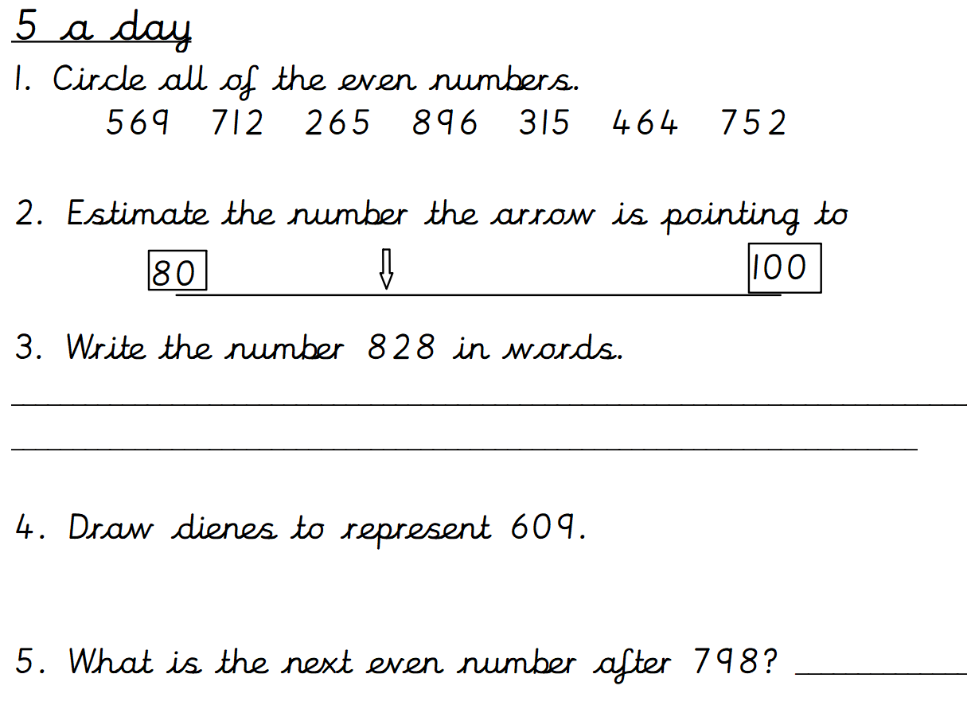
Day 5
Maths- 5 a day

Slide 10
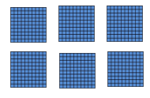

Day 5 ANSWERS
Maths- 5 a day
87
Eight hundred and twenty eight.
800

