Slide 1

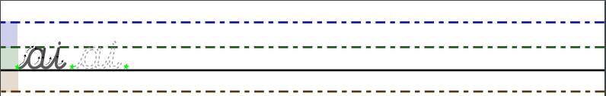
Day 1
Y3 English
5 a day
1. Copy this handwriting join as many times as you can.
2. Circle the noun in the sentence below.
The blue car drove very fast.
3. Circle the correct word to complete the sentence below.
It was extremely hot, _____ Ahmed had an ice cream.
so if or that
4. Circle the correct option to complete the sentence below.
You ______ walk on the grass.
'shouldnt shouldn't sh'ouldnt should'nt
5. Circle the option that is spelt correctly.
nale nayl nail neighl

Slide 2
Day 1
Y3 English
5 a day
1. Copy this handwriting join as many times as you can.
2. Circle the noun in the sentence below.
The blue car drove very fast.
3. Circle the correct word to complete the sentence below.
It was extremely hot, _____ Ahmed had an ice cream.
so if or that
4. Circle the correct option to complete the sentence below.
You ______ walk on the grass.
'shouldnt shouldn't sh'ouldnt should'nt
5. Circle the option that is spelt correctly.
nale nayl nail neighl
ANSWERS

Slide 3
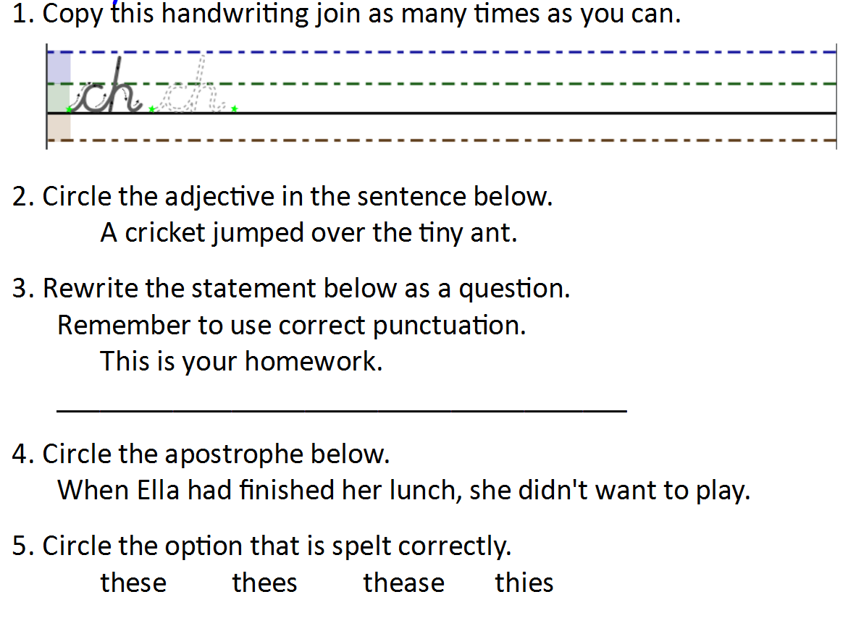

Day 2
Y3 English
5 a day

Slide 4
Day 2
Y3 English
5 a day
ANSWERS
Is this your homework?

Slide 5
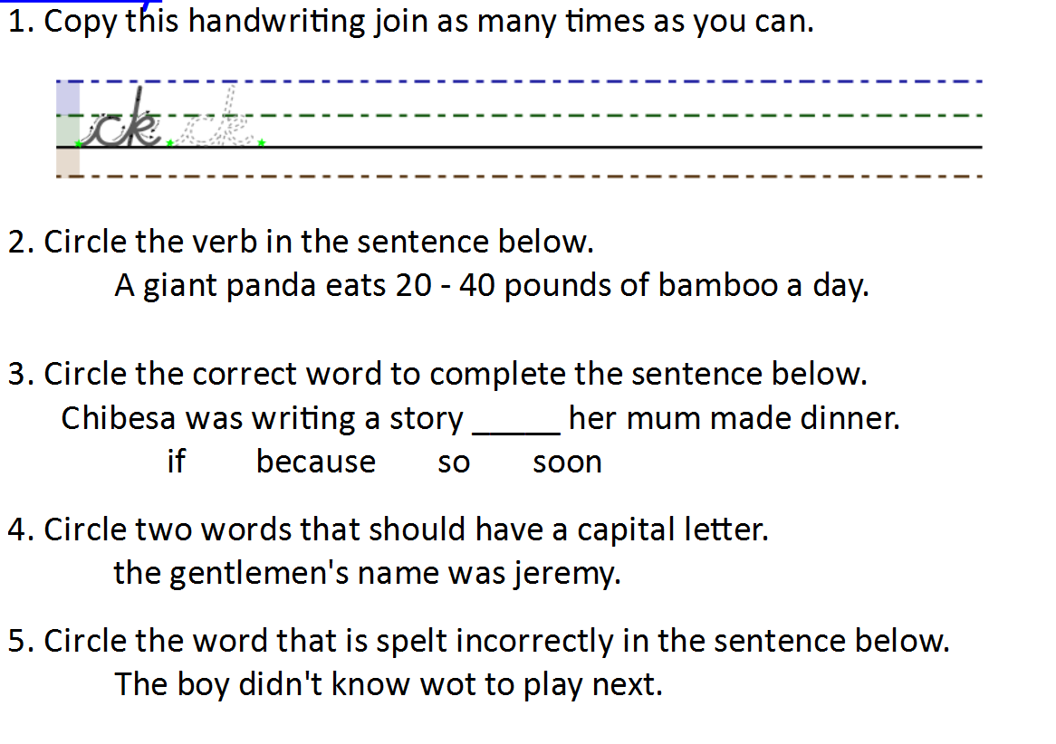
Day 3
Y3 English
5 a day

Slide 6
Day 3
Y3 English
5 a day
ANSWERS

Slide 7
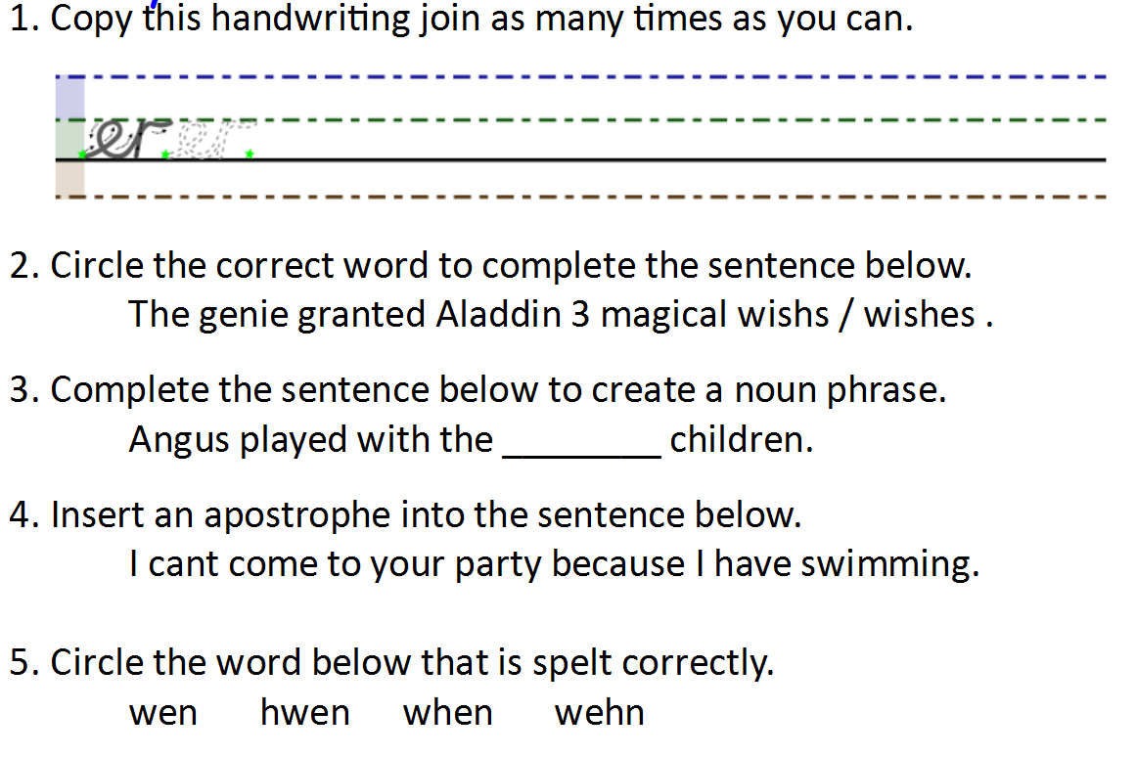
Day 4
Y3 English
5 a day

Slide 8
Day 4
Y3 English
5 a day
ANSWERS
any word
to describe
them
'

Slide 9
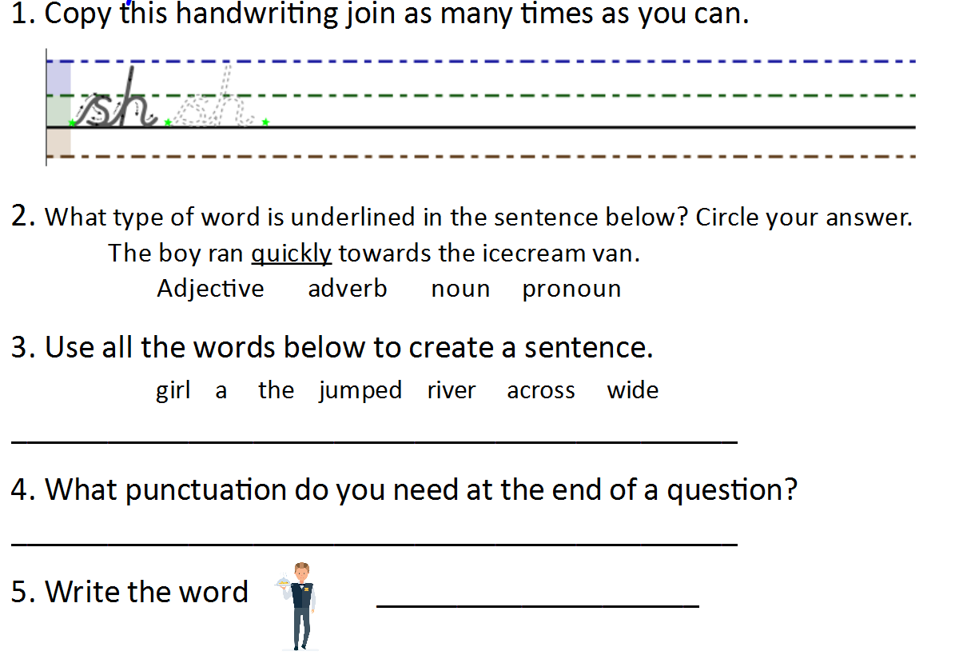
Day 5
Y3 English
5 a day

Slide 10
Day 5
Y3 English
5 a day
ANSWERS
The girl jumped across a wide river.
A question mark.
waiter

