Slide 1

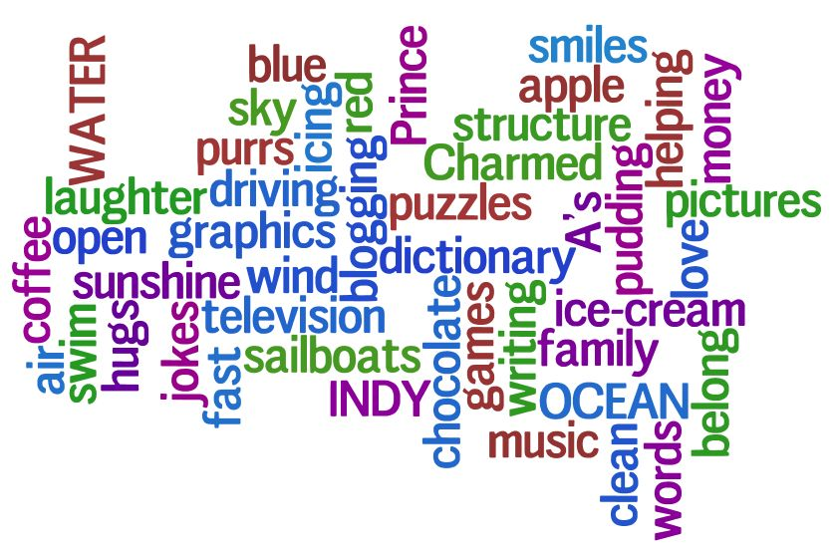
Welcome to back Home Learning Spellings with Mrs Andrews

Slide 2


I hope you had a good week.
and now … it is time to do some spellings!

Slide 3
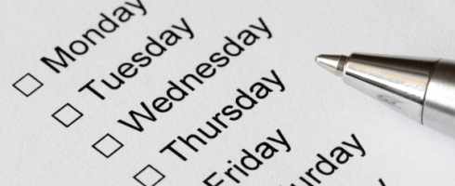
Every Week
I will be sending you:
a Power Point which will be linked to your Year 3 main focus words and spelling principle,
1 task worksheet and / or
a Spelling Frame on line task. I will direct you to the correct web page. Remember the main website we use is spellingframe.co.uk/spelling-rule
you should do a minimum of 1 spelling task per week but you should try to do both if you can.
AND you must do the handwriting task in which you will be asked to choose 5 tricky spelling words and put them into a sentence so you can practise your handwriting as well as writing sentences that make sense.

Slide 4
This week we are going to look at some more homophones
What is a homophone?
Homophones have the same sound, different spelling and different meaning.

Slide 5
Let’s recap the homophones that you have learnt so far.
Here are the homophones that you looked at in Year 2 or you have looked at recently with your class teachers. Do you remember what they mean? Tell your adult what each one means.
hear / here
their / there / they’re
no / know
weather / whether
Can you see the small words in the big words? I have underlined them to help you.
Try to use this strategy of remembering small words in big words when you are learning your spelling words.

Slide 6
Here are the homophones which you looked at with me at the beginning of lockdown… Talk to your adult what each one means.
break brake
son sun
eight ate
great grate
where wear
which witch
wait weight
Can you see the small words in the big words?
Tell your adult which small words you can spot in these bigger words.
Top tip: Not all words have small words inside them so try to spot easily remembered phonic sounds too to help you, if you can.
Try to use this strategy of remembering small words in big words when you are learning your spelling words.

Slide 7
Here are your new homophones.
heel and heal and he’ll
plain and plane
groan and grown
rein and reign
Can you say these words out loud.

Slide 8

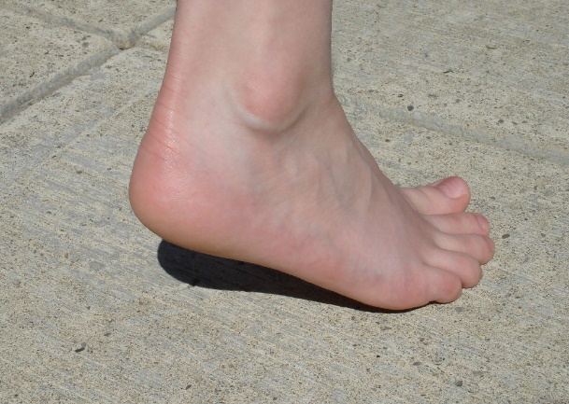
So what do these words mean?
It is contraction for ‘he will’
heal
heel
he’ll

Slide 9
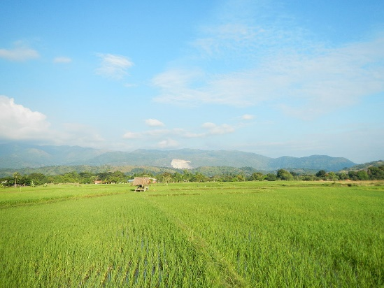
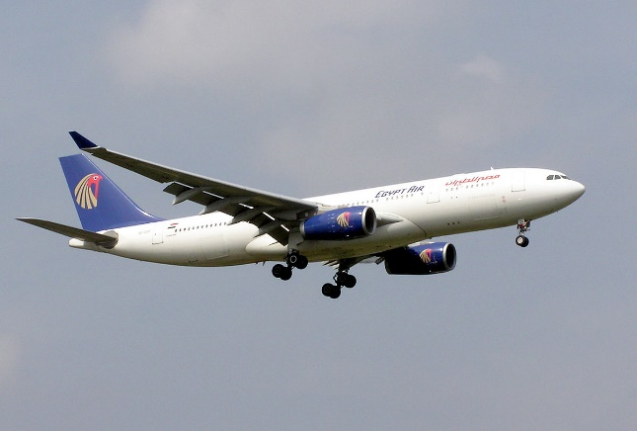
What do these words mean?
plain = large flat land
OR
plain is an adjective meaning
simple or bare
plane

Slide 10
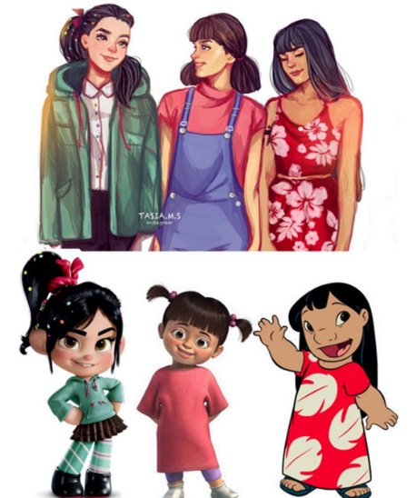

What do these words mean?
Groan means a deep
sound made to show
pain, grief or sadness.
Grown means to have
reached full size.
Past tense of grow.

Slide 11
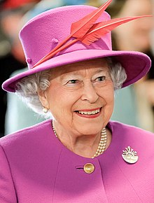
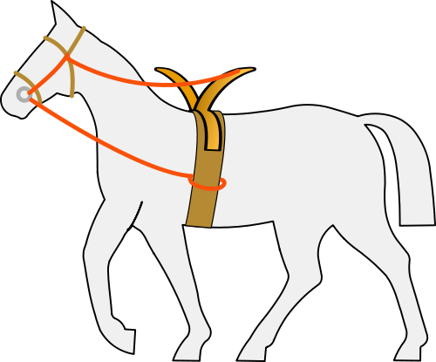
What do these words mean?
rein means the strap
that is attached to the bridle which is used to control an animal.
reign means the rules of
a king or queen.

Slide 12

Your Focus words
heel and heal and he’ll
plain and plane
groan and grown
rein and reign

Slide 13
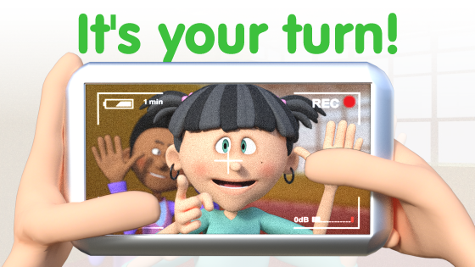
Your turn to do a spelling activity.
This week there is no on-line learning, but I would like to you do this spelling activity and your handwriting task this week.
To make Flash Card for each of your spelling words. Please keep them for next week.
All these words will make your writing fabulous!

Slide 14

Your turn to do a handwriting task
On a sheet of paper, choose 6 tricky spelling words and put them into a sentence so you can practise your handwriting as well as writing sentences that make sense.
heel and heal and he’ll
plain and plane
groan and grown
rein and reign

