Slide 1

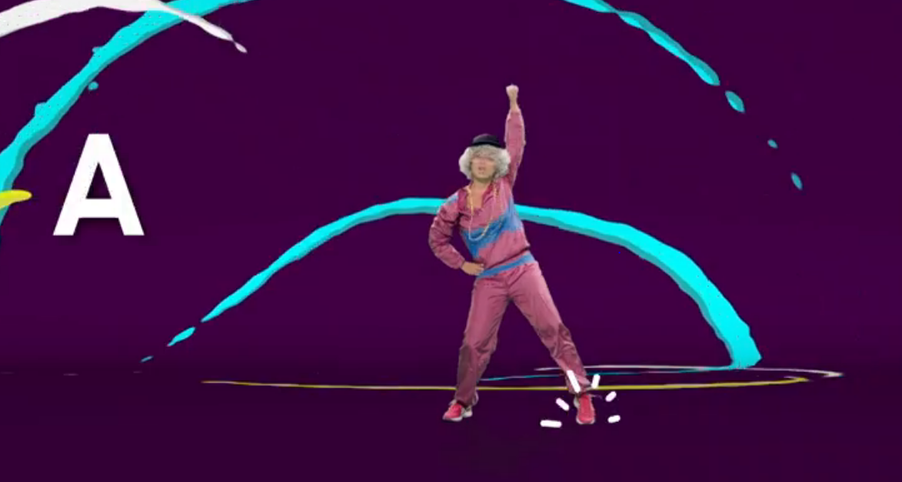
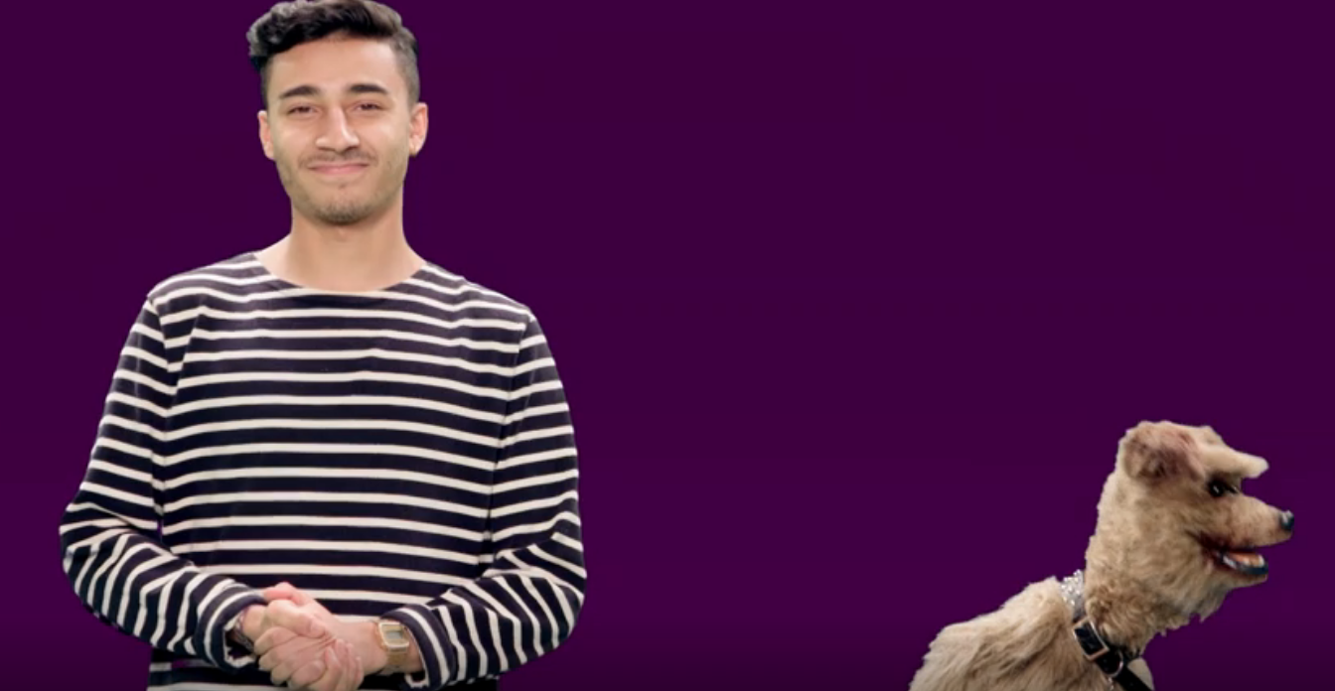
Day 1
Y3 English
5 a day
Let’s have a punctuation recap!
Go to these two websites to remind ourselves on how we use full stops, capital letters, ? and ! (you can click on the pictures to link too).
https://www.bbc.co.uk/teach/supermovers/ks1-english-capital-letters-full-stops/zjmrhbk
https://www.bbc.co.uk/teach/supermovers/ks1-english-question-exclamation-marks-with-karim-hacker/zkrx92p

Slide 2

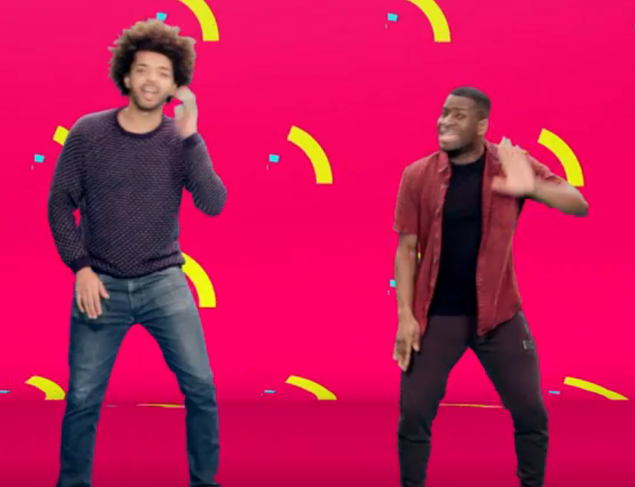
Day 2
Y3 English- 5 a day
Now we are going to use Super Movers again to remind ourselves about homophones.
Click on the picture or link below.
https://www.bbc.co.uk/teach/supermovers/ks2-english-homophones-with-johnny-inel/z6fjbdm

Slide 3
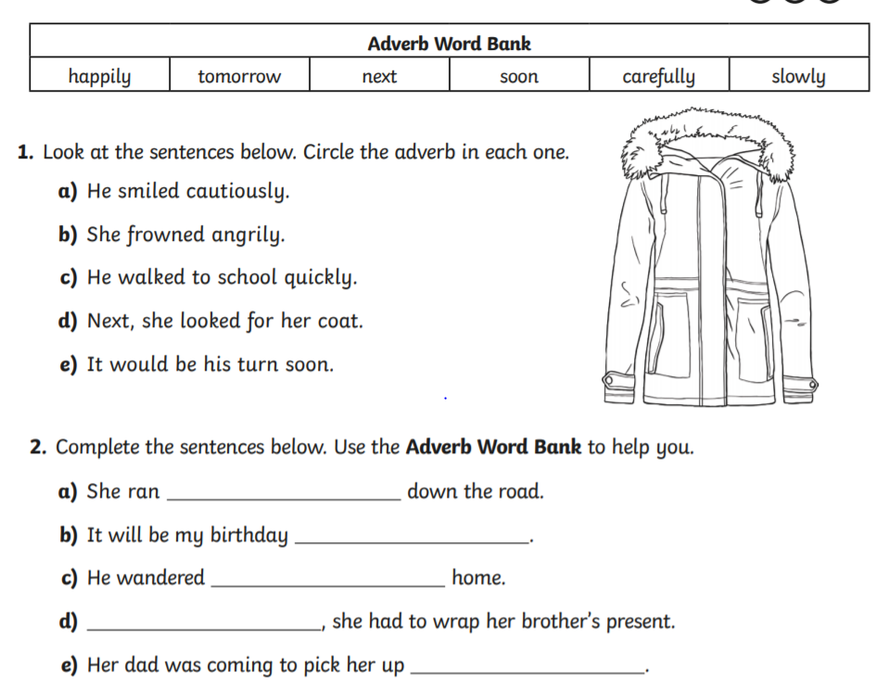
Day 3
Y3 English
5 a day
Adverbs

Slide 4
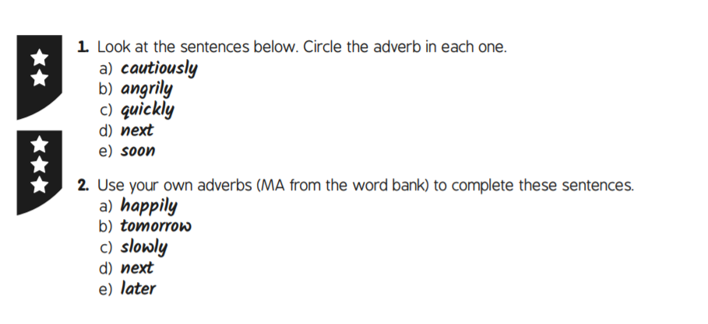
Day 3
ANSWERS
Adverbs
Y3 English
5 a day

Slide 5
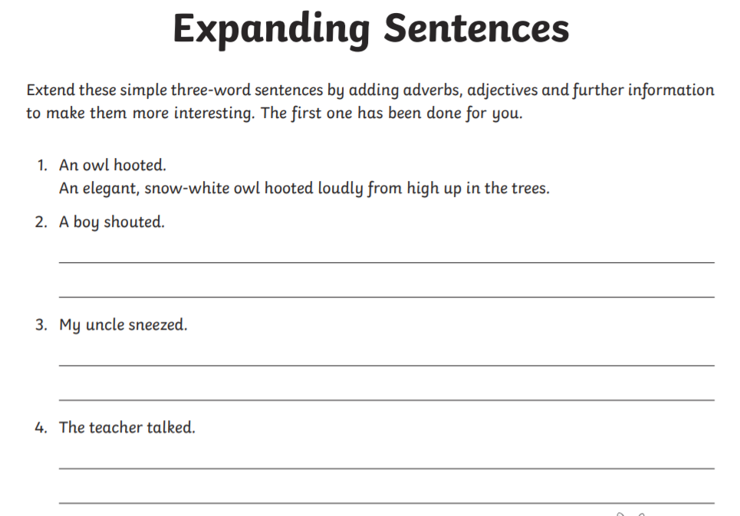
Day 4
Y3 English
5 a day

Slide 6
Day 4
ANSWERS
Y3 English
5 a day
The sentences may vary but make sure you have included:
An adverb
An adjective
Further information
For example you could choose an adverb like, ‘aggressively’ to describe how the boy is shouting.
You could use an adjective like, ‘nasty’ to describe the boy.
You could add further information e.g. as a dog barked nearby.
A nasty boy shouted aggressively as a dog barked nearby.

Slide 7

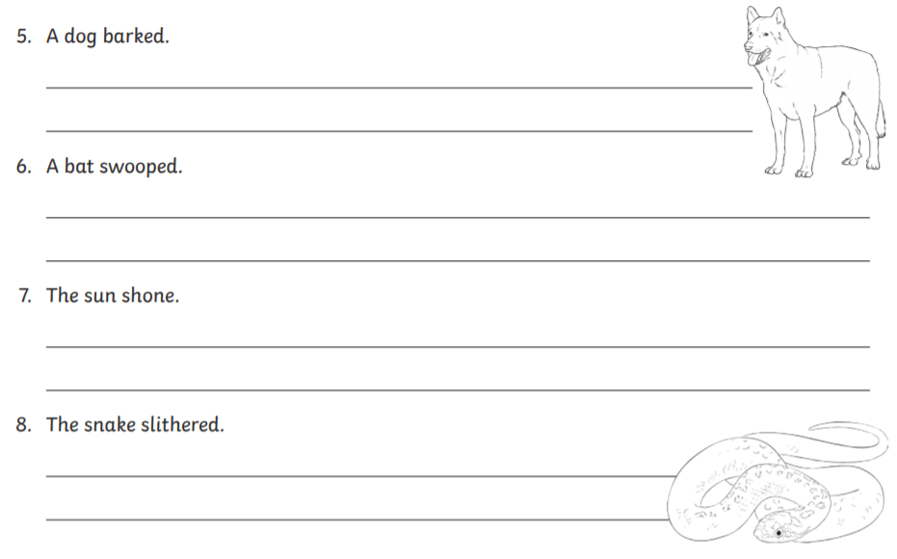
Continuing from yesterday’s ‘Expanding Sentences’ work:
Day 5
Y3 English
5 a day

Slide 8
Continuing from yesterday’s ‘Expanding Sentences’ work:
Day 5
ANSWERS
Y3 English
5 a day
The sentences may vary but make sure you have included:
An adverb
An adjective
Further information

