Slide 1
Year 4 Maths
Finding the area of rectilinear shapes

Slide 2
Recap – what is the perimeter of a shape?
Day 1
The number of sides a shape has.
The distance around the shape.
The number of corners a shape has.
The number of whiskers on Tabby the Cat.

Slide 3
Recap – what is the perimeter of a shape?
Day 1
The number of sides a shape has.
The distance around the shape.
The number of corners a shape has.
The number of whiskers on Tabby the Cat.

Slide 4
Recap – what is the perimeter of this shape?
Day 1
5cm
8cm
Remember to find the missing sides!
6cm
7cm

Slide 5
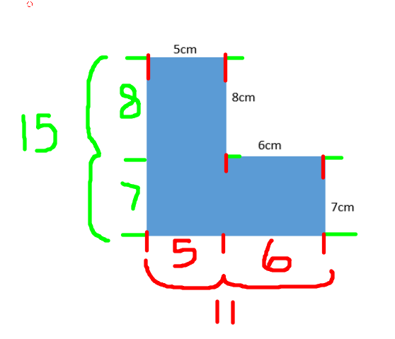
Recap – what is the perimeter of this shape?
Day 1
Answer = 52cm

Slide 6
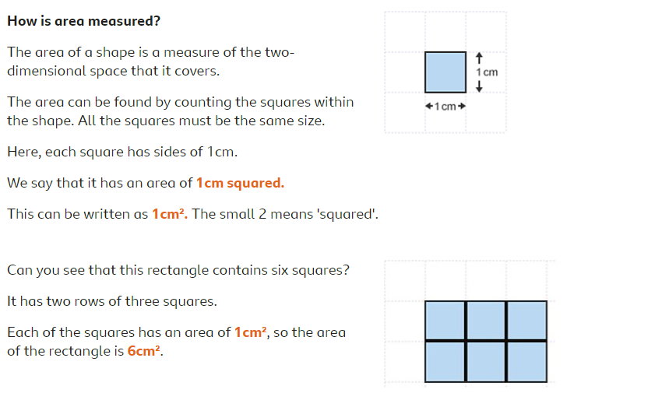
This week, we are going to find the area of shapes!
Day 1

Slide 7
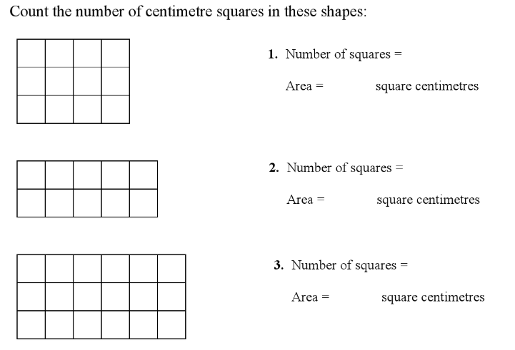
Can you find the area of these shapes?
Day 1

Slide 8
Can you find the area of these shapes?
Day 1
12
12
10
10
18
18

Slide 9
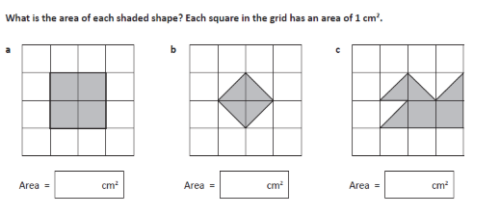
Can you find the area of the shapes below?
Day 1

Slide 10
Can you find the area of the shapes below?
Day 1
4
2
4
Careful here! Some squares are only half-filled, so 2 of them make 1cm!

Slide 11
Day 1
Now have a go at Day 1’s tasks!

Slide 12
Recap – what is the area of a shape?
Day 2
The distance around the shape.
The number of corners a shape has.
The shape of Tabby the Cat’s bed.
The amount of space inside a shape.

Slide 13
Recap – what is the area of a shape?
Day 2
The distance around the shape.
The number of corners a shape has.
The shape of Tabby the Cat’s bed.
The amount of space inside a shape.

Slide 14
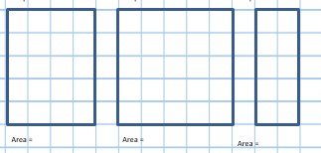
Recap – what are the areas of these shapes?
Day 2
1 square = 1cm2

Slide 15
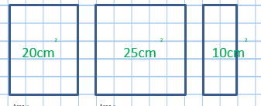
Recap – what are the areas of these shapes?
Day 2
1 square = 1cm2

Slide 16
Sometimes, shapes are so big it would take a really long time to count all of the squares.
Day 2

Slide 17
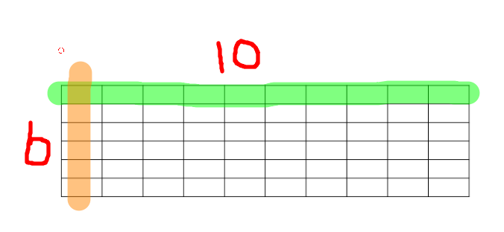
In this case, we can count how many squares are along the top and side of the shape and multiply them together.
Day 2
Area = 10 x 6
Area is 60cm 2

Slide 18
Can you calculate the area of these shapes*?
Day 2
7cm
8cm
6cm
3cm
11cm
*not to scale!

Slide 19
Can you calculate the area of these shapes*?
Day 2
7cm
8cm
6cm
3cm
11cm
Area = 7 x 3
Area = 21cm 2
Area = 6 x 6
(it’s a square!)
Area = 36 cm 2
Area = 8 x 11
Area = 88cm 2
*not to scale!

Slide 20
Some shapes you need you to use your knowledge of perimeter to help you find the area.
Day 2
11cm
6 cm
11 cm
8 cm
How can we find the area of this shape?

Slide 21
Day 2
Step 1 – divide the shape into 2 rectangles, and label them A and B.
Step 2 – work out the area of rectangle A by multiplying the length by the width.
11cm x 6cm = 66cm
Step 3 – work out how long the sides are on rectangle B before multiplying them together to find out the area.
5cm x 3cm = 15cm
Step 4 – add the 2 areas together to find the area of the whole shape
66cm + 15cm = 81cm 2
11cm
6
A
6 cm
3
11 cm
8 cm
B
5

Slide 22
Can you find the area of this shape?
Day 2
10cm
3cm
12cm
4cm

Slide 23
Can you find the area of this shape?
Day 2
10cm
3cm
A
12cm
A = 10 x 3 = 30cm
B = 9 x 4 = 36cm
Answer = 66cm
9cm
B
Now have a go at Day 2’s tasks!
4cm

Slide 24
Day 3
Have a go at the problem solving questions for Day 3.
Explain your answers carefully!

