Slide 1


Welcome back to Year 4 Home Learning Spellings with Mrs Andrews

Slide 2


I hope you have had a good week
and now … it is time to do some spellings!

Slide 3

Every Week
I will send you:
a Power Point which will be linked to your Year 4 main focus words and spelling principle.
1 task worksheet (with an answer sheet if appropriate) AND
If possible on a PC, tablet or smart phone, an on-line task such as spellingframe.co.uk/spelling-rule OR another task.
If at all possible, please do both tasks because the more you do, the better you will become at spelling, reading and writing!

Slide 4

All of your spelling words for this week and next week, focus on two or four letter patterns that all make the same sound.
Say these 3 words out loud.
What sound do they all make?
vein
obey
eight

Slide 5

So our rule for the next two weeks is…
They all make a long /a/ sound but are spelt using a ‘ei’ or eigh’ or ‘ey’!
vein
obey
weigh

Slide 6
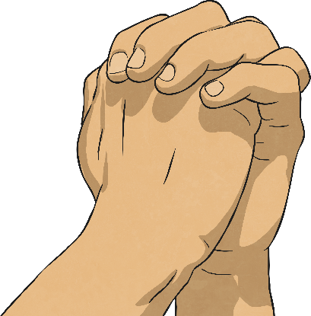
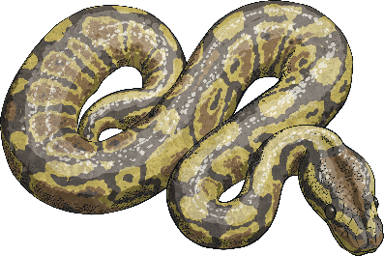

This week, we are going to look at –ei and
-eigh and next week –ey.
However, we already know that the long /a/ sound can be formed in words using...
a-e as in snake
ai as in train
ay as in praying
But we are looking at the other ways of making a long /a/ sound and knowing
this will definitely help your reading and writing!

Slide 7
Can you think of any words which includes –ei, -eigh?
Tell your adult or write them down (apart from vein and weigh).

Slide 8
How many did you think of?
eigh ei
sleigh vein
weigh veil
weight freight
neighbour sleigh
eight beige
eighty
eighth
Can you say these words out loud?

Slide 9
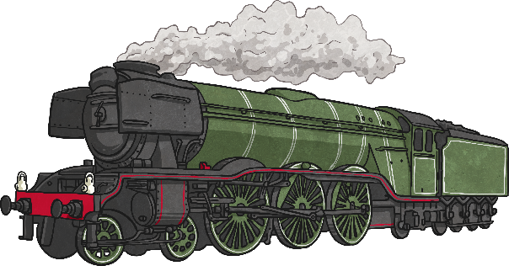









So now lets look at what these words mean?
‘eigh’ words
80
eighth
eight
eighth
eighty
freight
weight
weigh
neighbour
sleigh
Now say these words out loud

Slide 10
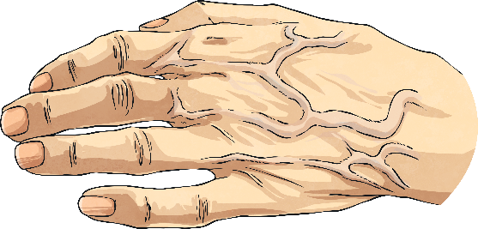


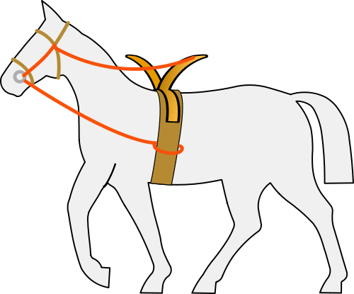
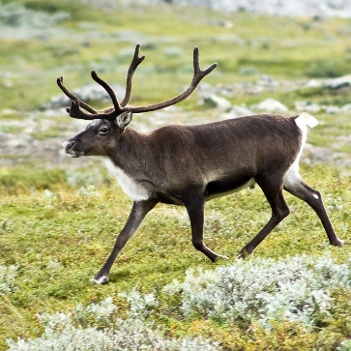
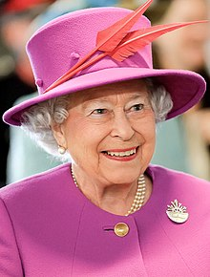
‘ei’ words
Now say these words out loud
vein
veil
beige
rein
reindeer
reign

Slide 11

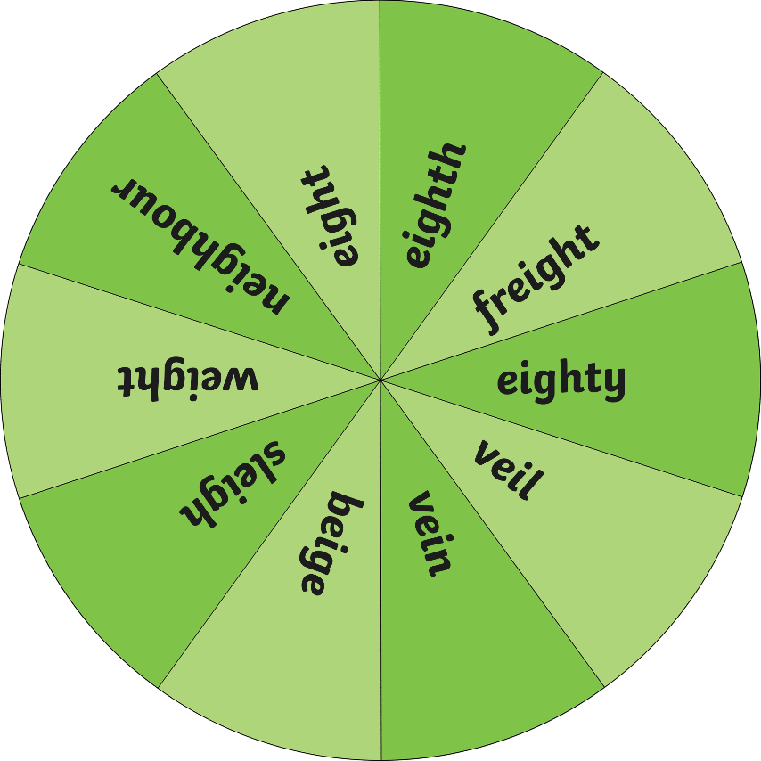
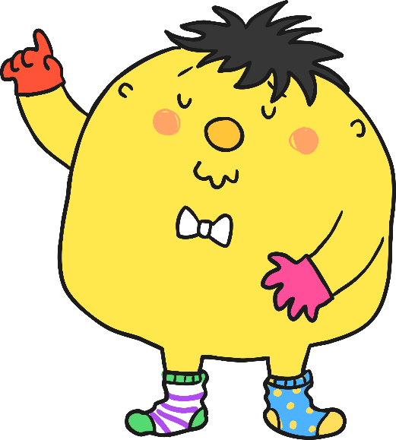
Now work with your adult and take turns to say an exciting sentence that contains a ‘ei’ or ‘eigh’ word. Does your sentence contain an exciting verb? Could you add an ambitious adjective?

Slide 12

Your Focus Words. Say them out loud.
eight
eighth
eighty
weight
weigh
neighbour
sleigh
vein
veil
beige
reign

Slide 13

Your Turn
Complete the words
Match the words to the Sentences
Complete the blanks for the words with ‘ei’ or ‘eigh’.
Answer sheet attached.
Match the spelling words with –ei and –eigh into the correct sentences.
The answer sheet is attached.

Slide 14


