Slide 1

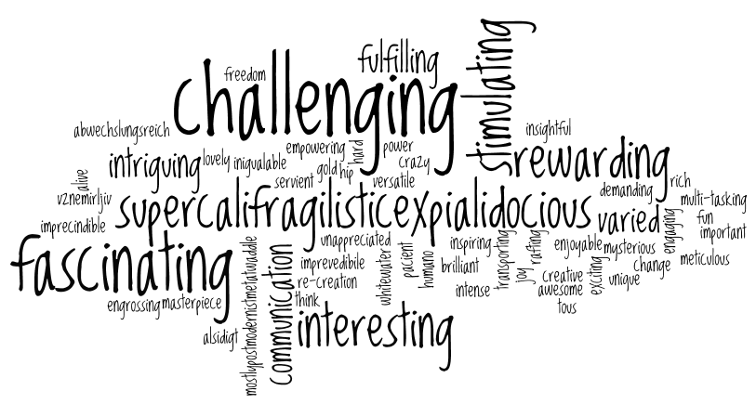
Welcome back to Home Learning Spellings with Mrs Andrews

Slide 2


I hope you had a good half term holiday! I did!
and now … it is time to do some spellings!

Slide 3
This week, is recap week!
This week, we are going to recap the last two weeks spelling principles.
Can you remember what they were?
Rule 1: The short /u/ sound that can be written with the letters ‘ou’.
AND
Rule 2: Words that contain a short /i/ sound but is spelt using a ‘y’.

Slide 4

Lets Remind ourselves about Rule 1
enough, young, touch, double, trouble.
Q) What sound does the ‘ou’ make?
It makes a short ‘u’ sound
(Some people say ‘uh’ sound but I think it is more of a short ‘u’ sound).
So the spelling rule is that the short /u/ sound can also be written with the letters ‘ou’

Slide 5
Let’s watch the BBC Bite size clip again
https://www.bbc.co.uk/bitesize/topics/zt62mnb/articles/zyq7v9q
The ‘u’ sound which is spelt ‘ou’ is in words such as…
country
cousin
courage
touch

Slide 6
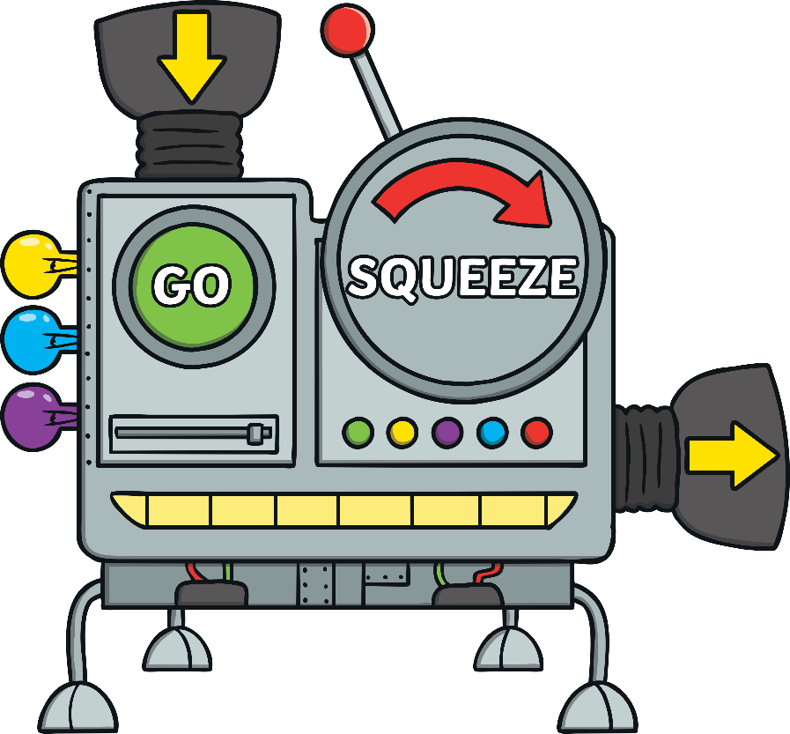
Can you work out this word?
g e o c a u r

Slide 7
Answer is …
co u r a g e

Slide 8
Can you work out this word?
b o l u e d

Slide 9
Answer is …
d o u b l e

Slide 10

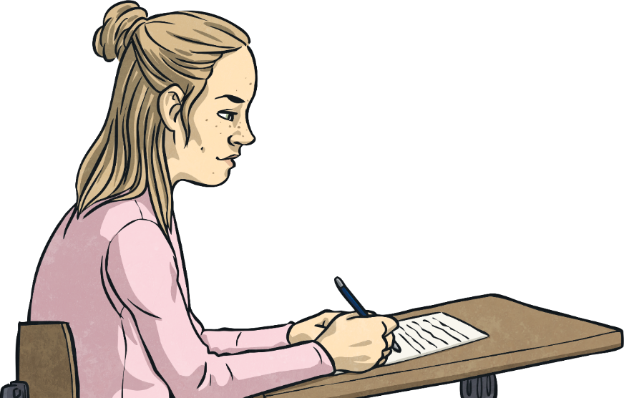
Your 10 Spelling Words for the ‘ou’ rule were...
young
trouble
country
double
touch
enough
rough
courage
cousin
tough
Do you remember them? If not, you need to try to remember them. I promise you that they will be good for your reading and writing!

Slide 11
Now remind ourselves of Rule 2
Words that contain a short /i/ sound but is spelt using a ‘y’
Can you remember any of the words that follow this spelling principle? If you can, say them out loud now…

Slide 12
Let’s watch the BBC Bite size clip again
https://www.bbc.co.uk/bitesize/topics/zt62mnb/articles/z3mktv4
So short 'i' is spelt with a ‘y’ in a few words such as…
gym
myth
pyramid
mystery
Egypt

Slide 13
Can you work out this word?
m g y

Slide 14
Answer is…
g y m

Slide 15
Can you work out this word?
y r p a d i m

Slide 16
Answer is…
p y r a m i d

Slide 17
Your 10 ‘y’ Spelling Words were…
mystery
symbol
system
typical
gym
myth
Egypt
pyramid
lyric
hymn
symptom

Slide 18

Your turn to do some spelling activities.
The short /u/ sound can also be written with the letters ‘ou’
Words that contain a short /i/ sound but is spelt using a ‘y’.
Pyramid write your 10 Focus ‘ou’ spelling words. You must write neatly!
Example:
t
to
tou
toug
tough
Then say the word out loud ‘tough’
Write each of your 11 Focus spelling words. Write each letter using a different coloured pencil or pen!
Example-
m y t h
Then say the word out loud ‘myth’

Slide 19
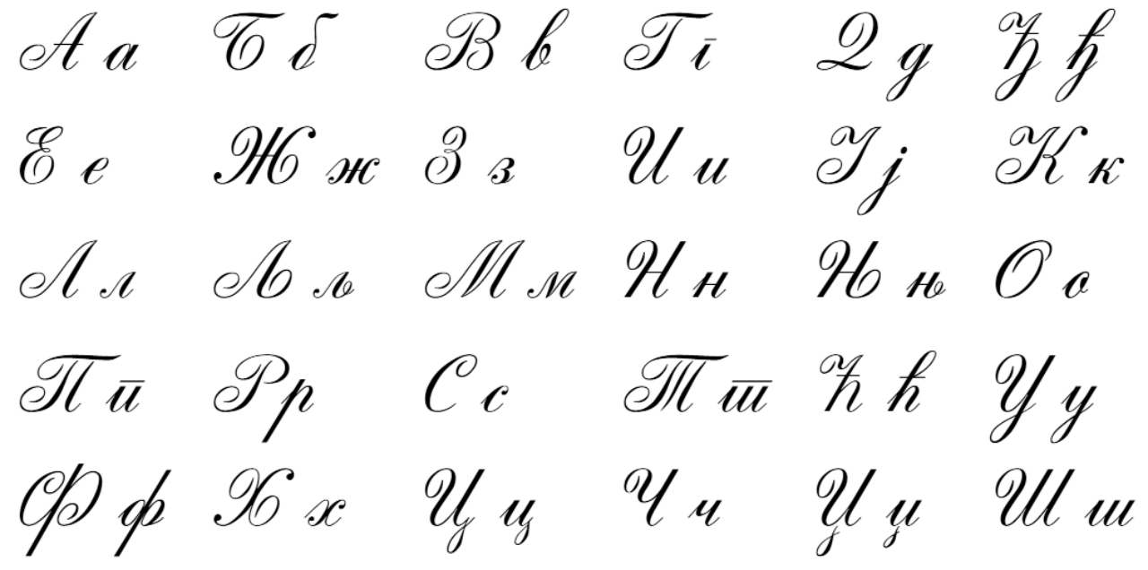
Your turn to do your handwriting task
On a sheet of paper, choose 6 tricky spelling words, three from each list and put them into a sentence so you can practise your handwriting as well as writing sentences that make sense.
young
trouble
country
double
touch
enough
rough
courage
cousin
tough
mystery
symbol
system
typical
gym
myth
Egypt
pyramid
lyric
hymn
symptom

Slide 20


