Slide 1
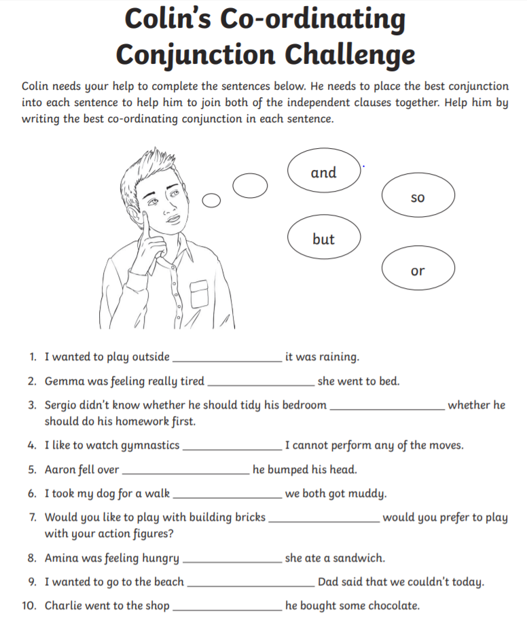

Day 1
Y3 English
5 a day

Slide 2
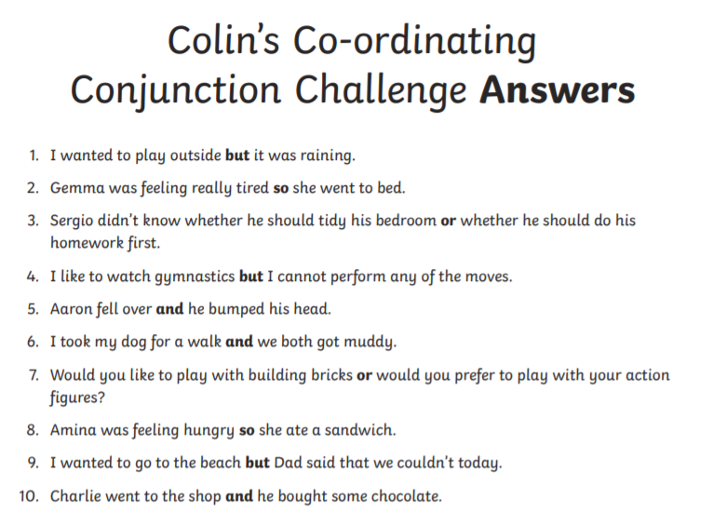
Day 2
ANSWERS
Y3 English
5 a day

Slide 3

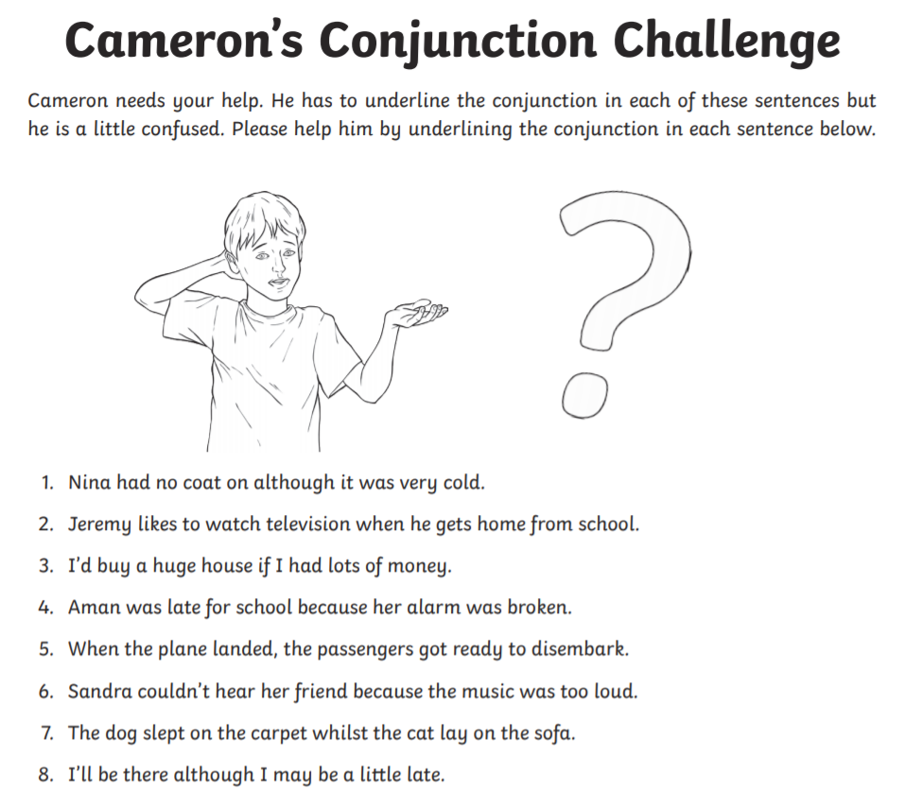
Day 2
Y3 English- 5 a day

Slide 4
Day 2
Y3 English- 5 a day
ANSWERS

Slide 5
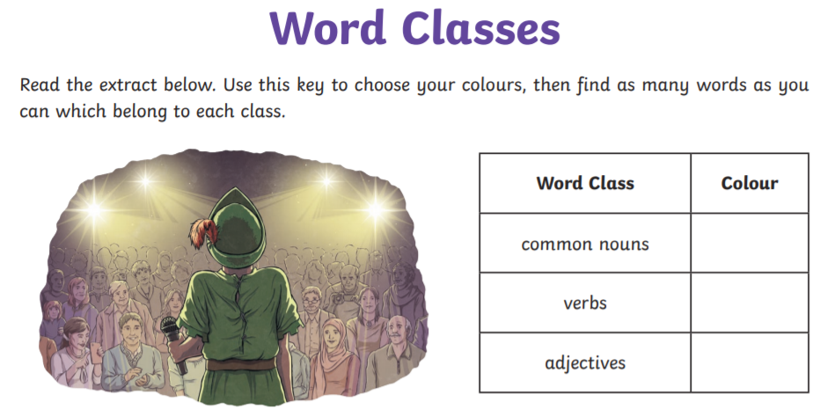
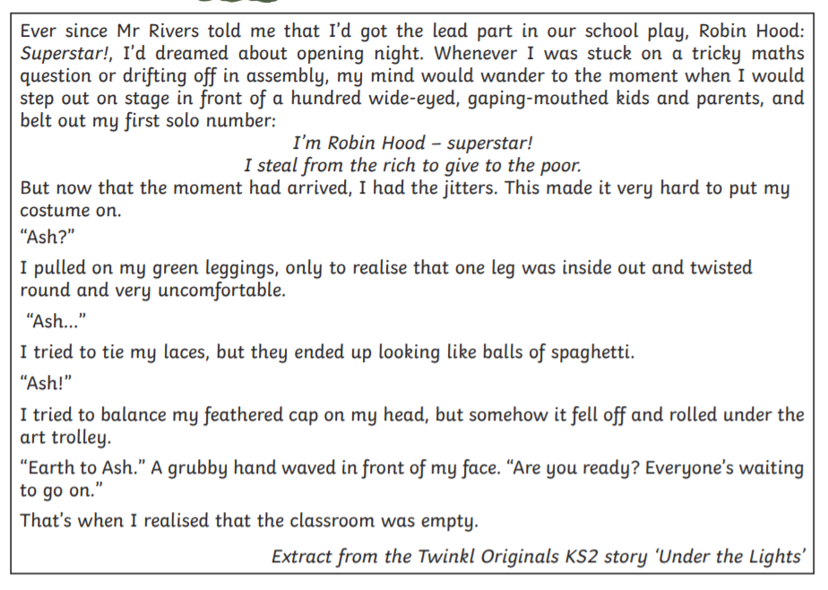
Day 3
Y3 English
5 a day

Slide 6
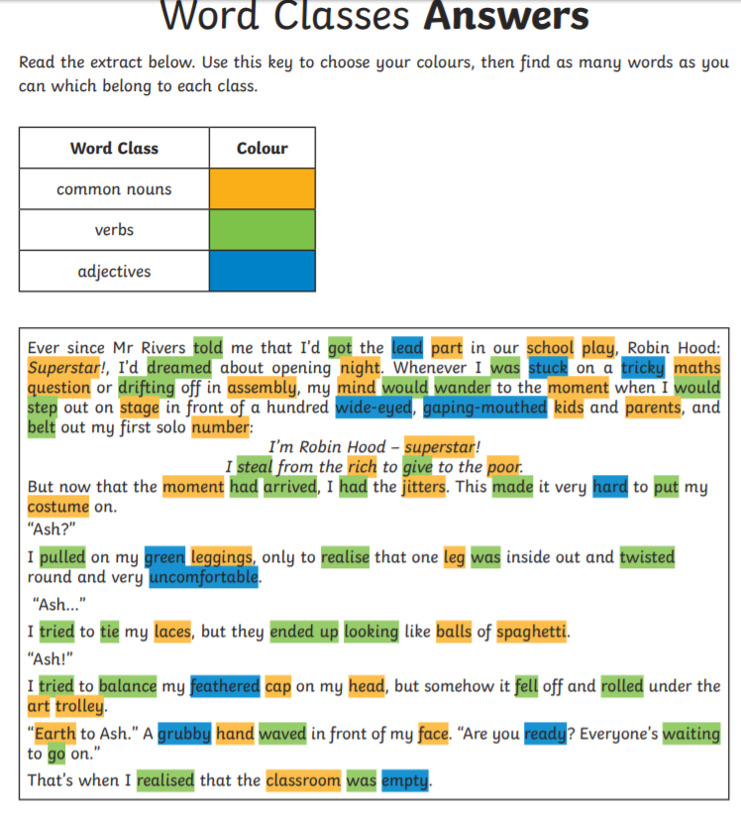
Day 3
ANSWERS
Y3 English
5 a day

Slide 7

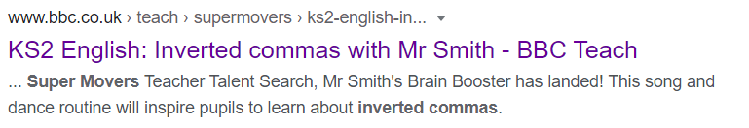
Day 4
Y3 English
5 a day
Watch the following video on inverted commas.
Click on the picture or use the link at the bottom.
https://www.bbc.co.uk/teach/supermovers/ks2-english-inverted-commas-with-mr-smith/z62rhbk
Google search = Super Moves Speech Marks

Slide 8
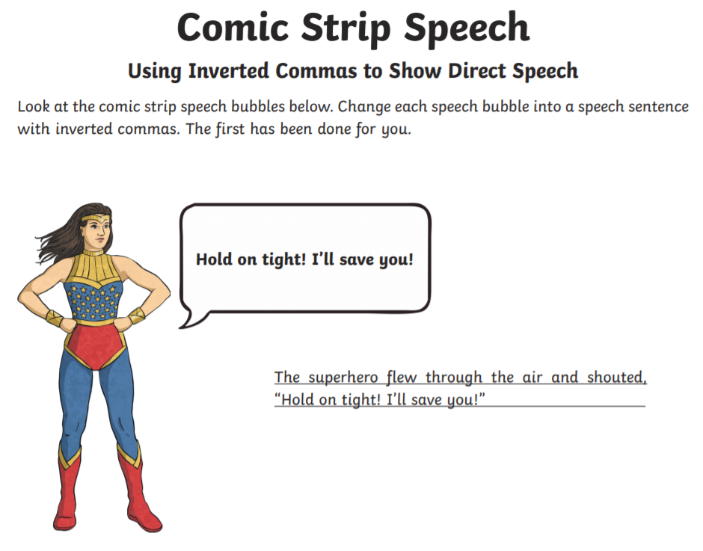
Day 5
Y3 English
5 a day
EXAMPLE

Slide 9
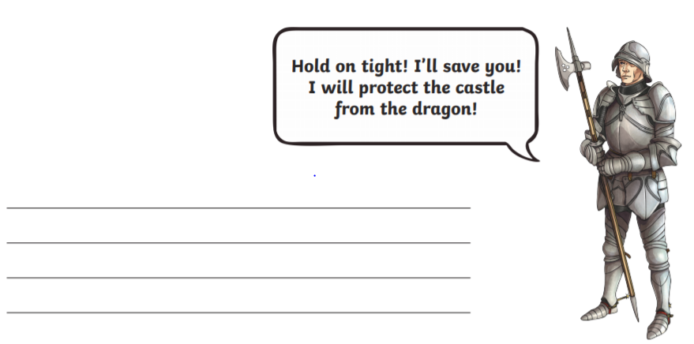
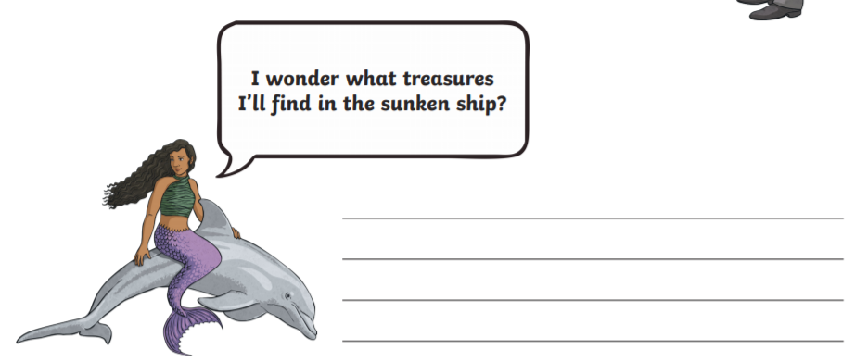
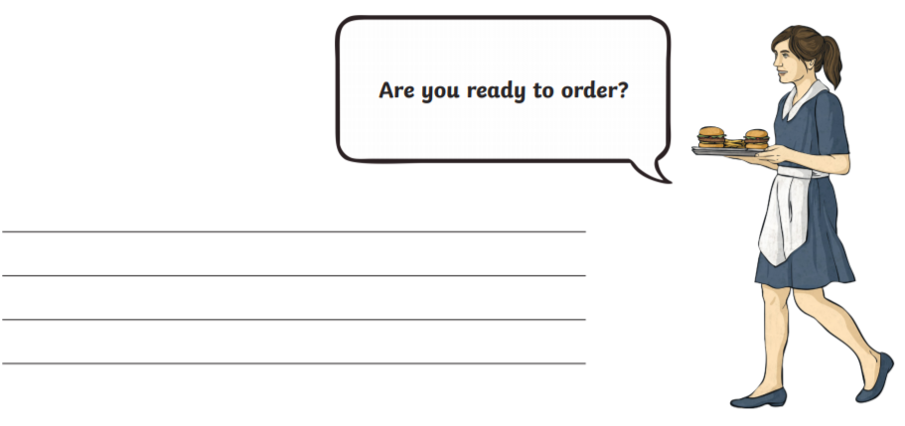
Day 5
Y3 English
5 a day

Slide 10
Day 5
ANSWERS
(synonyms for said may differ)
Y3 English
5 a day
“Hold on tight! I’ll save you! I will protect the castle from the dragon!” roared the knight.
“I wonder what treasures I’ll find in the sunken ship?” questioned the mermaid.
The waitress arrived at the table and asked, “Are you ready to order?”

Slide 11
Year 3
Writing in paragraphs
Part 2!
You will complete Task 1 which will revise how to writing in paragraphs.
Next you will complete Task 2 which will let you practise this skill.
Finally you will apply your knowledge by using the skill in a piece of writing for Task 3.

Slide 12
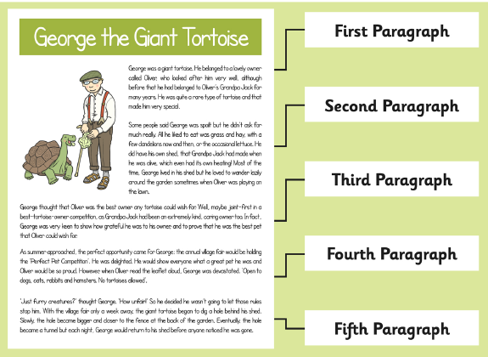
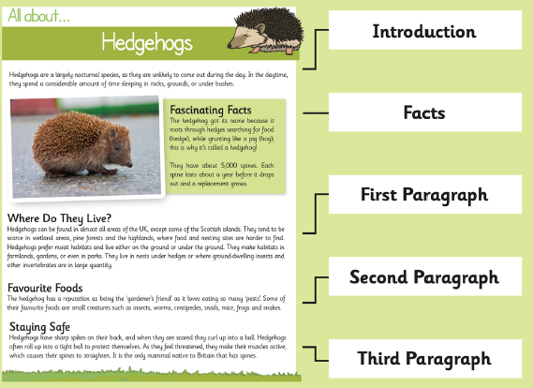
Year 3 Writing in paragraphs 2: Task 1
Remember!
What is a Paragraph?
A paragraph is a group of sentences within a piece of writing which is written about the same idea or topic.
Paragraphs are used to show when a writer has changed time, place or argument. When they do this, they will start a new paragraph.
In a non-fiction text, we usually see a subheading before each paragraph, telling us what it will be about.

Slide 13
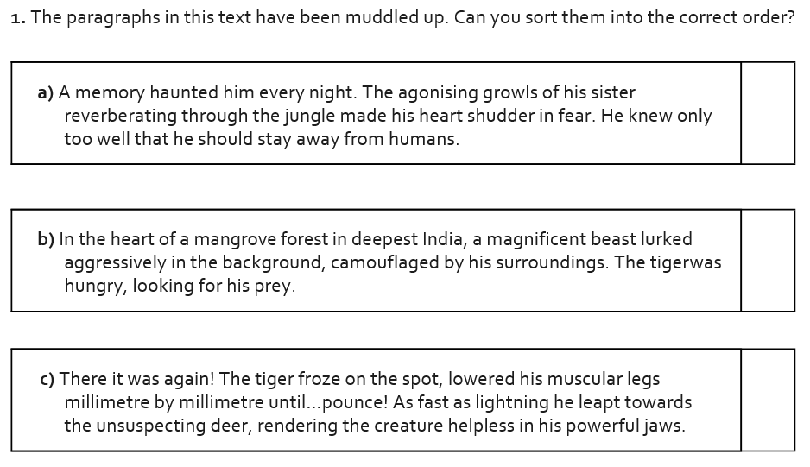
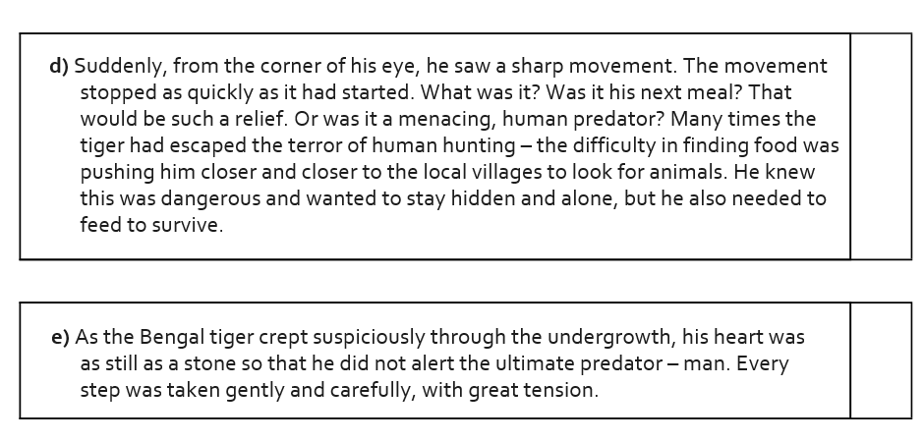
Year 3 Writing in paragraphs 2: Task 1

Slide 14

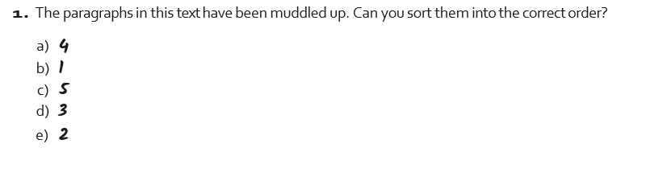
Year 3 Writing in paragraphs 2: Task 1

Slide 15
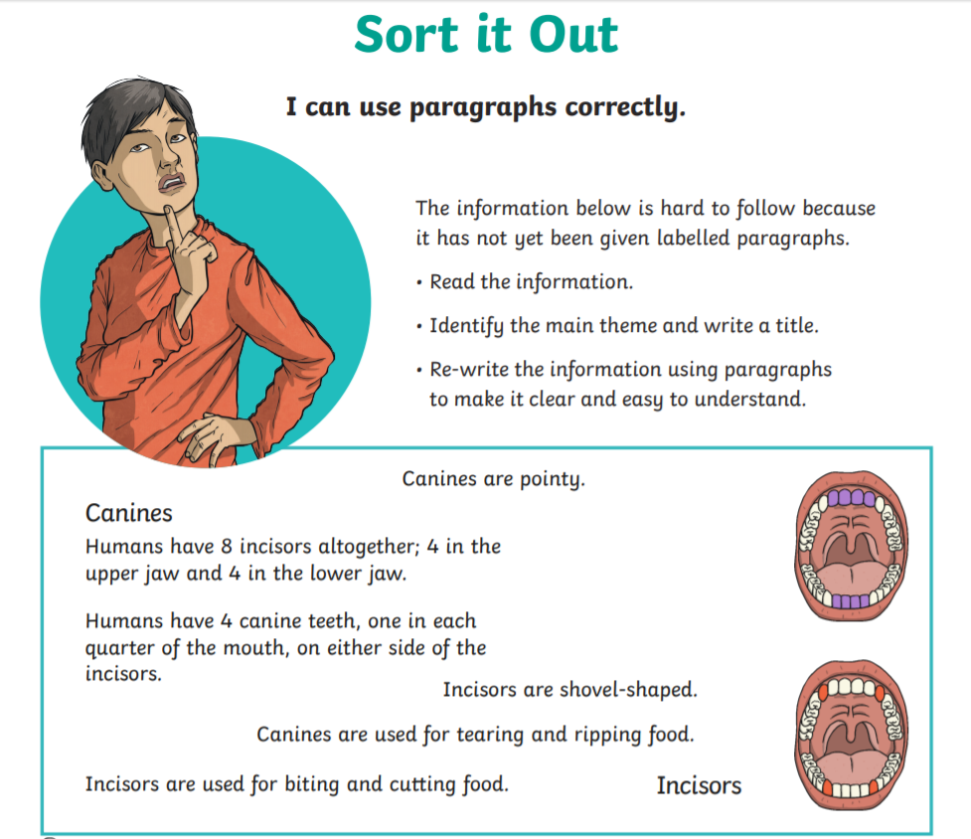
Year 3 Writing in paragraphs 2: Task 2

Slide 16

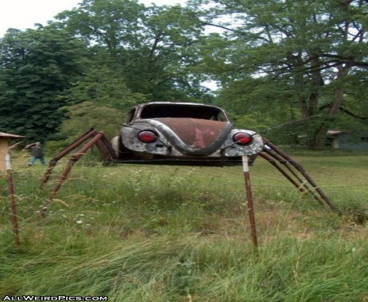

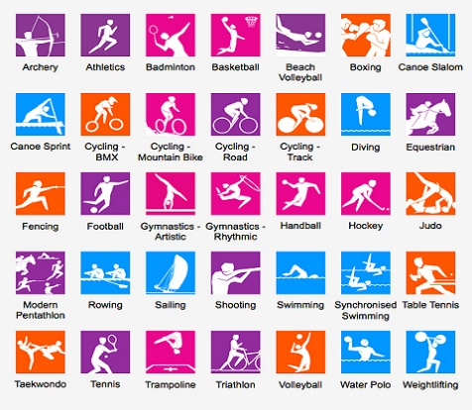
Year 3 Writing in paragraphs 2: Task 3
You must remember your
non-negotiables:
capital letters
full stops
commas in a list
neat handwriting, mostly joined
Last time you had one of these to choose from, this week select a different one to write about. You can choose whatever task you like but you must make sure you write in paragraphs. Try to write 3 paragraphs making sure that all the ideas link in one paragraph.
Task A
Task B
Task C
Task D
If you had one superpower, what would it be? Explain why you have chosen that superpower, what you would do with it, and how it would change your life?
A new type of car has just been invented: The Spider Car. Write about all the cool features of this car.
If you could change one rule at school, which rule would it be and what would you change it to? Why did you choose that rule? Why is your rule better than the old one?
Invent a new Olympic sport that would be fun to watch and play. What is it called and what type of sport is it? Describe the sport – who watches/plays? What are the rules?

