Slide 1


Welcome back to Year 4 Home Learning Spellings with Mrs Andrews

Slide 2


I hope you have had a good half term holiday. I did.
and now … it is time to do some spellings!

Slide 3

Every Week
I will send you:
a Power Point which will be linked to your Year 4 main focus words and spelling principle.
1 task worksheet (with an answer sheet if appropriate) AND
If possible on a PC, tablet or smart phone, an on-line task such as spellingframe.co.uk/spelling-rule OR another task.
If at all possible, please do both tasks because the more you do, the better you will become at spelling, reading and writing!

Slide 4

All of your spelling words for this week and the last week before the half term holiday, focus on two letter patterns that usually appear at the end of words. Both have similar patterns.
‘gue’
‘gue’ makes a /g/ sound but is spelt ‘gue’
E.G. fatigue
‘que’
‘que’ makes a /k/ sound but is spelt ‘que’
E.G. antique

Slide 5

From last time, can you think of any words which end with ‘gue’ or ‘que’?
Tell your adult or write them down (apart from antique and fatigue).

Slide 6
How many can you think of?
league technique
tongue antique
fatigue unique
vague cheque
plague mosque
dialogue
catalogue

Slide 7

This is the Squeeze O-Matic 17. It squeezes letters together which makes a word. Can you work out the word? Can you work with an adult or partner to figure out what they might be? Don’t forget that they’ll all have either a ‘que’ (/k/ sound) or a ‘gue’ (/g/ sound).
n
u
i
q
e
u

Slide 8

Answer is …
unique
Only one of its kind.

Slide 9

Don’t forget that they’ll all have either a ‘que’ (/k/ sound) or a ‘gue’ (/g/ sound).
i
e
a
f
g
u
t

Slide 10
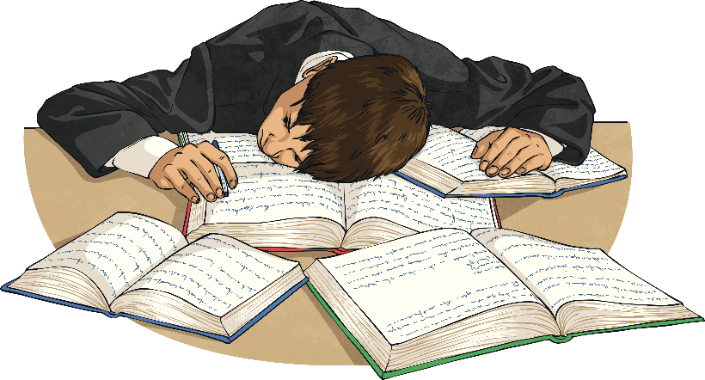

Answer is …
fatigue
Very tired

Slide 11

Don’t forget that they’ll all have either a ‘que’ (/k/ sound) or a ‘gue’ (/g/ sound).
t
u
n
e
g
o

Slide 12

Answer is … tongue
tongue

Slide 13

Your Focus Words. Say them out loud.
league
tongue
fatigue
vague
plague
dialogue
mosque
technique
antique
unique

Slide 14
Can you remember what these words mean?
league = A group of clubs which play each other in a championship.
tongue = The red fleshy organ in the mouth used for tasting and eating.
fatigue = Very tired.
vague = Unclear
plague = A horrible disease
dialogue = To talk between two people.
mosque = A building of worship for Muslims
technique = A way of carrying a particular task like a skill.
antique = A collectable object or art that has a high value.
unique = Only one of its kind. You are all unique!

Slide 15

Your Turn
Scrambled Words
On-line Task: Spelling Frame
Fold a piece of paper three times lengthwise (making three long rectangular columns). Write your words in the first column.
Then write them again with the letters all mixed up (scrambled) in the second column.
Put your words aside. Come back later to unscramble your words. Write the unscrambled words in the third column. Check them against the words in your first column.
Use the words in your focus list.
Either, cut and paste this link into your browser
https://spellingframe.co.uk/spelling-rule/20/17-Words-ending-with-the-g-sound-spelt%E2%80%93gue-and-the-k-sound-spelt-%E2%80%93que-(French-in-origin)
OR
Go onto your browser
Type in Spelling Frame
Select Year 3 and 4
Select Rule 17 ‘gue’ and ‘que’
Select Spelling Tiles
Select Sorting Puzzle and Segment Silhouette. If you have time, do the free game.

Slide 16


