Slide 1
Year 4 Maths
Calculating the perimeter of rectilinear shapes

Slide 2
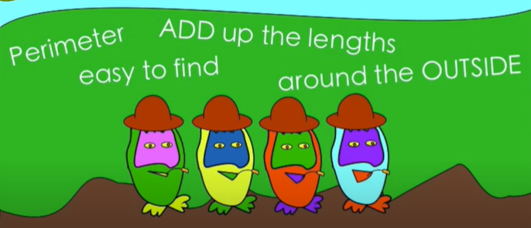
What is the perimeter of a shape?
Day 1
Click this link for a funky song!

Slide 3
So, how do you find the perimeter?
Day 1
You add up the lengths around the outside of the shape!
4cm
So, to find the perimeter of this square, I would need to add up the lengths of all of the sides.
4cm + 4cm + 4cm + 4cm = 16cm
4cm
4cm
4cm

Slide 4
Can you find the perimeter of these shapes*?
Day 1
7 cm
2 cm
6 cm
4 cm
4 cm
6 cm
6 cm
7 cm
10 cm
10 cm
6 cm
2 cm
*not drawn to scale!

Slide 5
Can you find the perimeter of these shapes?
Day 1
7 cm
2 cm
6 cm
4 cm
4 cm
6 cm
6 cm
7 cm
10 cm
10 cm
7 + 7 + 4 + 4 = 22cm
6 cm
6 + 6 + 6 + 6 = 24cm
2 cm
10 + 10 + 2 + 2 = 24cm

Slide 6
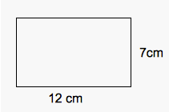

Sometimes all of the lengths aren’t marked on the shape.
?
How can our previous maths learning help us here?
?

Slide 7
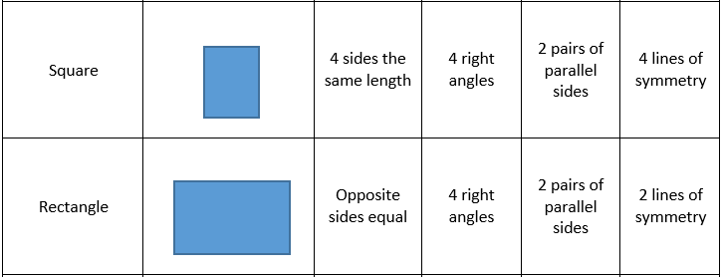
Day 1
?
Using this list of properties of 2D shapes, I can work out the missing sides before I add them together to find the perimeter!
?

Slide 8
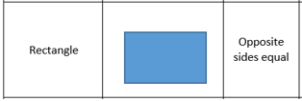
Day 1
So, I know the missing sides are the same length as it’s opposite side! Now I can find my answer!
12 + 12 + 7 + 7 = 38cm
12cm
7cm
Now have a go at Day 1 tasks!

Slide 9

Day 2
If you can, warm up your brain and remind yourself about Perimeter – click the link below and it will take you to a BBC Bitesize page all about perimeter. Scroll down to activity 2 and take the quiz!

Slide 10
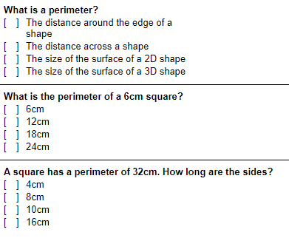
Quick Quiz!
Day 2

Slide 11
Quick Quiz Answers!
Day 2
X
X
X

Slide 12
Day 2
In our last lesson, we were working out the perimeter of rectangles and squares, using our knowledge of properties of 2D shapes.
In this lesson, we are going to practise working out the perimeter of shapes made up of more than 1 rectangle.

Slide 13
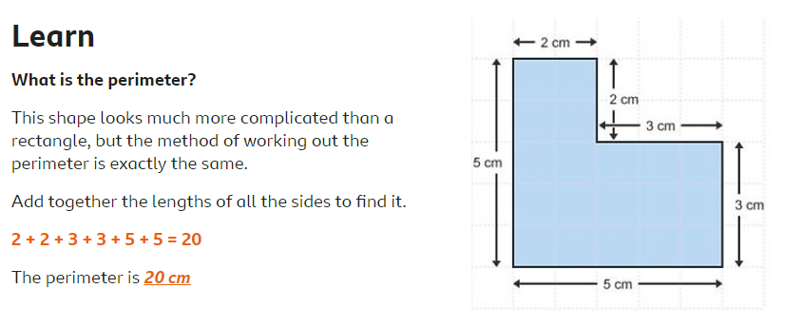
Day 2

Slide 14
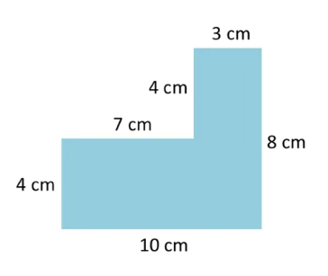
Day 2
Can you calculate the perimeter of this shape?

Slide 15
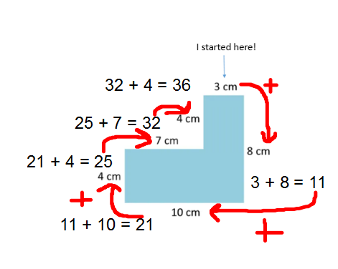
Day 2
How did I get my answer?
Step 1 – I chose a starting point and added the first 2 sides together (I always go clockwise!)
3 + 8 = 11
Step 2 – I then took the answer from step 1 and added the next side
11 + 10 = 21
Step 3 - I took the answer from step 2 and
added the next side
21 + 4 = 25
Step 4 – I continued until I had added all of the sides.
25 + 7 = 32
32 + 4 = 36
Answer = 36cm

Slide 16
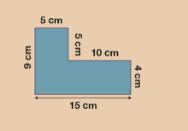
Day 2
Can you find the perimeter of this rectilinear shape?

Slide 17
Day 2
Can you find the perimeter of this rectilinear shape?
I started here!
5 + 5 = 10
10 + 10 = 20
20 + 4 = 24
24 + 15 = 39
39 + 9 = 48
Answer = 48cm

Slide 18

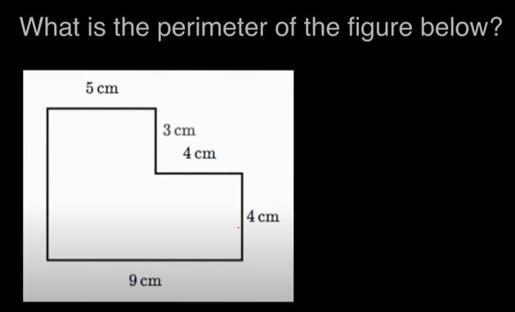
Day 2
Sometimes, you are asked to find the perimeter of a rectilinear shape but not all the sides are labelled.
?
Watch this video for a step-by-step instruction of how to find the missing side and then the whole perimeter.

Slide 19
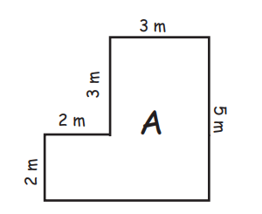
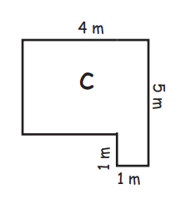
Day 2
Can you find the perimeter of these shapes?

Slide 20
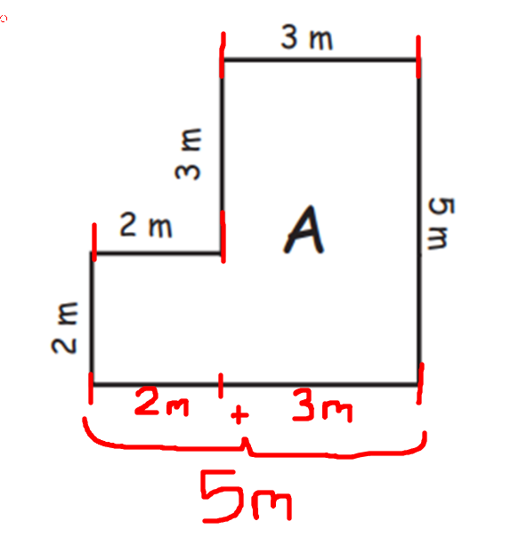
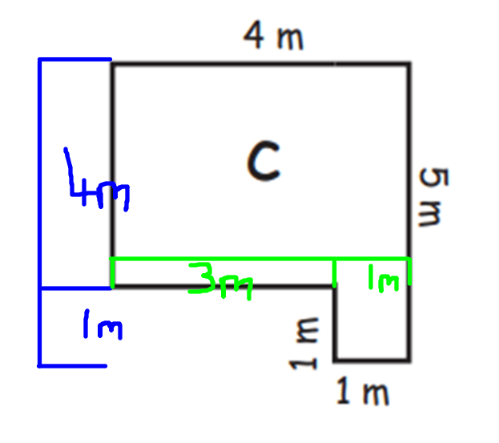
Day 2
Answers
I started here!
I started here!
3 + 5 = 8
8 + 5 = 13
13 + 2 = 15
15 + 2 = 17
17 + 3 = 20
Answer = 20m
4 + 5 = 9
9 + 1 = 10
10 + 1 = 11
11 + 3 = 14
14 + 4 = 18
Answer = 18m
Now have a go at Day 2 tasks!

Slide 21
Day 3
Have a go at the Day 3 questions – make sure you read them carefully!
If you fancy an extra challenge, have a go at the final question on the sheet!

