Slide 1


Welcome back to Year 4 Home Learning Spellings with Mrs Andrews

Slide 2


I hope you have had a good week
and now … it is time to do some spellings!

Slide 3

Every Week
I will send you:
a Power Point which will be linked to your Year 4 main focus words and spelling principle.
1 task worksheet (with an answer sheet if appropriate) AND
If possible on a PC, tablet or smart phone, an on-line task such as spellingframe.co.uk/spelling-rule OR another task.
If at all possible, please do both tasks because the more you do, the better you will become at spelling, reading and writing!

Slide 4

All of your spelling words for this week and next week, focus on two letter patterns that usually appear at the end of words. Both have similar patterns.
‘gue’
‘gue’ makes a /g/ sound but is spelt ‘gue’
E.G. fatigue
‘que’
‘que’ makes a /k/ sound but is spelt ‘que’
E.G. antique

Slide 5

Can you think of any words which end with ‘gue’ or ‘que’?
Tell your adult or write them down (apart from antique and fatigue).

Slide 6
How many can you think of?
league technique
tongue antique
fatigue unique
vague cheque
plague mosque
dialogue
catalogue
As you can see there are a few more ‘gue’ words than ‘que’ words! Can you say these words out loud?

Slide 7
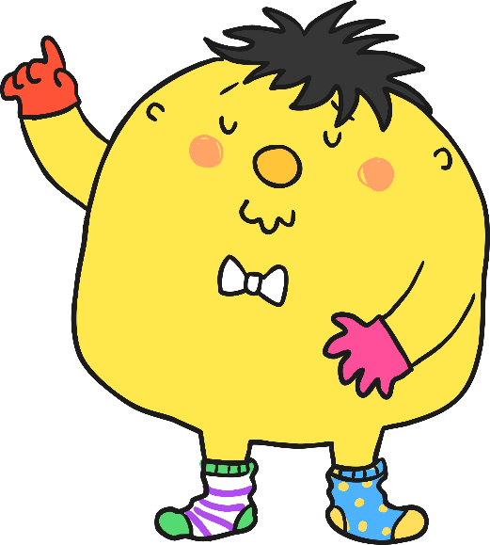
Mr Whoops has been juggling with some of your spelling words for this week. Can you work with an adult or partner to figure out what they might be? Don’t forget that they’ll all have either a ‘que’ (/k/ sound) or a ‘gue’ (/g/ sound).
g
o
r
e
u

Slide 8
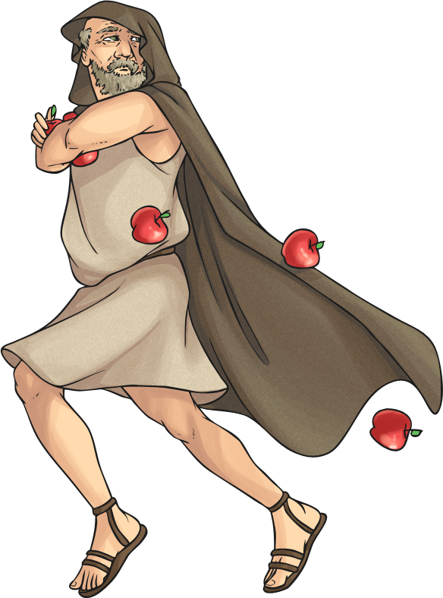

Answer is … rogue

Slide 9
Don’t forget that they’ll all have either a ‘que’ (/k/ sound) or a ‘gue’ (/g/ sound).
g
e
l
a
e
u

Slide 10


Answer is … league…

Slide 11
Don’t forget that they’ll all have either a ‘que’ (/k/ sound) or a ‘gue’ (/g/ sound).
q
e
m
u
s
o

Slide 12
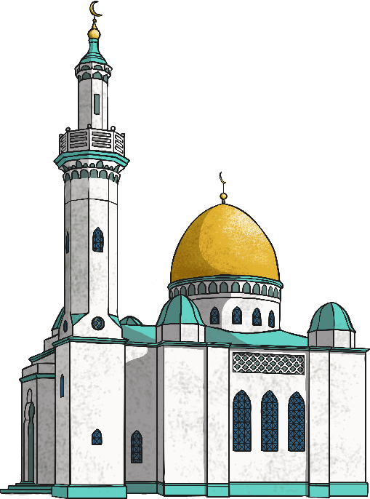
Answer is … mosque

Slide 13
Don’t forget that they’ll all have either a ‘que’ (/k/ sound) or a ‘gue’ (/g/ sound).
n
q
e
a
t
u
i

Slide 14
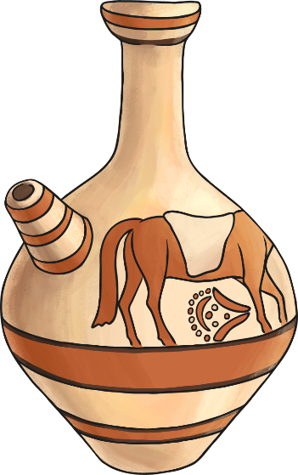
Answer is … antique

Slide 15

Your Focus Words. Say them out loud.
league
tongue
fatigue
vague
plague
dialogue
mosque
technique
antique
unique

Slide 16

What do these words mean? Talk to an adult about their meanings.
league
tongue
fatigue
vague
plague
dialogue
mosque
technique
antique
unique

Slide 17
These words mean…
league = A group of clubs which play each other in a championship.
tongue = The red fleshy organ in the mouth used for tasting and eating.
fatigue = Very tired.
vague = Unclear
plague = A horrible disease
dialogue = To talk between two people.
mosque = A building of worship for Muslims
technique = A way of carrying a particular task like a skill.
antique = A collectable object or art that has a high value.
unique = Only one of its kind. You are all unique!

Slide 18

Your Turn
Letter Tile Spellings
On-line Task: Spelling Frame
I have been playing lots of on-line scramble so I thought you can too.
Use the letter tile scores to find out which of your ‘gue’ and ‘que’ words would score the most points.
The answer sheet is attached.
Either, cut and paste this link into your browser
https://spellingframe.co.uk/spelling-rule/20/17-Words-ending-with-the-g-sound-spelt%E2%80%93gue-and-the-k-sound-spelt-%E2%80%93que-(French-in-origin)
OR
Go onto your browser
Type in Spelling Frame
Select Year 3 and 4
Select Rule 17 ‘gue’ and ‘que’
Select Spelling Tiles
Select Puzzle Segment and the Word Search

Slide 19


