Slide 1

Day 1
Maths- 5 a day
724 + 118 =
How many days are there in September?
155 - 27 =
How many corners do 5 pentagons have altogether?
Complete the number sequence
48, 44, 40, __, __

Slide 2
Day 1 ANSWERS
Maths- 5 a day
724 + 118 = 842
How many days are there in September? 30 days
155 - 27 = 128
How many corners do 5 pentagons have altogether? 25
Complete the number sequence
48, 44, 40, 36, 32

Slide 3
Day 2
Maths- 5 a day
565 + 78 =
9 + 5 + 4 =
Complete the part part whole.
Put these numbers in ascending order.
12, 121, 21, 112, 211
5. What month comes before September?
600
30
2

Slide 4
Day 2 ANSWERS
Maths- 5 a day
565 + 78 = 643
9 + 5 + 4 = 18
Complete the part part whole.
Put these numbers in ascending order.
12, 21, 112, 121, 211
5. What month comes before September? August
632
600
30
2

Slide 5
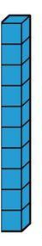

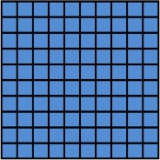
Day 3
Maths- 5 a day
333 + 78 =
What is 10 less than 407?
What number is represented by the dienes?
21 ÷ 3 =
How many days are there in a leap year?

Slide 6
Day 3 ANSWERS
Maths- 5 a day
333 + 78 = 411
What is 10 less than 407? 397
What number is represented by the dienes? 317
21 ÷ 3 = 7
How many days are there in a leap year? 366

Slide 7
Day 4
Maths- 5 a day
525 + 291 =
111 - 68 =
Use =<> to make the sentence true. The number of seconds in a minute ___ the number of minutes in an hour.
How many right angles can you find in this shape?
Complete the number sequence..
60, 55, 50, __, __

Slide 8
Day 4 ANSWERS
Maths- 5 a day
525 + 291 = 816
111 - 68 = 43
Use =<> to make the sentence true. The number of seconds in a minute = the number of minutes in an hour.
How many right angles can you find in this shape? 0
Complete the number sequence..
60, 55, 50, 45, 40

Slide 9
Day 5
Maths- 5 a day
284 + 222 =
183 - 156 =
Complete the part-part whole.
Complete the number sequence.
1, 4, 7, __, __
Which month of the year has the least days?
894
90

Slide 10
Day 5
Maths- 5 a day
284 + 222 = 506
183 - 156 = 27
Complete the part-part whole.
Complete the number sequence.
1, 4, 7, 10, 13
Which month of the year has the least days? February
894
800
90
4

Slide 11
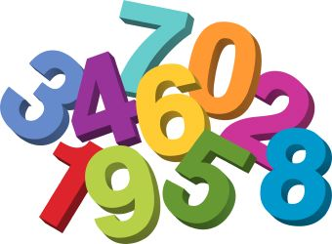
TLHT add 3 digit numbers using the formal written method
Week 6 task 1

Slide 12
This week we will be revising adding using the formal written method.
Remember to use the formal written method to solve every addition.
(Also remember you can draw place value discs to help you if you need to)
We look forward to seeing all your hard work!

Slide 13
TLHT add 3 digit numbers using the formal written method
Glossary
Addition – joining two or more amounts together
Digit- the symbols 0,1,2,3,4,5,6,7,8,9 that can be used to make numbers
Place value column – the position of a digit in a number showing its value.
Exchange and rename – swapping equal values from different place value columns e.g 10 ones become 1 ten.

Slide 14
TLHT add 3 digit numbers using the formal written method
This is how we set out formal written addition.
234 + 105 = 339
The first number in the addition goes above the second.
H
T
O
Put the digits of the two numbers you are adding in the correct place value column.
2
3
4
+
1
0
5
3
3
9
The answer goes between the two lines underneath.
You must write the addition symbol to the left of the second number.

Slide 15
TLHT add 3 digit numbers using the formal written method
To use the written method we add one column at a time starting with the lowest value column.
Step 1
Step 2
Step 3
H
T
O
H
T
O
H
T
O
2
3
4
2
3
4
2
3
4
+
+
+
+
1
0
5
+
1
0
5
+
1
0
5
9
3
9
3
3
9

Slide 16
TLHT add 3 digit numbers using the formal written method
Solve these three addition calculations. Make sure you start in the lowest place value column.
H
T
O
H
T
O
H
T
O
3
2
2
7
0
3
5
7
0
+
1
4
2
+
2
6
2
+
3
1
9

Slide 17
TLHT add 3 digit numbers using the formal written method
Solve these three addition calculations. Make sure you start in the lowest place value column. ANSWERS
H
T
O
H
T
O
H
T
O
3
2
2
7
0
3
5
7
0
+
1
4
2
+
2
6
2
+
3
1
9
4
6
4
9
6
5
8
8
9

Slide 18
TLHT add 3 digit numbers using the formal written method
Sometimes, when using the written method, the digits in one place value column add together to make more than 9. You cannot have more than 9 in one place value column. Instead you will have to exchange and rename into the next column.
H
T
O
H
T
O
H
T
O
1
2
5
1
2
5
1
2
5
+
1
6
+
1
6
+
1
6
1
4
1
1
4
1
1
1
1
5+6 = 11 so you write the 1 one in the ones column and the 1 ten under the tens column.
2 + 1 = 3 but you have to add the extra ten that has been exchanged and renamed to make 4. Cross out the exchanged digit to show that you have added it.
There is only 1 hundred so we don’t have to add anything. Just write the hundred in the answer.

Slide 19
TLHT add 3 digit numbers using the formal written method
Sometimes, when using the written method, the digits in one place value column add together to make more than 9. You cannot have more than 9 in one place value column. Instead you will have to exchange and rename into the next column.
H
T
O
H
T
O
H
T
O
2
2
6
1
5
2
3
2
5
+
2
7
+
1
1
8
+
9
1

Slide 20
TLHT add 3 digit numbers using the formal written method
Sometimes, when using the written method, the digits in one place value column add together to make more than 9. You cannot have more than 9 in one place value column. Instead you will have to exchange and rename into the next column. ANSWERS
H
T
O
H
T
O
H
T
O
2
2
6
1
5
2
3
2
5
+
2
7
+
1
1
8
+
9
1
2
5
3
2
7
0
4
1
6
1
1
1

Slide 21
TLHT add 3 digit numbers using the formal written method
Sometimes, you will need to exchange and rename more than once when adding two three digit numbers.
H
T
O
H
T
O
H
T
O
1
8
9
1
8
9
1
8
9
+
4
1
6
+
4
1
6
+
4
1
6
5
0
5
6
0
5
1
1
1
1
1
This ten, added to the 8 and the 1 to makes 10 tens which become 1 hundred.

Slide 22
TLHT add 3 digit numbers using the formal written method
Solve these addition calculations. Remember each one will have two lots of exchanging and renaming.
H
T
O
H
T
O
H
T
O
2
9
5
3
3
5
1
0
9
+
4
2
5
+
1
7
6
+
6
9
3

Slide 23
TLHT add 3 digit numbers using the formal written method
Solve these addition calculations. Remember each one will have two lots of exchanging and renaming. ANSWERS
H
T
O
H
T
O
H
T
O
2
9
5
3
3
5
1
0
9
+
4
2
5
+
1
7
6
+
6
9
3
7
2
0
5
1
1
8
0
2
1
1
1
1
1
1

Slide 24
Week 6 task 2
TLHT add 3 digit numbers using the formal written method

Slide 25
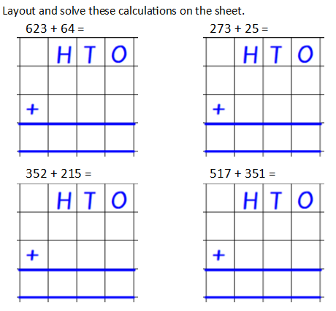
TLHT add 3 digit numbers using the formal written method

Slide 26
TLHT add 3 digit numbers using the formal written method
6
2
3
2
7
3
6
4
2
5
6
8
7
2
9
8
3
5
2
5
1
7
2
1
5
3
5
1
5
6
7
8
6
8

Slide 27
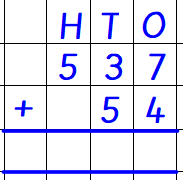
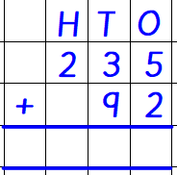
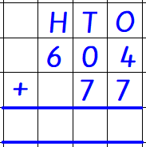
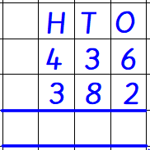
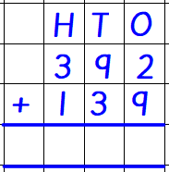
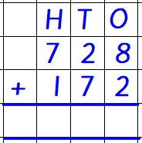
TLHT add 3 digit numbers using the formal written method
Solve these written addition calculations.

Slide 28
TLHT add 3 digit numbers using the formal written method
Solve these written addition calculations.
5
9
1
3
2
7
6
8
1
1
1
1
8
1
8
5
3
1
9
0
0
1
1
1
1
1

Slide 29
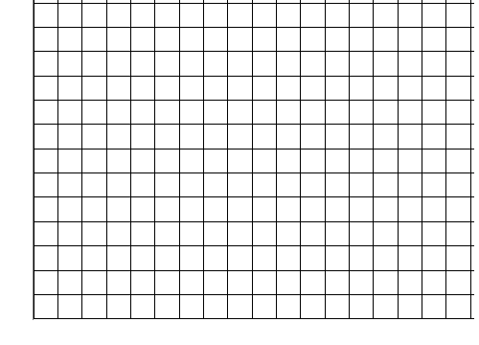
TLHT add 3 digit numbers using the formal written method
Solve these additions using the formal written method.
1. 274 + 16 =
2. 516 + 55 =
3. 445 + 182 =
4. 624 + 284 =
5. 321 + 299 =

Slide 30
TLHT add 3 digit numbers using the formal written method
Solve these additions using the formal written method. ANSWERS
1. 274 + 16 = 290
2. 516 + 55 = 571
3. 445 + 182 = 627
4. 624 + 284 = 908
5. 321 + 299 = 620

Slide 31
Week 6 task 3
TLHT add 3 digit numbers using the formal written method

Slide 32
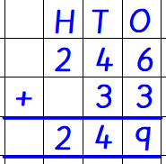
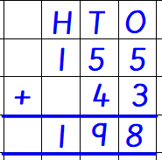
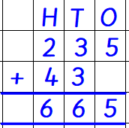
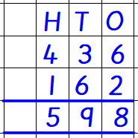
TLHT add 3 digit numbers using the formal written method
You are the teacher!
Check if these calculations are correct.
Put a tick or a cross in the box next to them.

Slide 33

TLHT add 3 digit numbers using the formal written method
ANSWERS
You are the teacher!
Check if these calculations are correct.
Put a tick or a cross in the box next to them.

Slide 34
TLHT add 3 digit numbers using the formal written method
Can you use the digits 1,2,3 and 4 only once to make this addition correct?
T
O
+
8
7

Slide 35
TLHT add 3 digit numbers using the formal written method
Can you use the digits 1,2,3 and 4 only once to make this addition correct?
(Exchange and rename digits do not count)
T
O
2
3
+
4
8
7
1
1

Slide 36
TLHT add 3 digit numbers using the formal written method
Dan has been learning to add using the formal written method.
He has made some mistakes. Can you explain to him what he has done wrong?
H
T
O
4
2
9
+
1
3
2
5
5
1

Slide 37
TLHT add 3 digit numbers using the formal written method
Dan has been learning to add using the formal written method.
He has made some mistakes. Can you explain to him what he has done wrong?
H
T
O
4
2
9
+
1
3
2
5
5
1
Dan has written the addition symbol on the wrong side of the calculation and he has not written the exchange and renamed 10 in the tens column and so has got 5 tens not 6 tens. The answer should be 561.

