Slide 1

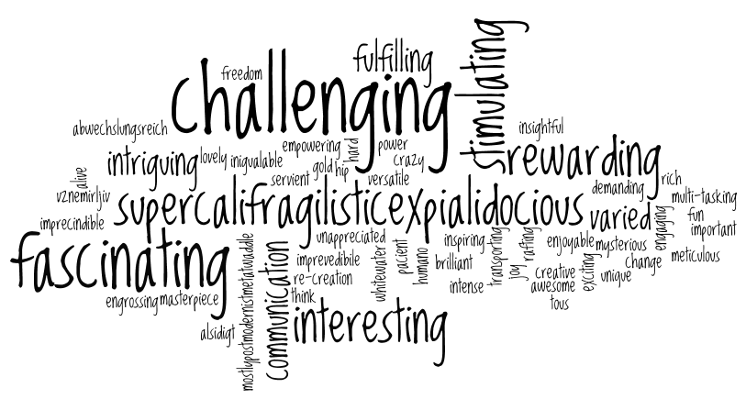
Welcome back to Home Learning Spellings with Mrs Andrews

Slide 2


I hope you have had a good week
and now … it is time to do some spellings!

Slide 3

Every Week
I will be sending you:
a Power Point which will be linked to your Year 3 main focus words and spelling principle,
1 task worksheet and / or
An on-line task such as Spelling Frame. I will direct you to the correct web page. Remember the main website we use is spellingframe.co.uk/spelling-rule
You should do a minimum of 1 spelling task per week but you can do both if you wish.
AND you must do the handwriting task in which you will be asked to choose 5 tricky spelling words and put them into a sentence so you can practise your handwriting as well as writing sentences that make sense.

Slide 4
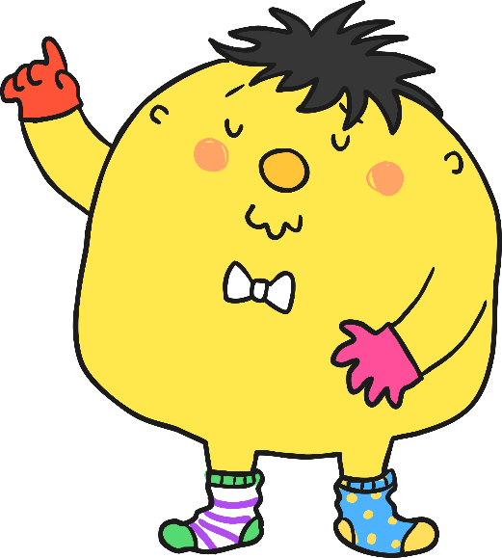
This week, we are going to look at a new spelling principle.
What are the 2 missing letters in these words? Tell your adult or write them down.
enough
young
touch
double
trouble

Slide 5

Answer
enough
young
touch
double
trouble
Now can you say these words out loud.

Slide 6

Our New Spelling Principle
enough, young, touch, double, trouble.
Q) What sound does the ‘ou’ make?
It makes a short ‘u’ sound
(Some people say ‘uh’ sound but I think it is more of a short ‘u’ sound).
So our spelling rule is that the short /u/ sound can also be written with the letters ‘ou’
Top Tip: So you need to be careful when you are reading that you make the correct sounds for the words.

Slide 7
Let’s watch the BBC Bitesize clip
https://www.bbc.co.uk/bitesize/topics/zt62mnb/articles/zyq7v9q
The ‘u’ sound which is spelt ‘ou’ is in words such as…
country
cousin
courage
touch
Can you think of any more? Tell your adult about any more words that follow this rule or write the words down.

Slide 8

This is the Squeeze O-Matic 17. It squeezes letters together which makes a word. Can you work out the word?
o g h u r

Slide 9
Answer…
rough

Slide 10
Can you work out this word?
n u o c t y r

Slide 11
Answer…
country

Slide 12
Can you work out this word?
gyonu

Slide 13
Answer…
young

Slide 14

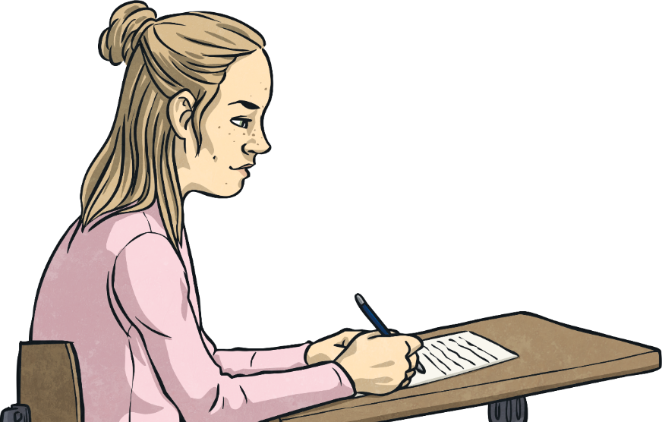
Your 10 Spelling Words
young
trouble
country
double
touch
enough
rough
courage
cousin
tough
Q) What do these words mean?

Slide 15
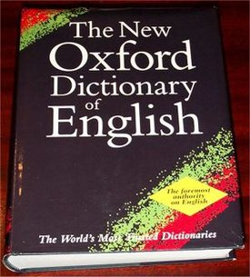
Can you work out what these words mean by reading these sentences? Talk to your adult about them.
young = The classroom was filled with young children.
trouble = Please do not get into trouble on the playground.
country = Our country is Great Britain.
double = Double click to open the computer document.
touch = Do not touch the objects on display.
enough = Three eggs will be enough for the recipe.
rough = The path was rough and rocky. I nearly fell over!
courage = I admire her courage. She was brave.
cousin = My cousin is coming to stay for Christmas.
tough = This meat is too tough. I cannot chew it!

Slide 16


Your turn to do some spelling activities.
Word Search
Spelling Frame
Complete the word search on your focus words.
The answer sheet is attached.
1. Spelling Frame
Copy and paste this link
https://spellingframe.co.uk/spelling-rule/10/3-The-sound-spelt-ou
OR
Write Spelling Frame into your browser
Select Year 3 AND 4, Rule 3 (sound spelt ou)
Select Segment Puzzle and try the free spelling game.

Slide 17
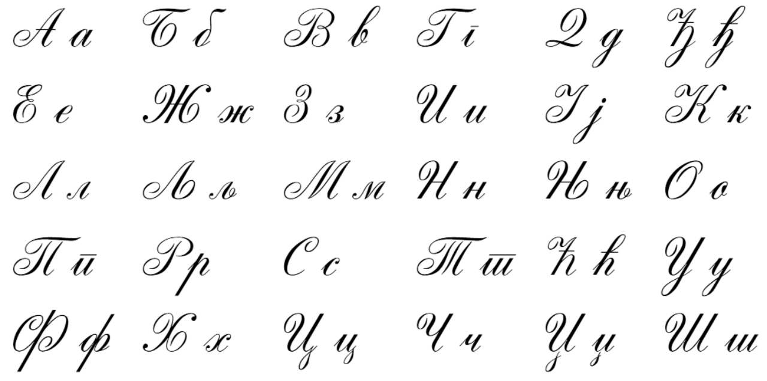
Your turn to do your handwriting task
On a sheet of paper, choose 5 tricky spelling words and put them into a sentence so you can practise your handwriting as well as writing sentences that make sense.
young
trouble
country
double
touch
enough
rough
courage
cousin
tough

Slide 18


