Slide 1


Welcome back to Year 4 Home Learning Spellings with Mrs Andrews

Slide 2


I hope you have had a good week
and now … it is time to do some spellings!

Slide 3

Every Week
I will send you:
a Power Point which will be linked to your Year 4 main focus words and spelling principle.
1 task worksheet (with an answer sheet if appropriate) AND
If possible on a PC, tablet or smart phone, an on-line task such as spellingframe.co.uk/spelling-rule OR another task.
If at all possible, please do both tasks because the more you do, the better you will become at spelling, reading and writing!

Slide 4
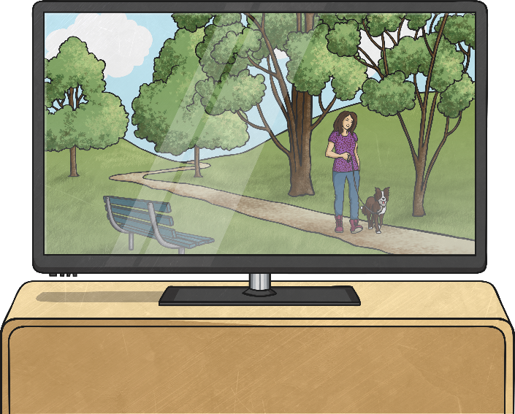
If you were to spell these two words, what would they have in common?
televi
sion
divi
sion
They both end with the suffix ‘-sion’ that sounds like /shun/.

Slide 5
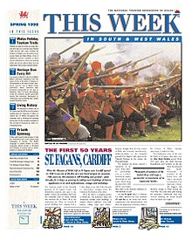
So this week…
We are going to look at how to spell words with the suffix –sion. We will come back to this particular suffix next half term.
Apart from television and division, can you think of any other words which end with –sion?
Working with an adult, say or write down as many ‘sion’ words as you can remember.

Slide 6

Did you think of any of these ‘-sion’ words?
division invasion confusion
decision television collision
revision erosion inclusion
explosion
Do you notice anything about all of these words with the ‘-sion’ pattern? Top Tip: Think of the root words!

Slide 7

All of the words that end in ‘sion’ have a root word that ends in either de or se.
division = divide inclusion = include
invasion = invade explosion = explode
decision = decide confusion = confide
collision = collide television = televise
erosion = erode revision = revise
Do you now see the links?

Slide 8

Can you work out what these words mean from the sentences? Discuss your thoughts with an adult.
division = Addition, subtraction, division are mathematical operations.
decision = That was a great decision to go to the restaurant.
explosion = The bomb caused an explosion.
erosion = The erosion of the land meant the house may fall into the sea.
collision = Cars are designed to crumble in a collision.
inclusion = Everyone’s inclusion in the game is important.
television = I like to watch television.
revision = I must do my revision before my tests so I can improve.
invasion = The Vikings invaded England.
confusion = The man was confused when he saw the sign.

Slide 9

The words meanings are…
division means separating into parts (think maths).
decision means the act of deciding something or solving a question.
explosion means a violent shattering of something or a sudden outburst of something like anger.
erosion means the gradual wearing away of something.
collision means one moving object striking another object.
television is a piece of equipment with a screen to watch programmes.
revision means the act of learning, changing or improving something.
invasion means the act of entering a place in an attempt to
take control of it.
confusion means to be unsure about what is happening.
inclusion means the act of including someone or something as part
of a group.

Slide 10


Your Focus Words
division
decision
explosion
erosion
collision
inclusion
television
revision
invasion
confusion

Slide 11


Your Turn
Rainbow Writing
On-line Task: Spelling Frame
First write 8 words in pencil. Then trace over each word three times. Each time you trace, you must use a DIFFERENT colour crayon or pen. Trace neatly and you will see a rainbow! Or, can you make your words into a rainbow for the NHS? Be creative!
Use you focus words.
Either, cut and paste this link into your browser
https://spellingframe.co.uk/spelling-rule/15/10-Endings-which-sound-like-sion OR
Go onto your browser
Type in Spelling Frame
Select Year 3 and 4
Select Rule 10 -sion
Select Spelling Tiles
Select Segment Puzzle and Segment Sort. If you have time, try the free game.

Slide 12


