Slide 1
Year 4 Maths
Negative Numbers

Slide 2
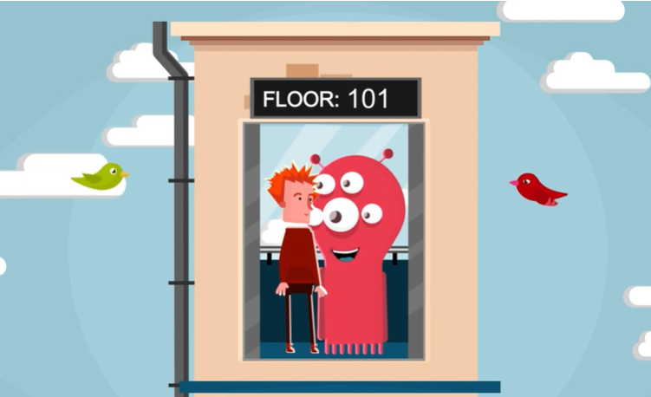
What are negative numbers?
Negative numbers are numbers that are LESS THAN 0.
Can you think of any examples of when you might see negative numbers in everyday life?
Click this picture to be taken to BBC Bitesize with a great video explaining about negative numbers!

Slide 3
You can use a number line to help you with placing negative numbers.
Where would -3 go on this numberline?
-5
0
5

Slide 4
You can use a number line to help you with placing negative numbers.
Where would -3 go on this numberline?
Answer – you need to jump backwards 3 times from 0 to find it!
-3
-5
-2
-1
0
2
3
4
5
-4
1

Slide 5
You can use a number line to help you with placing negative numbers.
Look carefully at the numbers already on the number line so you can work out how big each jump is!
Where would -3 go on this numberline?
-10
0
10

Slide 6
You can use a number line to help you with placing negative numbers.
Look carefully at the numbers already on the number line so you can work out how big each jump is!
Where would -3 go on this numberline?
Answer – the jumps are in 2’s, so -3 would be in-between -2 and -4.
Time for you to have a go at Task 1!
-3
-10
-8
-6
-4
-2
0
2
6
8
10
4

Slide 7
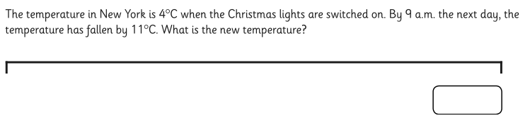
You are going to have some word problems to answer this week.
Have a go at the one below – would drawing a numberline help you?

Slide 8
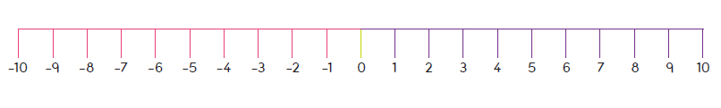
You are going to have some word problems to answer this week.
Have a go at the one below – would drawing a numberline help you?
Reading the question, I know my starting temperature is 4c. In the context of the
question, “fallen” means getting colder so I know I need to go backwards to find
the temperature that is 11c colder than the starting temperature.
-7
Start
Jump backwards 11 times

Slide 9
Now work through the questions:
There are 3 questions for day 2
And
2 sets of questions for day 3.
There is also a maths challenge – have a go and email your answers to your teachers!

