Slide 1

Day 1
Maths- 5 a day
597 + 10 =
56 + 178 =
205 - 17 =
Write the number 482 in words.
Complete the number sequence
27, 24, 21, __, __

Slide 2
Day 1 ANSWERS
Maths- 5 a day
597 + 10 = 607
56 + 178 = 234
205 - 17 = 188
Write the number 482 in words. Four hundred and eighty two.
Complete the number sequence
27, 24, 21, 18, 15

Slide 3
Day 2
Maths- 5 a day
728 + 125 =
8 + 4 + 3 =
Complete the part part whole.
Put these numbers in descending order.
505, 550, 50, 55, 105
5. How many sides do 3 squares have?
700
50
0

Slide 4
Day 2 ANSWER
Maths- 5 a day
728 + 125 = 853
8 + 4 + 3 = 15
Complete the part part whole.
Put these numbers in descending order.
505, 550, 50, 55, 105
550, 505, 105, 55, 50
How many sides do 3 squares have? 12
750
700
50
0

Slide 5
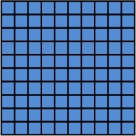
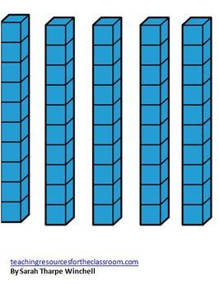

Day 3
Maths- 5 a day
512 + 89 =
What is 100 less than 436?
What number is represented by the dienes?
7 X 3 =
Name the shape…..

Slide 6
Day 3 ANSWERS
Maths- 5 a day
512 + 89 = 601
What is 100 less than 436? 336
What number is represented by the dienes? 325
7 X 3 = 21
Name the shape….. Irregular pentagon

Slide 7
Day 4
Maths- 5 a day
444 + 128 =
350 - 26 =
24 ÷ 4 =
Circle the quadrilaterals.
Complete the number sentence (<>=)
six hundred and seven __ 607

Slide 8
Day 4 ANSWERS
Maths- 5 a day
444 + 128 = 572
350 - 26 = 324
24 ÷ 4 = 6
Circle the quadrilaterals.
Complete the number sentence (<>=)
six hundred and seven = 607

Slide 9
Day 5
Maths- 5 a day
426 + 78 =
277 - 39 =
Complete the part-part whole.
Complete the number sequence.
90, 80, 70, __, __
What is the difference between 48 and 24?
729
20
7

Slide 10
Day 5 ANSWERS
Maths- 5 a day
426 + 78 = 504
277 - 39 = 238
Complete the part-part whole.
Complete the number sequence.
90, 80, 70, 60, 50
What is the difference between 48 and 24?
48 – 24 = 24
729
700
20
7

Slide 11
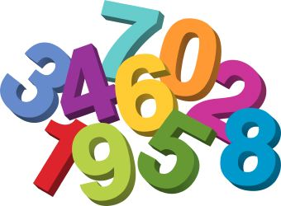
TLHT add numbers using mental strategies
Week 2 task 1

Slide 12
This week we are going to revise different mental strategies that we can use to add numbers.
Although we want you to practice all these strategies, when it comes to mental maths it is all about choosing the strategy that works best for you to calculate quickly and accurately.

Slide 13
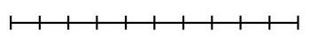
TLHT add numbers using mental strategies
Counting up
When you are adding small numbers (usually 1-5) you can simply count up in ones.
24 + 3 = 27
We can show this using a number line like below.
1
2
3
24
25
26
27

Slide 14
TLHT add numbers using mental strategies
Counting up
Solve the additions by counting up using the number lines provided.
1. 26 + 3 =
26
2. 54 + 4 =
54
3. 162 + 2 =
162

Slide 15
TLHT add numbers using mental strategies
Counting up ANSWERS
Solve the additions by counting up using the number lines provided.
1. 26 + 3 = 29
26
27
28
29
2. 54 + 4 = 58
54
55
56
57
58
3. 162 + 2 = 164
162
163
164

Slide 16
TLHT add numbers using mental strategies
Counting up
You can also count up in tens or hundreds if you are adding these…
123 + 30 = 153
123 + 300 = 423
10
20
30
100
200
300
123
133
143
153
123
223
323
423

Slide 17
TLHT add numbers using mental strategies
Counting up
Solve the additions by counting up using the number lines provided.
1. 132 + 30 =
132
2. 436 + 300 =
436
3. 162 + 20 =
162

Slide 18
TLHT add numbers using mental strategies
Counting up ANSWERS
Solve the additions by counting up using the number lines provided.
1. 132 + 30 = 162
132
142
152
162
2. 436 + 300 = 736
436
536
636
736
3. 162 + 20 = 182
162
172
182

Slide 19
TLHT add numbers using mental strategies
Nearest 10
When your addition will cross over into the next ten you can jump to the next ten then add on what you have left over.
37 + 6 = 43
+3
+3
37
40
43

Slide 20
TLHT add numbers using mental strategies
Nearest 10
Use nearest 10 to solve these additions.
17 + 7 =
38 + 5 =
44 + 8 =

Slide 21
TLHT add numbers using mental strategies
Nearest 10 ANSWERS
Use nearest 10 to solve these additions.
+3
+4
17 + 7 = 24
17
+2
20
+3
24
38 + 5 = 43
38
40
+2
43
+6
44 + 8 = 52
44
50
52

Slide 22
TLHT add numbers using mental strategies
Adjusting
In some addition calculations it can help to change the numbers to make them easier to add mentally. This is usually done to numbers with a 8 or 9 in the ones column.
36 + 9 =
We can make this addition simpler by changing 9 to a 10 by adding 1 to it.
36 + 10 = 46
We now need to make sure we subtract the 1 we added to the 9 so we get the answer to the original question..
46 – 1 = 45

Slide 23
TLHT add numbers using mental strategies
Adjusting
Use adjusting to solve these calculations. Show your working out like the example below.
44 + 8 =
44 + 10 = 54 54 – 2 = 52
25 + 9 =
63 + 8 =
72 + 9 =

Slide 24
TLHT add numbers using mental strategies
Adjusting ANSWERS
Use adjusting to solve these calculations. Show your working out like the example below.
44 + 8 =
44 + 10 = 54 54 – 2 = 53
25 + 9 = 34
63 + 8 = 71
72 + 9 =
25 + 10 = 35 35 – 1 = 34
63 + 10 = 73 73 – 2 = 71
72 + 10 = 82 82 – 1 = 81

Slide 25
TLHT add numbers using mental strategies
Partitioning
When you are adding numbers that have digits in more than one place value column it can help to partition one of the numbers and add the place value columns separately.
23
56 + 20 = 76
76 + 3 = 79
56 + 23 =
20
3
Top tip: Make sure you add the second place value column to the answer you get from adding the first place value column.

Slide 26
TLHT add numbers using mental strategies
Partitioning
Solve these additions using partitioning.
73 + 26 =
125 + 14 =
254 + 33 =

Slide 27
TLHT add numbers using mental strategies
Partitioning
Solve these additions using partitioning.
26
73 + 20 = 93
93 + 6 = 99
73 + 26 = 99
20
6
14
125 + 10 = 135
135 + 4 = 139
125 + 14 = 139
10
4
33
254 + 30 = 284
284 + 3 = 287
254 + 33 = 287
30
3

Slide 28
Task 2
TLHT add numbers using mental strategies

Slide 29
TLHT add numbers using mental strategies
Solve these additions using the counting up strategy.
54 + 5 =
132 + 6 =
23 + 40 =
420 + 60 =

Slide 30
TLHT add numbers using mental strategies
Solve these additions using the nearest 10 strategy. ANSWERS
54 + 5 = 59
132 + 6 = 138
23 + 40 = 63
420 + 60 = 480
54
55
56
57
58
59
132
133
134
135
136
137
138
23
33
43
53
63
440
460
470
480
420
430
440
450

Slide 31
TLHT add numbers using mental strategies
Solve these additions using the nearest 10 strategy.
157 + 6 =
78 + 4 =
528 + 5 =
464 + 7 =

Slide 32
TLHT add numbers using mental strategies
Solve these additions using the nearest 10 strategy. ANSWERS
157 + 6 = 163
78 + 4 = 82
528 + 5 = 533
464 + 7 = 471
157
160
163
78
80
82
528
530
533
464
470
471

Slide 33
TLHT add numbers using mental strategies
Solve these additions using partitioning to help you.
254 + 23 =
722 + 42 =
635 + 24 =
411 + 67 =

Slide 34
TLHT add numbers using mental strategies
Solve these additions using partitioning to help you. ANSWERS
23
254 + 23 = 277
722 + 42 = 764
635 + 24 = 659
411 + 67 = 478
254 + 20 = 274 274 + 3 = 277
20
3
42
722 + 40 = 762 762 + 2 = 764
40
2
24
635 + 20 = 655 655 + 4 = 659
20
4
67
411 + 60 = 471 471 + 7 = 478
60
7

Slide 35
TLHT add numbers using mental strategies
Solve these additions using adjusting.
43 + 9 =
125 + 9 =
512 + 8 =
437 + 9 =

Slide 36
TLHT add numbers using mental strategies
Solve these additions using adjusting. ANSWERS
43 + 9 = 52
125 + 9 = 134
512 + 8 = 520
437 + 9 = 446
43 + 10 = 53 53 – 1 = 52
125 + 10 = 135 135 – 1 = 134
512 + 10 = 522 522 – 2 = 520
437 + 10 = 447 447 – 1 = 446

Slide 37
TLHT add numbers using mental strategies
Use the mental strategy of your choice to solve these additions. Show the method you used.
125 + 30 =
45 + 9 =
222 + 45 =
67 + 6 =

Slide 38
TLHT add numbers using mental strategies
Use the mental strategy of your choice to solve these additions. Show the method you used.
10
20
30
125 + 30 = 155
35 + 9 = 44
222 + 45 = 267
67 + 6 = 73
125
135
145
155
35 + 10 = 45 45 – 1 = 44
222 + 40 = 262 262 + 5 = 267
+3
+3
67
70
73

Slide 39
Task 3
TLHT add numbers using mental strategies

Slide 40
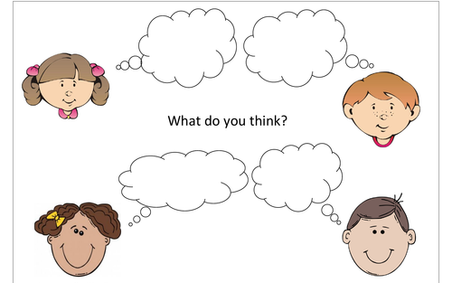
TLHT add numbers using mental strategies
These children are solving the addition 124 + 9 using adjusting. Who has adjusted correctly?
I124 + 10 = 134
134 + 1 = 135
124 + 6 = 130
130 + 3 = 133
April
Ben
124 + 10 = 134
134 – 1 = 133.
124 + 9 = 133
133 + 1 = 134
May
Simeon

Slide 41
TLHT add numbers using mental strategies
ANSWER
These children are solving the addition 124 + 9 using adjusting. Who has adjusted correctly?
I124 + 10 = 134
134 + 1 = 135
124 + 6 = 130
130 + 3 = 133
April
Ben
124 + 10 = 134
134 – 1 = 133.
124 + 9 = 133
133 + 1 = 134
May
Simeon

Slide 42
TLHT add numbers using mental strategies
Write the method you would use to solve these mental additions. You do not have to solve them.
146 + 7 =
534 + 9 =
612 + 45 =
67 + 8 =

Slide 43
TLHT add numbers using mental strategies
Write the method you would use to solve these mental additions. You do not have to solve them. ANSWERS
146 + 7 =
534 + 9 =
612 + 45 =
67 + 8 =
Nearest 10
Adjusting
Partitioning
Adjusting

Slide 44
TLHT add numbers using mental strategies
Complete the number pyramid by adding the two number below to find the number in the box above..
18
9
25
7
8

Slide 45
TLHT add numbers using mental strategies
Complete the number pyramid by adding the two numbers below to find the number in the box above. ANSWERS.
144
129
115
61
68
47
27
34
32
15
18
9
25
7
8

Slide 46
TLHT add numbers using mental strategies
These addition calculations are wrong. Explain the mistakes that have been made.
23
134 + 20 = 154 134 + 3 = 137
134 + 23 = 137
20
3
344 + 9 = 355 344 + 10 = 354 354 + 1 = 355

Slide 47
TLHT add numbers using mental strategies
These addition calculations are wrong. Explain the mistakes that have been made. ANSWERS
23
134 + 20 = 154 134 + 3 = 137
134 + 23 = 137
20
3
They have added the ones to 134 rather than adding them to 154. This means they haven’t added the 20.
344 + 9 = 355 344 + 10 = 354 354 + 1 = 355
They have added 1 to 354 rather than subtracted 1. This means they have added 11 to 344 rather than 9.

