Slide 1

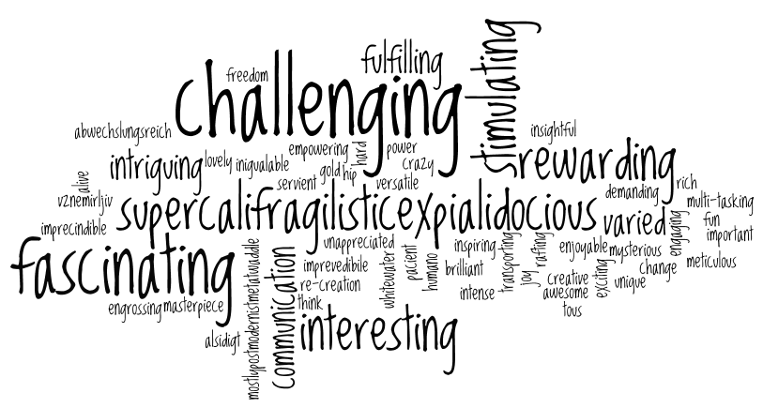
Welcome back to Home Learning Spellings with Mrs Andrews

Slide 2


I hope you have had a good week
and now … it is time to do some spellings!

Slide 3

Every Week
I will be sending you:
a Power Point which will be linked to your Year 3 main focus words and spelling principle,
1 task worksheet and / or
An on-line task such as Spelling Frame. I will direct you to the correct web page. Remember the main website we use is spellingframe.co.uk/spelling-rule
You should do a minimum of 1 spelling task per week but you can do both if you wish.
AND you must do the handwriting task in which you will be asked to choose 5 tricky spelling words and put them into a sentence so you can practise your handwriting as well as writing sentences that make sense.

Slide 4
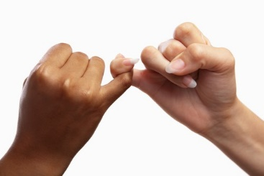
This week, we are going to look at a new spelling principle.
Words that contain a short /i/ sound but is spelt using a ‘y’.
I know this sounds a bit weird but if you can say the words out loud while you read the words, it will become clear! I promise!

Slide 5
Let’s watch the BBC Bitesize
https://www.bbc.co.uk/bitesize/topics/zt62mnb/articles/z3mktv4
So short 'i' is spelt with a ‘y’ in a few words such as…
gym
myth
pyramid
mystery
Egypt
Can you think of any more? Talk to your adult or write some down.

Slide 6
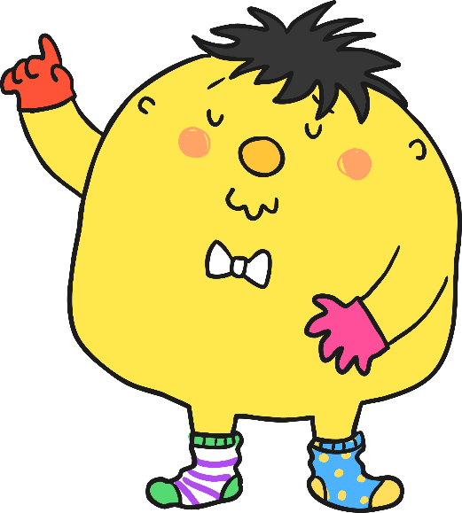
Unfortunately, Mr Whoops has got in a bit of a muddle with your spelling words. Can you figure them out?
y
m
t
h

Slide 7
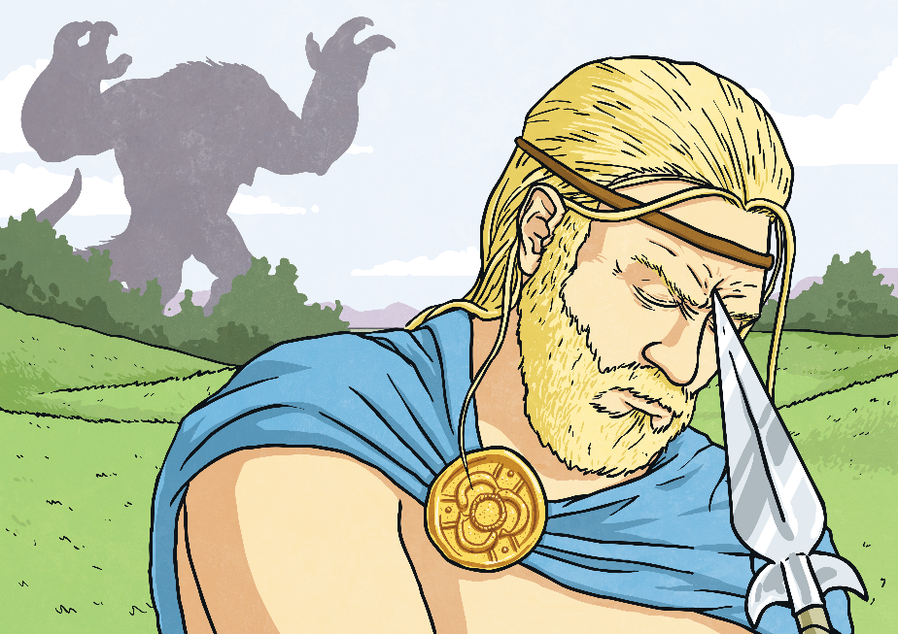
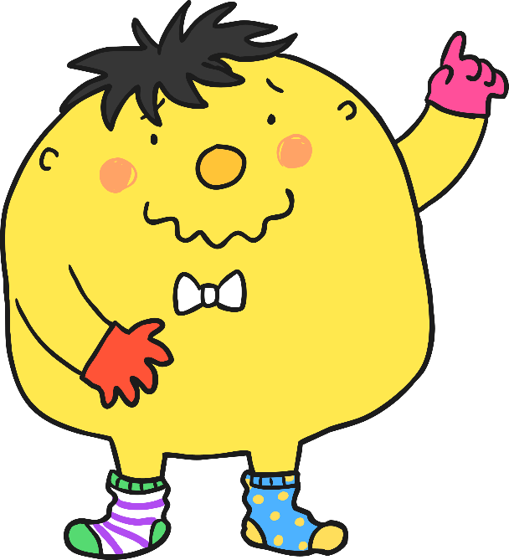
The answer is… myth

Slide 8
Which ‘y’ word is jumbled here?
r
c
i
l
y

Slide 9
The answer is… lyric
“Twinkle, twinkle, little star,”

Slide 10
Which ‘y’ word is jumbled here?
t
r
s
e
m
y
y

Slide 11

The answer is… mystery

Slide 12
Which ‘y’ word is jumbled here?
s
l
m
o
y
b

Slide 13

Then answer is… symbol

Slide 14

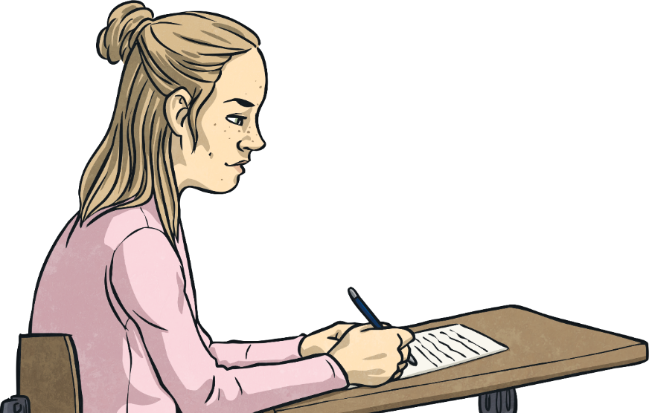
Your 10 Spelling Words
mystery PLUS a cheeky extra one… symptom
symbol
system
typical
gym
myth
Egypt
pyramid
lyric
hymn
So what do these words mean? Talk to your adult. Do you recognise any of these words from your past learning? Egypt or pyramid from you Egyptian topic?

Slide 15
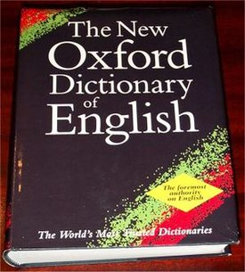
Can these sentences help you to understand their meanings? Talk to your adult about these words.
symptom = Sneezing is a symptom of hay fever.
mystery = I really enjoy a mystery story.
symbol = This symbol + means to add.
system = Windows 8 has a software system to help run it.
typical = Red and white strips are typical of Southampton FC.
gym = My mum goes to the gym to get fit.
myth = A myth is an old story that maybe untrue.
Egypt = Egypt is a country where there are huge ancient pyramids.
pyramid = A pyramids is a 3D shape.
lyric = Lyrics are lines in a song.
hymn = Everyone enjoyed singing the hymn in singing assembly.

Slide 16


Your turn to do some spelling activities.
Be the Teacher
On-line Task. BBC Bitesize
Read the 10 sentences and spot the mistakes and then rewrite the sentences using the correct spellings. The answer sheet is attached.
Please use your focus words to help you. The answers are attached to the questions.
https://www.bbc.co.uk/bitesize/topics/zt62mnb/articles/z3mktv4
Highlight the spelling mistakes task. It is under the clip that you watched earlier. Be careful, there may my some correct words with ‘i’ in them to trick you!

Slide 17
Your turn to do your handwriting task
On a sheet of paper, choose 5 tricky spelling words and put them into a sentence so you can practise your handwriting as well as writing sentences that make sense.
symptom
mystery
symbol
system
typical
gym
myth
Egypt
pyramid
lyric
hymn

Slide 18


