Slide 1

Welcome back to Year 4 Home Learning Spellings with Mrs Andrews

Slide 2

Every Week
I will send you:
a Power Point which will be linked to your Year 4 main focus words and spelling principle.
1 task worksheet (with an answer sheet if appropriate) AND
If possible on a PC, tablet or smart phone, an on-line task such as spellingframe.co.uk/spelling-rule OR another task.
If at all possible, please do both tasks because the more you do, the better you will become at spelling, reading and writing!

Slide 3
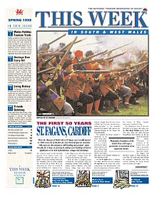
This week…
We are going to look again at how to spell words ending with ‘-sure' and ‘-ture’.
Can you remember how to say the endings ‘-sure' and ‘-ture‘?
Write down or tell an adult any words which you can remember from last week.

Slide 4

-sure and –ture spelling principles
The Rules:
The ending sounding like ‘zur’ are always spelt -sure. E.G. measure
The ending sounding like ‘chur’ are often spelt -ture.
E.G. adventure

Slide 5
Watch these short clips to help you remember.
Recap –sure and –ture
https://www.bbc.co.uk/bitesize/topics/zt62mnb/articles/z3jpk2p
And just -ture
https://www.youtube.com/watch?v=Ao_pKZ-ZM_4

Slide 6
Exceptions
BUT check that the word is not a root word ending in (t)ch with an ending!
E.G. teacher or catcher or richer or stretcher

Slide 7
Your focus words are going to be the same as last week.
adventure treasure
picture measure
furniture enclosure
nature pleasure
creature
Do you know what these words mean? Tell your adult their meanings.

Slide 8
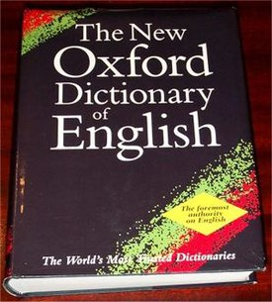
Do you know what these words mean?
creature an animal (not a human)
furniture moveable articles for a room or building
nature the physical world (not man made)
picture a painting or a drawing
adventure an unusual, exciting or daring experience
measure a certain size, length, amount using a scale
treasure a quantity of precious metals or gems
pleasure a feeling of happy satisfaction and joy
enclosure an area surrounded by a barrier

Slide 9

Your Turn
Task 1
On-line Task: Spelling Frame
Complete the sentences using the words.
Please self mark using the answer sheet provided.
Please use a different coloured pen and do not forget to write in your corrections!
Either, cut and paste this link into your browser
https://spellingframe.co.uk/spelling-rule/14/9-Words-with-endings-sounding-like-ture
OR
Go onto your browser
Type in Spelling Frame
Select Year 3 and 4
Select Rule 9
Select Spelling Tiles
Select Segment Silhouette and Word Search

Slide 10


