Slide 1
Year 4 Maths
4.5.2020
To learn how to multiply three single digit numbers

Slide 2

Remember the x means ‘lots of’
3 lots of five is 15

Slide 3
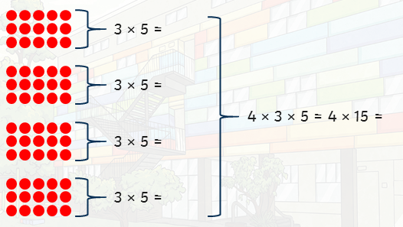
Now we have 4 lots of 3 x 5 or 4 x 3 x 5 or 4 lots of 15
BUT x can be done in any order so we could also say:
3 lots of 4 x 5 which is much easier to do! 3 lots of 20 is 60.
The trick is to try and spot the easiest way of doing it!

Slide 4

Try this one:
You could do 8 lots of 2 x 2
Or 2 lots of 8 x 2
Or 2 lots of 2 x 8
I think I would find the first way easier, so 8 x 4 = 32

Slide 5

Your turn to have a go!
Write down three calculations that you could do, then choose the one that you think will be the easiest.

Slide 6
You could do 10 lots of 7 x 3
OR 3 lots of 10 x 7
Or 7 lots of 3 x 10
The answer is 210

Slide 7
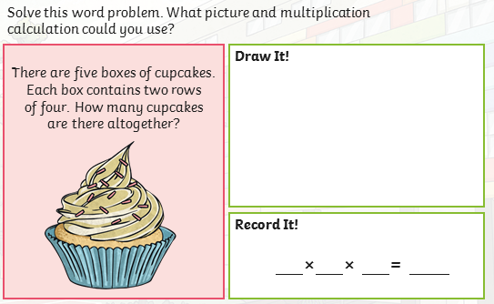
We can use this knowledge to help us solve problems.

Slide 8
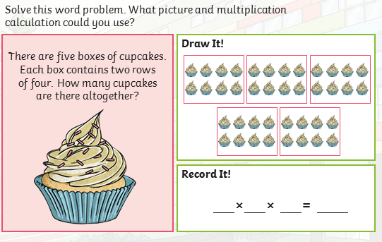
First we can draw a picture:

Slide 9
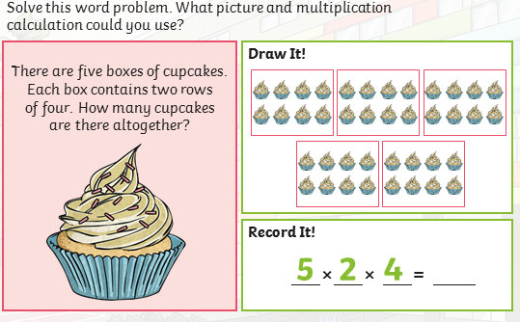
Now, we can fill in the calculation:
We could do 5 lots of 2 x 4 OR 2 lots of 5 x 4 which is easier. The answer is 40.

Slide 10
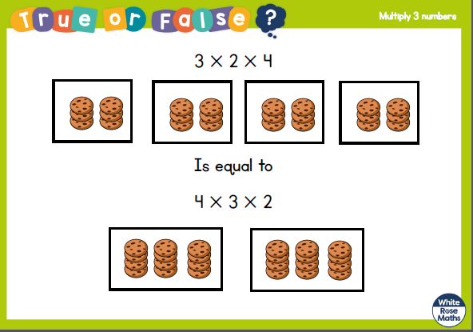

Slide 11
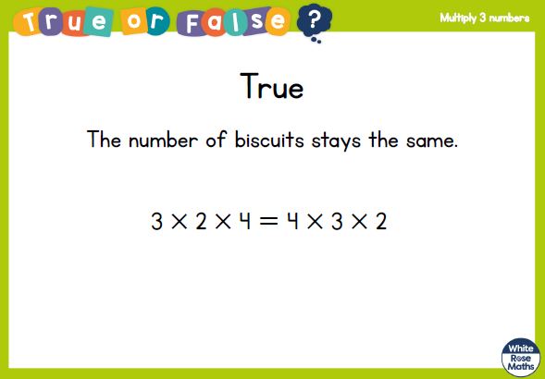

Slide 12
Now, complete the Lesson 1 practise questions.

Slide 13
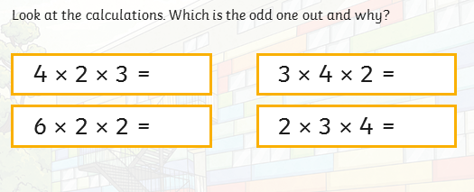

Slide 14
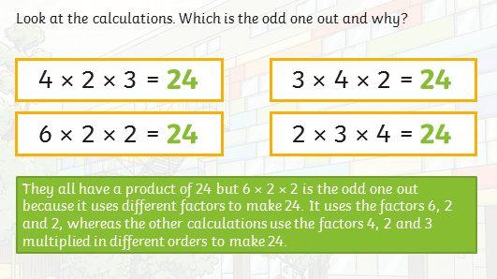

Slide 15
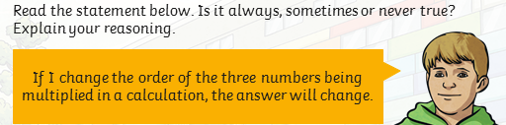

Slide 16
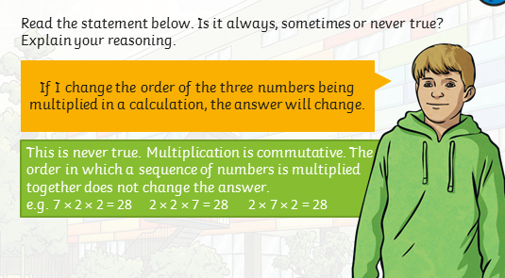

Slide 17
Now try the Lesson 2 Prove It questions.
Hints and Tips:
If it says explain you will need to use mathematical language to explain what you mean. Multiply and factor are two key words for this area of learning.
Using an example to support your answer is important. Otherwise we may ask you to go back and prove it!
If you get a sometimes, always, never questions you will need at least 2 examples to prove your point.
Working systematically, in an order, usually means you don’t miss an example.

Slide 18
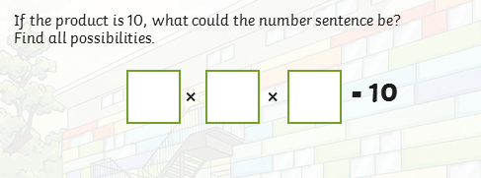
First of all, what time tables do I know with the answer 10?
I know 10 x 1
I know I can replace the 10 with 10 x 1 or 5 x 2
So now I have 10 x 1 x 1 or 5 x 2 x 1
AND I know that I can write my three numbers in any order, so...

Slide 19
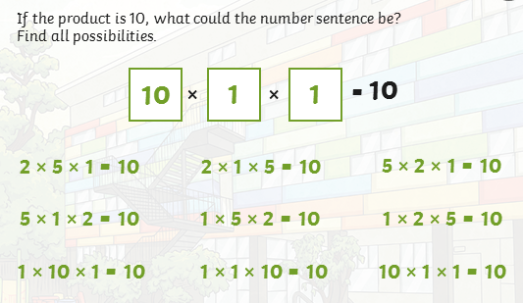
There are 9 different possibilities.

Slide 20
Now, try the Question 3 Prove It questions.:
Hints and Tips:
If it says explain you will need to use mathematical language to explain what you mean. Multiply and factor are two key words for this area of learning.
Using an example to support your answer is important. Otherwise we may ask you to go back and prove it!
If you get a sometimes, always, never questions you will need at least 2 examples to prove your point.
Working systematically, in an order, usually means you don’t miss an example.

