Slide 1
27.04.2020
Factor Pairs

Slide 2
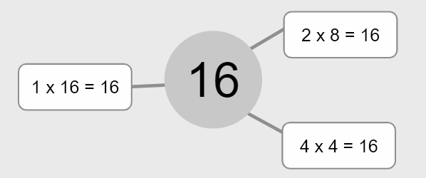
What is a factor pair?
Pairs of numbers that multiply to make a particular number are called factor pairs.
For Example:
Factor Pairs for 16 are:
1 x 16
2 x 8
4 x 4
BBC Bitesize - What are factors? https://www.bbc.co.uk/bitesize/topics/zfq7hyc/articles/zp6wfcw

Slide 3
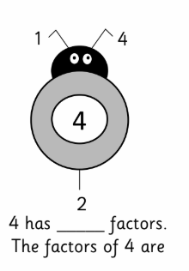
Task 1 - Factor Bugs
An example: This is a factor bug. One half of the bug has been completed. Find all of the factors and complete the factor bugs.
1 x 4 = 4
2 x 2 =
4 has 3 factors. The factors of 4 are: 1, 4 and 2
Now have a go at Task 1

Slide 4
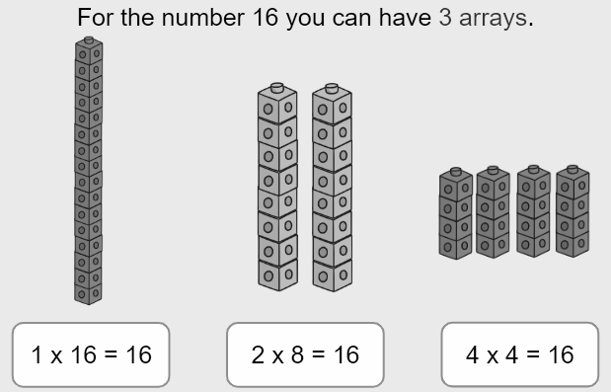
Arrays
Arrays are a way to help find different factor pairs of a number

Slide 5
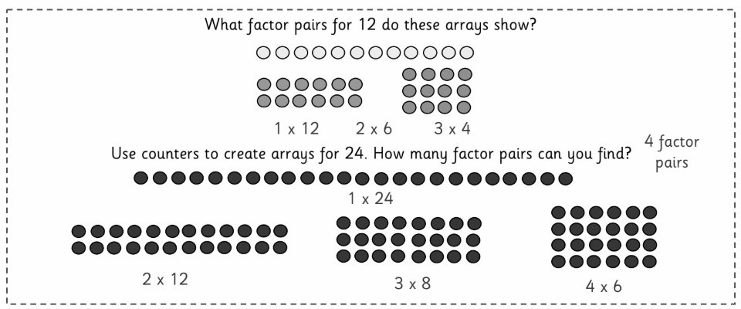
Task 2 - Using Arrays
Example 1: When solving these types of questions you need to work systematically following and order to help you find all the solutions.

Slide 6
Reasoning and Problem Solving
Hints and Tips:
If it says explain you will need to use mathematical language to explain what you mean. Multiple and factor are two key words for this area of learning.
Using an example to support your answer is important. Otherwise we may ask you to go back and prove it!
If you get a sometimes, always, never questions you will need at least 2 examples to prove you point.
Working systematically, in an order, usually means you don’t miss an example.

Slide 7
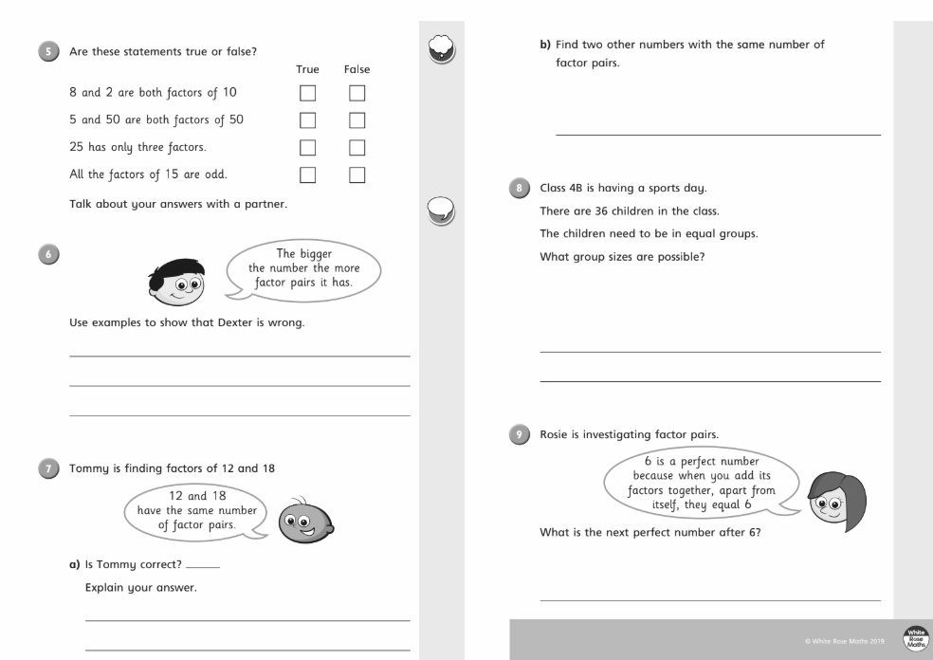
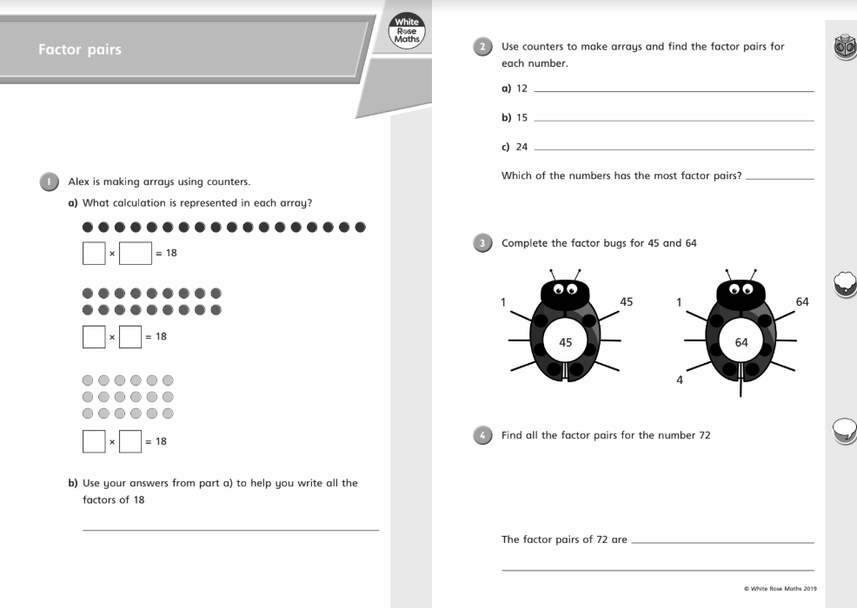
Task 3 - Mixture of Questions
Complete the end of unit worksheets from the White Rose Maths

