Slide 1

Welcome Year 4 to Home Learning Spellings with Mrs Andrews

Slide 2
Every Week
I shall be sending you a spelling task linked to one of your Year 4’s spelling rules as well as some tips on how the rule works and those dreaded exceptions!
For this week, let’s finish the suffix –ly which you started with me before our school closed. Remember, -ly suffixes are great for writing adverbs (describing your verbs)! E.G. Quickly, the man ran down the street. Remember, adverbs will make your writing fantastic!
So let’s remind ourselves of the ‘spelling rules for the –ly suffix’.

Slide 3


The Rules for adding –ly to a word:
1. Most words – you just ADD –ly
sad = sadly complete = completely
2. If the root word ends in -y, CHANGE the y to an i and add –ly
happy = happily angry = angrily

Slide 4
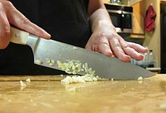
3. If the root word ends in -le, CHOP the -le and
add -ly
gentle = gently
simple = simply
noble = nobly

Slide 5
4. If the root word ends in -ic, just ADD ally
magic = magically
dramatic = dramatically
basic = basically
frantic = frantically

Slide 6
5. If the root word ends in -l, just ADD –ly.
careful = carefully
6. If the root word has a silent 'e', just ADD -ly
nice = nicely
love = lovely

Slide 7

Our favourites the ... exceptions!
public to publicly
true to truly
whole to wholly
due to duly

Slide 8
Here are the 10 –ly words I asked you to learn a few weeks ago. Can you remember them?
finally
truly
nobly
angrily
happily
gently
simply
dramatically
sadly
basically

Slide 9

Now, you are ready to do this week’s tasks.
Task 1: Look, say, cover, write, check.

Slide 10

Task 2: Across and Down
Choose 9 of your trickiest words and complete the shapes.
Look at the example before you start.

Slide 11
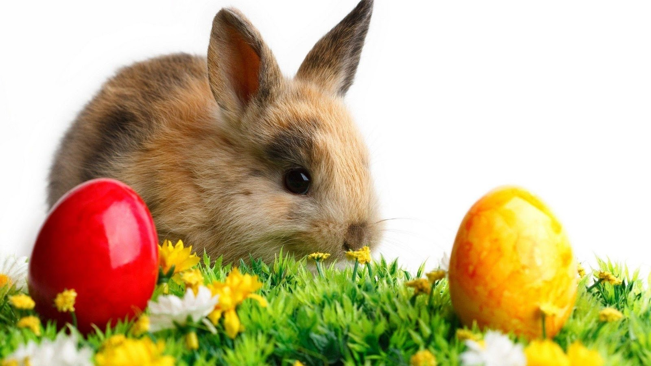
The End
Have a good Easter Holiday.

