Slide 1
TLHT multiply a 3 digit number by 1 digit number
Year 4 - Maths - Week 1

Slide 2
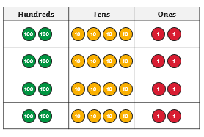

I Do 242 x 4 =
This can be represented using place value discs like this:
3. To find the answer, add up each column starting with the ones.
1. Each row has 2 hundreds, 4 tens and 2 ones. This creates the number 242.
2. There are 4 rows as we are multiplying by 4.
Remember: If you get more than 10 in a column you will need to exchange.
9 | 6 | 8

Slide 3
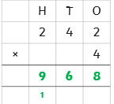
I Do 242 x 4 =
Using the formal written method we write it likes this:

Slide 4
You Do 126 x 5 =
Represent the question using place value discs and the formal method.
See the next slide for the answer

Slide 5
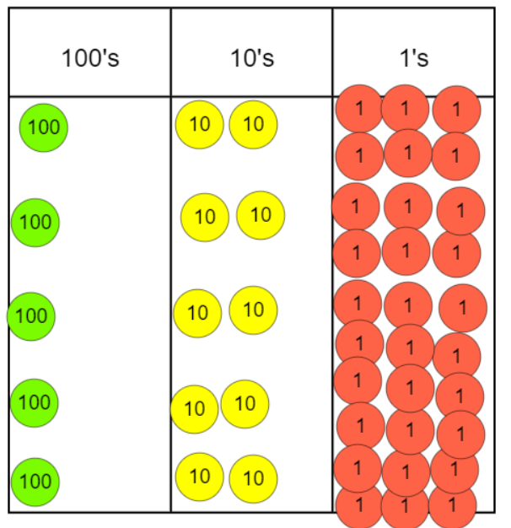
You Do - Answer
 | H | T | O
 | 1 | 2 | 6
X |  |  | 5
 | 6 | 3 | 0
 | 1 | 3

Slide 6
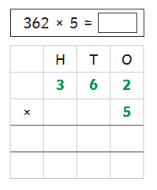
I Do 362 x 5 =
Let’s discuss the formal method.

Slide 7
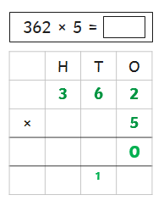
First I multiply the ones. 2 x 5 is 10 so I write it in the same way that I would for column addition:

Slide 8
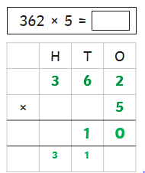
Now, I multiply the tens digit. 6 x 5 = 30 but I need to add on the one underneath so my answer is 31. Again I write this in the same way that I would for column addition.

Slide 9
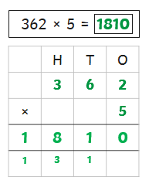
Finally, I multiply the hundreds digit. 3 x 5 = 15 but I need to add on the three underneath so my answer is 18. Again I write this in the same way that I would for column addition.

Slide 10
You Do 559 x 9 =
Using the previous slides to help you solve this question.
Don’t forget you can use the place value discs to help you.
See the next slide for the answer

Slide 11
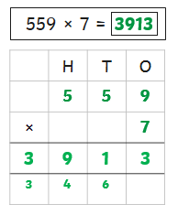
You Do - Answer

Slide 12
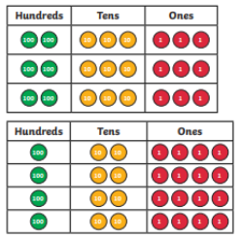
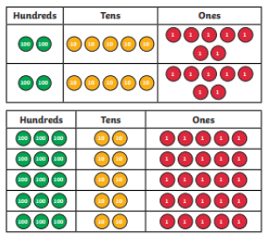
Prove it 1 - For each grid, write down the calculation that is represented. Work out the answer using the formal method and then count the disks to see if you are correct.
3
1
4
2

Slide 13
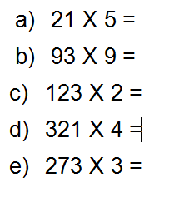
Prove it 2 - Using the formal written method of short multiplication to find the answer to each calculation.

Slide 14
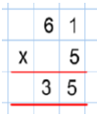
I Do Mark the calculation
Here is a calculation. What are the mistakes and what should the answer be?
 | H | T | O
 |  | 6 | 1
X |  |  | 5
 | 3 | 0 | 5
 | 3
The mistake is in the tens column they have said the answer 3. However 60x5=300, there for there are no tens and 3 hundreds.

Slide 15
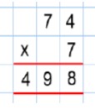
You Do Mark the calculation
Here is a calculation. What are the mistakes and what should the answer be?
Don’t forget to use mathematical language in your explanation.

Slide 16
You Do Mark the calculation
Here is a calculation. What are the mistakes and what should the answer be?
The person has corrected multiplied both columns. However has forgetten to write down the 2 tens exchanged from multiplying 4x7. They have then not added them to the tens column.
 | H | T | O
 |  | 7 | 4
X |  |  | 7
 | 5 | 1 | 8
 | 5 | 2

Slide 17
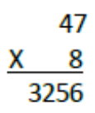
Prove it 3 - Find the mistake that has been made in the calculation below.
Explain the mistake and
correct the calculation.

Slide 18
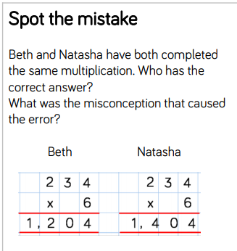
Prove it 4

