Slide 1
TLHT use prepositional noun phrases.
Year 4 - Week 1- English

Slide 2
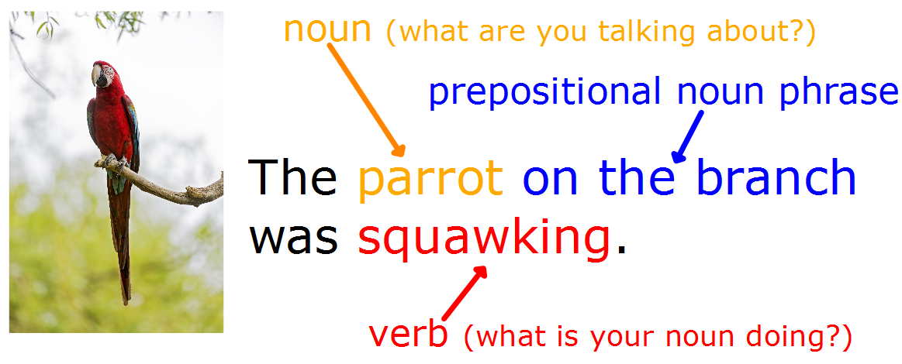
Remember a prepositional noun phrase describes where noun is.

Slide 3
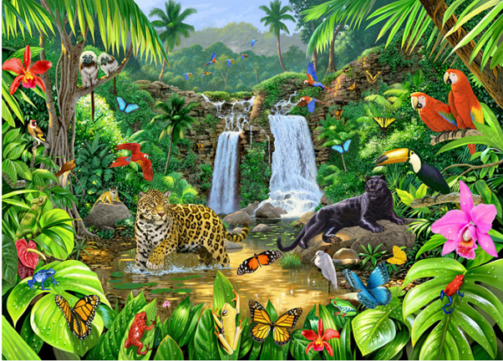
Task One - Using a prepositional noun phrase in a sentence.
Identify a noun in the image.
Describe where the noun is.
What is the noun doing?
For example: The jaguar in the water was silently stalking its prey.
Do this for 8 different nouns?
2 on the ground
2 that climb,
2 that fly
2 of your own choice.
Don’t forget to use the thesaurus to help you uplevel the your verbs and adverbs.

Slide 4
If you were to use all the sentences you created in task one as a description it wouldn’t flow together particularly well.
The jaguar in the water was silently stalking its prey. Bright flowers on the plants were moving in the breeze. Red parrots on the branch were squawking loudly.
Therefore we need to add more information about some of the nouns.

Slide 5
Task Two - Adding extra information.
What do we extra do we know about the noun?
Which conjunction are you going to use to join these pieces of information together?
The jaguar in the water was silently stalking its prey and it had spotted fur.
Choose 3 sentences to add more information to.

Slide 6
Recap: Using fronted adverbials
Year 4 - Week 1- English

Slide 7
This year we have been learning to master fronted adverbials. We are now going to add these to some of our sentences.
Remember:
Fronted adverbial phrase describes the verb.
It goes at the beginning of the sentence.
It is followed by a comma (,).
There are 5 types:
  Place - where the verb takes place.
  Time - when the verb takes place.
  Manner - how the verb is carried out.
  Frequency - how often the verb is done.
  Degree - how likely the verb is to be carried out.

Slide 8
We have used a prepositional noun phrase so we shouldn’t use a fronted adverbial of place because we have already described where the noun and therefore the verb is taking place.
You can however use any of the other 4:
  Time - when the verb takes place.
  Manner - how the verb is carried out.
  Frequency - how often the verb is done.
  Possibility - how likely the verb is to be carried out.
For example: Slowly, the jaguar in the water was silently stalking its prey and it had spotted fur. OR During dusk, the jaguar in the water was silently stalking its prey and has spotted fur.

Slide 9
Task Three - Add fronted adverbials
For 3 sentences you haven’t added extra information to add a fronted adverbial.
Time - when the verb takes place.
Manner - how the verb is carried out.
Frequency - how often the verb is done.
Possibility - how likely the verb is to be carried out.

Slide 10
To apply prepositional noun phrases and fronted adverbials.
Year 4 - Week 1- English

Slide 11
Using the work you have done in the previous tasks you are now going to write a descriptive paragraph about the jungle picture
Splitting the picture up and describing different sections may help
For example: The jaguar in the water was silently stalking its prey whilst the snakes bath in the last of the sunshine. Nearby, another jaguar with black fur lounged on a rock.

Slide 12
Task Four - Write a descriptive setting.
Write a descriptive piece about this picture. We are writing in the past tense.
Have you included your senses? Hear, touch, see, smell and taste.

