Slide 1
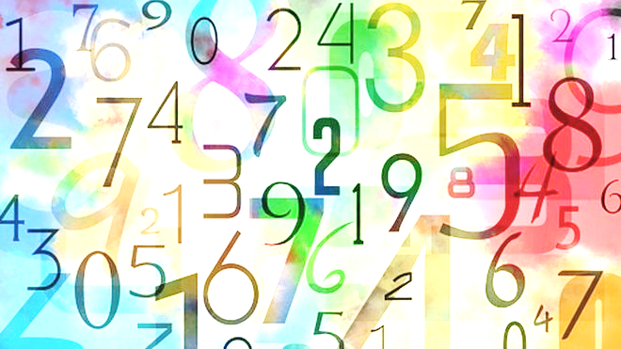
TLHT use written subtraction

Slide 2
Each Monday, maths will be uploaded to the website.
There will be a PowerPoint and 3 tasks for you to complete.
The Maths PowerPoint and tasks will be similar to how we do things when in school.
There will be an I do/ You do, Practice and Evidence tasks.
There are also Maths 5-A-Day on the website for you to complete – there are 5 in total.
Try to complete one 5-A-Day per day.
There are answers for all of the 5-A-Day, Practices and Evidence tasks.
Make sure you complete the tasks before looking at the answers!
When you check your answers and you can see you have made an error, try to work out where you went wrong as this will help you next time.

Slide 3
This week we are going to be looking at written subtraction.
This is what we started when we were last in school together.
Don’t worry if you can’t remember or found it tricky last time as we are going to go back to the beginning and do it together again.
If you have completed the practices and evidences already – do not worry, complete them again as this will help remind you of the correct method and also will give you some good practise at completing these calculations again.
Ok, let’s get on with it!
Have fun and remember to go back to the start for reminders if you find something tricky.

Slide 4
Glossary Subtract: to remove something Difference: how much more one number is to another number

Slide 5
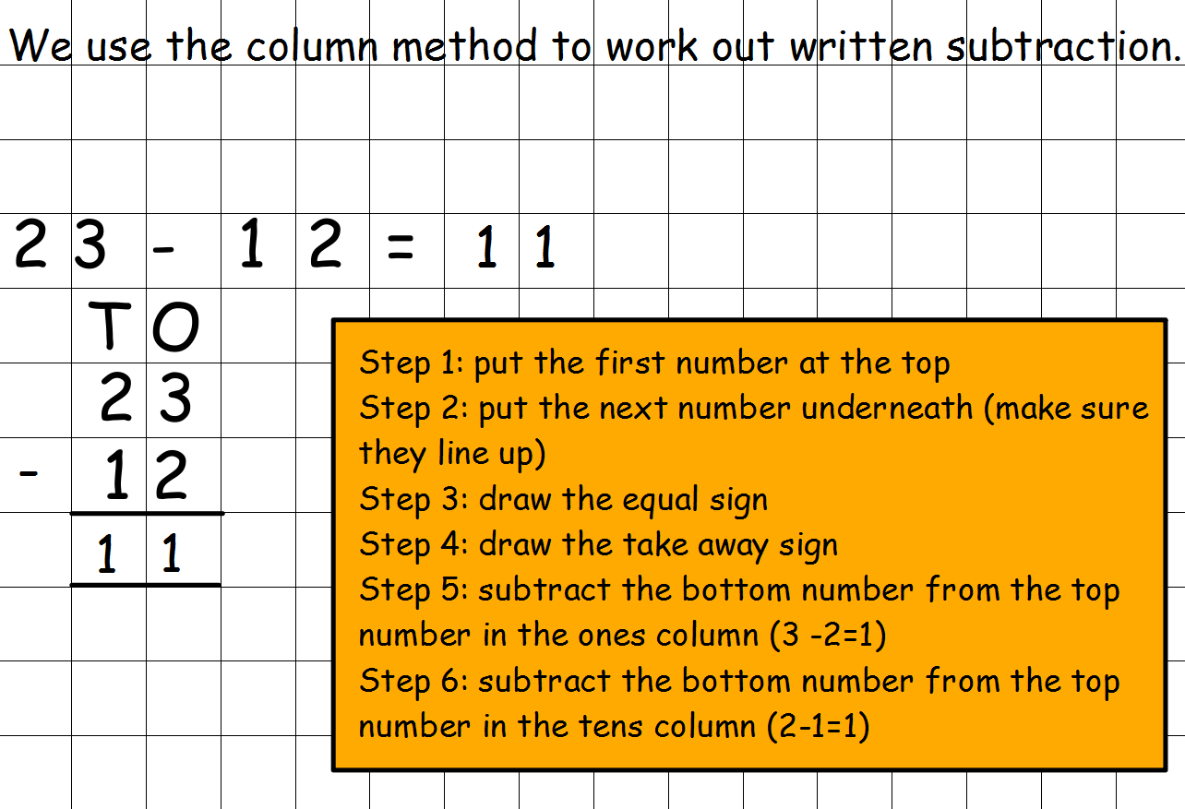
Task 1:
Written subtraction with no exchange

Slide 6
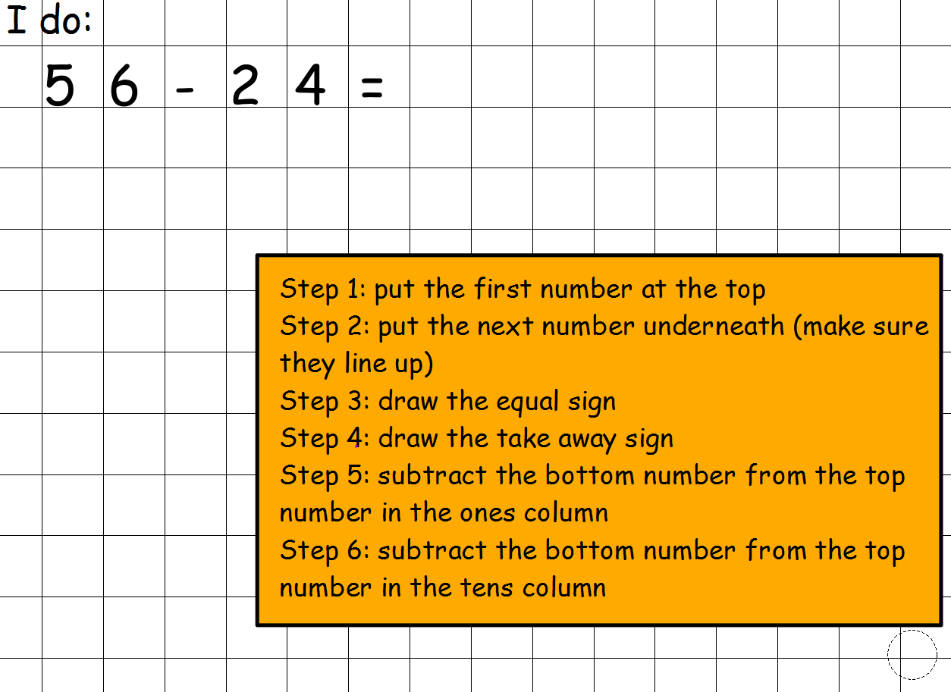
Task 1:
Written subtraction with no exchange
Step 1
T O
5 6
2 4
Step 2
Step 4
Step 3

Slide 7
Task 1:
Written subtraction with no exchange
T O
5 6
2 4
Step 5
6 - 4
2

Slide 8
Task 1:
Written subtraction with no exchange
T O
5 6
2 4
Step 6
5 - 2
3 2

Slide 9
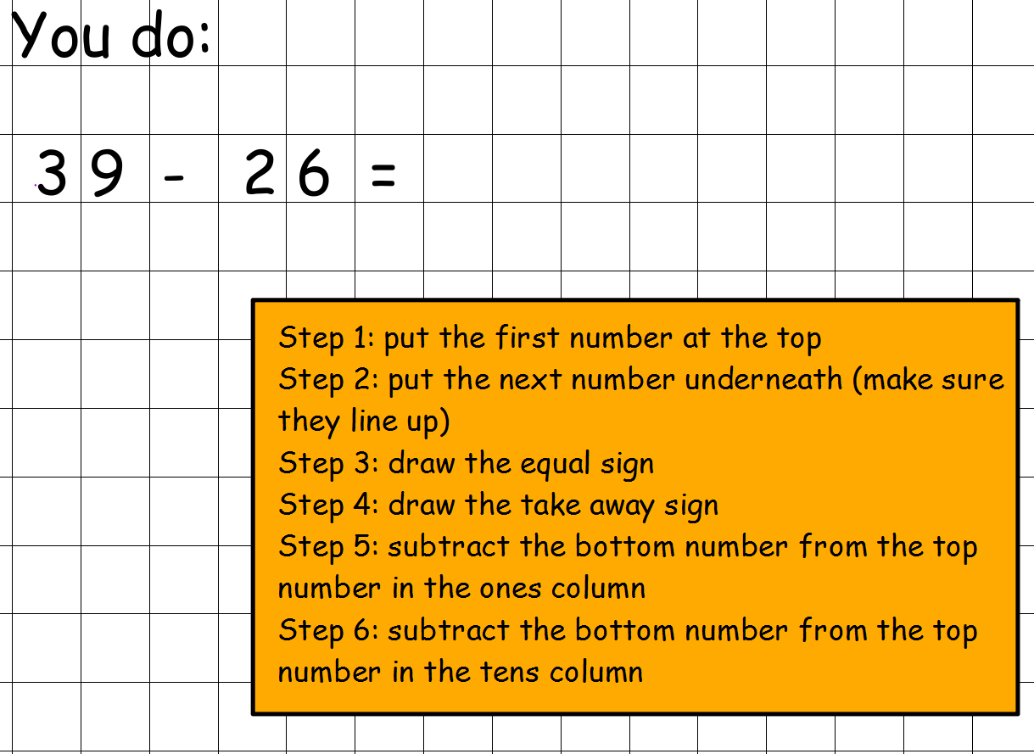
Task 1:
Written subtraction with no exchange
Now complete this ‘You do’.
If you have squared paper
please use that.
If not and you are able to print squared paper then there is some blank squared paper saved to the website.
If not, then just use blank paper.

Slide 10
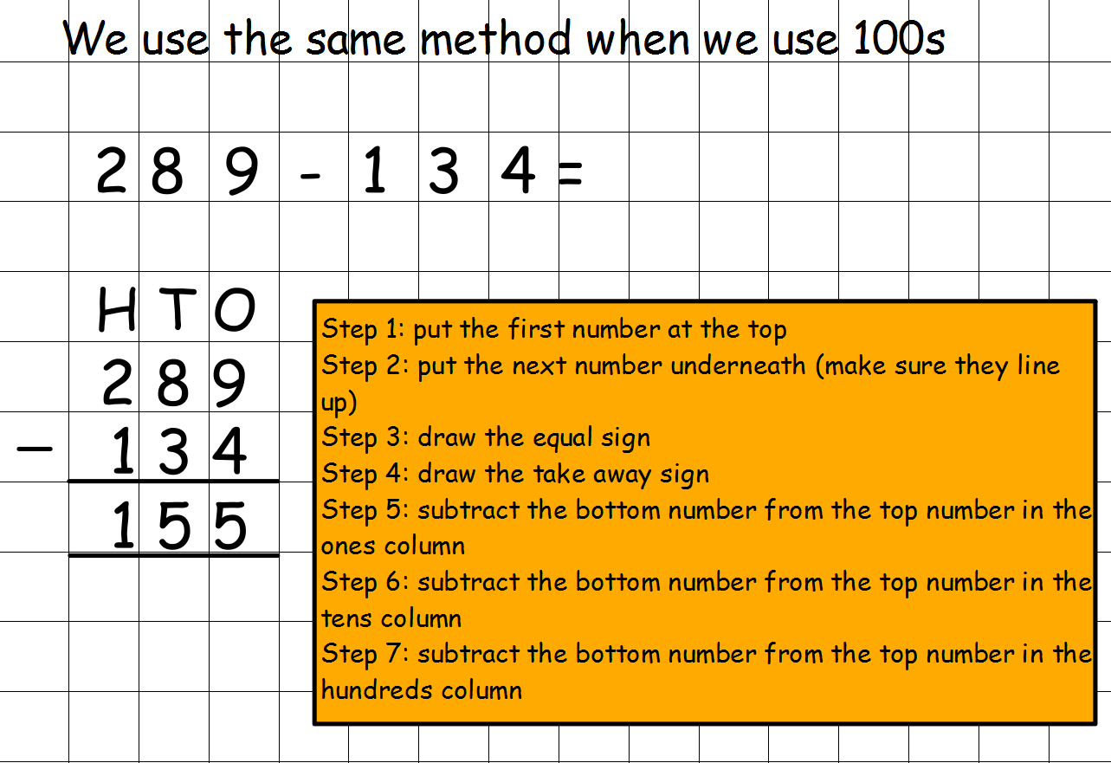
Task 1:
Written subtraction with no exchange

Slide 11
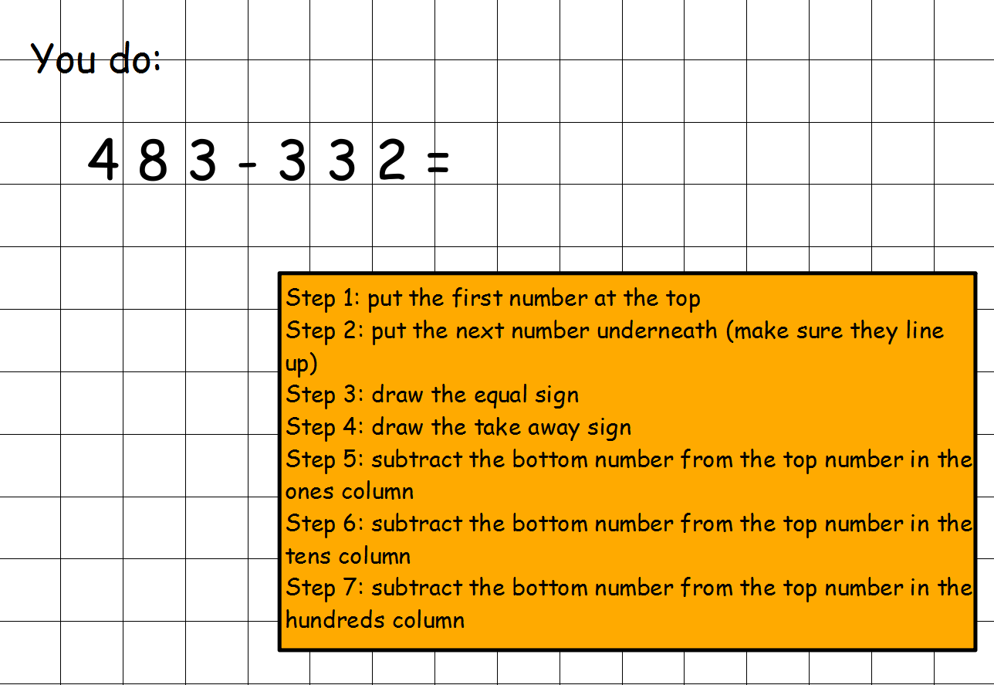
Task 1:
Written subtraction with no exchange
Now complete this ‘You do’ following the steps as you go.

Slide 12
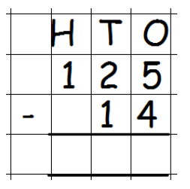
Task 1:
Written subtraction with no exchange
Now it’s time to complete Task 1
Practice Tasks.
Practice 1
Practice 2
Solve these calculations by using the formal written method using squared paper if you can and following the steps on the slides.
274 - 52 =
349 - 25 =
882 - 350 =
708 - 303 =
995 - 425 =
On the next slide are the answers.
Remember, complete the practices first and then if you get any incorrect have a look to see where you went wrong.
Ask an adult to help you if you are unsure.
.

Slide 13
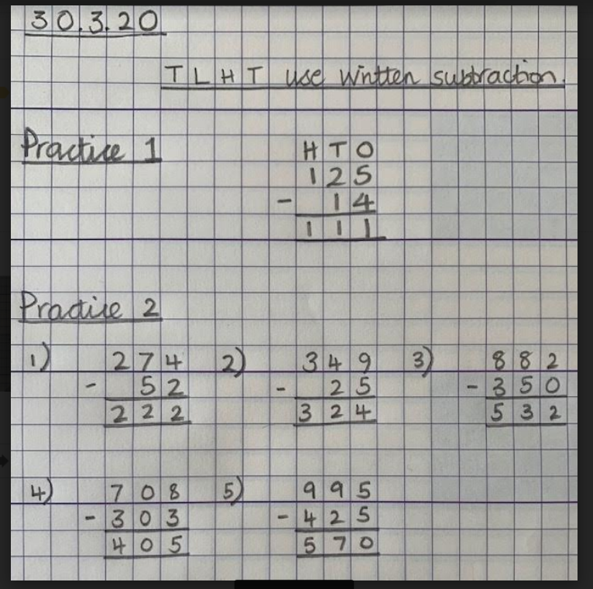
Task 1:
Written subtraction with no exchange
ANSWERS

Slide 14
Well done, you have now completed Maths Task 1
☺
Remember to complete a 5-A-Day every day (Mon – Fri) and then complete Task 2 and 3 later this week.

Slide 15
TLHT use written subtraction Task 2

Slide 16
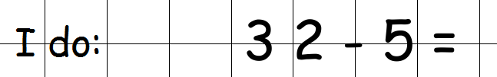
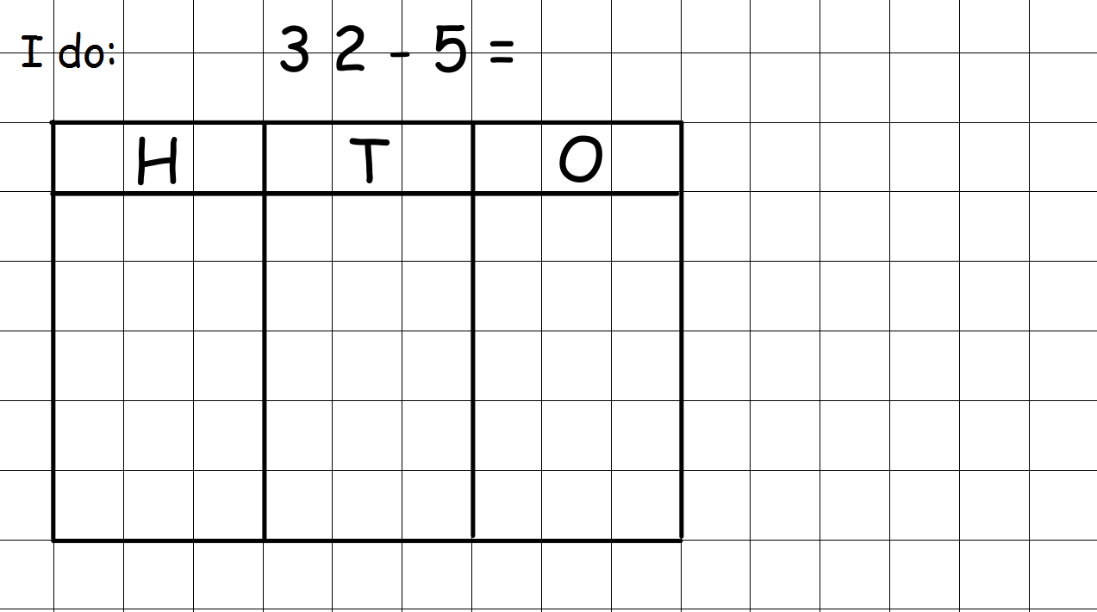
Task 2:
Written subtraction with one exchange
Follow steps 1-4 the same as before
Step 1: put the first number at the top Step 2: put the next number underneath (make sure they line up) Step 3: draw the equal sign Step 4: draw the take away sign
Step 5:
Draw out your HTO
Place Value chart
H T O
3 2
- 5

Slide 17
Task 2:
Written subtraction with one exchange
Follow steps 1-4 the same as before
Step 1: put the first number at the top Step 2: put the next number underneath (make sure they line up) Step 3: draw the equal sign Step 4: draw the take away sign
Step 6a:
Draw place value discs into the ones column for the top number
H T O
3 2
- 5

Slide 18
Task 2:
Written subtraction with one exchange
Follow steps 1-4 the same as before
Step 1: put the first number at the top Step 2: put the next number underneath (make sure they line up) Step 3: draw the equal sign Step 4: draw the take away sign
Step 6b:
Draw place value discs into the tens column for the top number
H T O
3 2
- 5

Slide 19
Task 2:
Written subtraction with one exchange
Follow steps 1-4 the same as before
Step 1: put the first number at the top Step 2: put the next number underneath (make sure they line up) Step 3: draw the equal sign Step 4: draw the take away sign
First cross through one place value disc in the tens column.
Then cross through the number in the tens column.
Then count the remaining discs in the tens column and write the number in front of the 3.
Step 7a:
Ones column first but 2 – 5 can not be done.
Exchange and rename from the tens column.
H T O
3 2
- 5
2

Slide 20
Task 2:
Written subtraction with one exchange
Follow steps 1-4 the same as before
Step 1: put the first number at the top Step 2: put the next number underneath (make sure they line up) Step 3: draw the equal sign Step 4: draw the take away sign
Next add 10 place value discs into the ones column.
Then place a small 1 in front of the number in the ones column.
Step 7b:
Ones column first but 2 – 5 can not be done.
Exchange and rename from the tens column.
H T O
3 2
- 5
2
1

Slide 21
Task 2:
Written subtraction with one exchange
Follow steps 1-4 the same as before
Step 1: put the first number at the top Step 2: put the next number underneath (make sure they line up) Step 3: draw the equal sign Step 4: draw the take away sign
Step 7c:
Now complete the subtraction in the ones column.
12 - 5
H T O
3 2
5
Cross through 5 discs from the ones column.
Then count the remaining discs in the ones column.
Write the answer in the ones column of your written subtraction.
1
7

Slide 22
Task 2:
Written subtraction with one exchange
Follow steps 1-4 the same as before
Step 1: put the first number at the top Step 2: put the next number underneath (make sure they line up) Step 3: draw the equal sign Step 4: draw the take away sign
Step 8:
Now complete the subtraction in the tens column.
H T O
3 2
5
2
1
2 – 0
Count the remaining discs in the tens column.
Place the answer in the tens column.
2
7

Slide 23

Task 2:
Written subtraction with one exchange
Follow the steps below and if you get stuck go back to the slides and steps on the I do.
Step 1: put the first number at the top Step 2: put the next number underneath (make sure they line up) Step 3: draw the equal sign Step 4: draw the take away sign Step 5: draw out your HTO Place Value chart
Use sides
19-21 to help you with
step 7
Step 6a: draw place value discs into the ones column for the top number
Step 6b: draw place value discs into the tens column for the top number
Step 6c: draw place value discs into the hundreds column for the top number (if this is needed)
Step 7: complete subtraction in ones column first.
Exchange and rename from the tens column if needed.
Use your place value chart and whatever you do on the place value chart you MUST do on your written column method too.
Step 8:
Now complete the subtraction in the tens column

Slide 24
Task 2:
Written subtraction with one exchange
Now it’s time to complete Task 2
Practice Tasks.

Slide 25
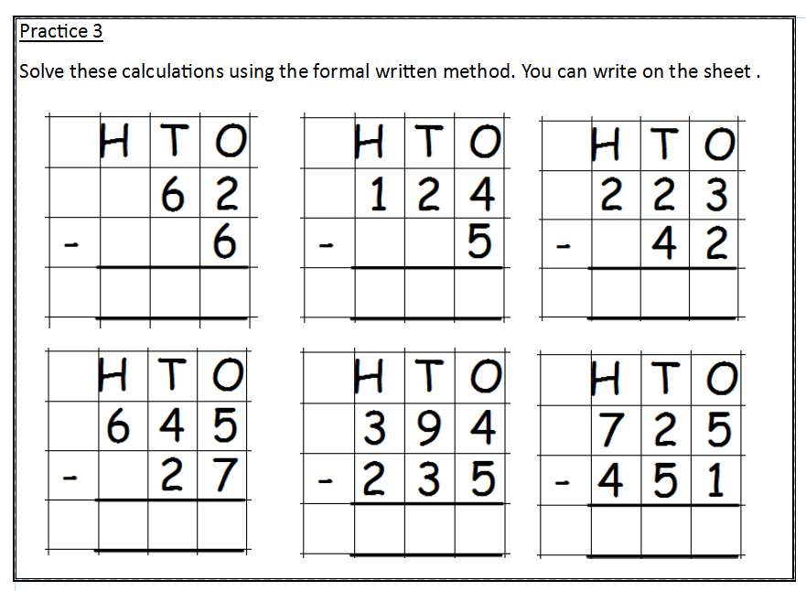
You can print this slide to complete or you can write out on squared paper.
Remember for EVERY calculation you need to draw out a place value chart and follow the steps on slide 23.
It is very important to show your exchange and rename on the written method as well as on your place value chart.

Slide 26
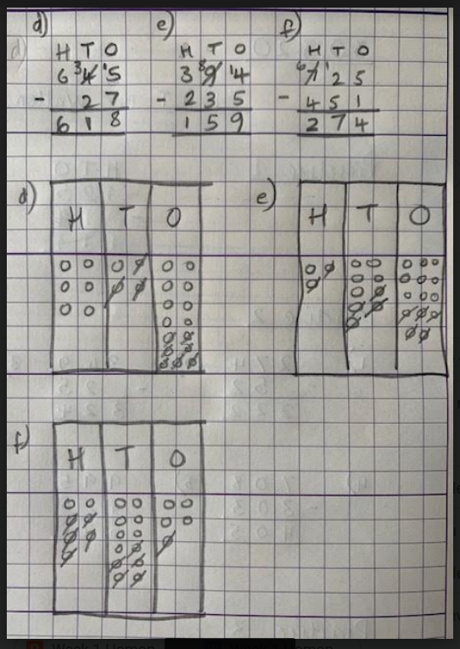
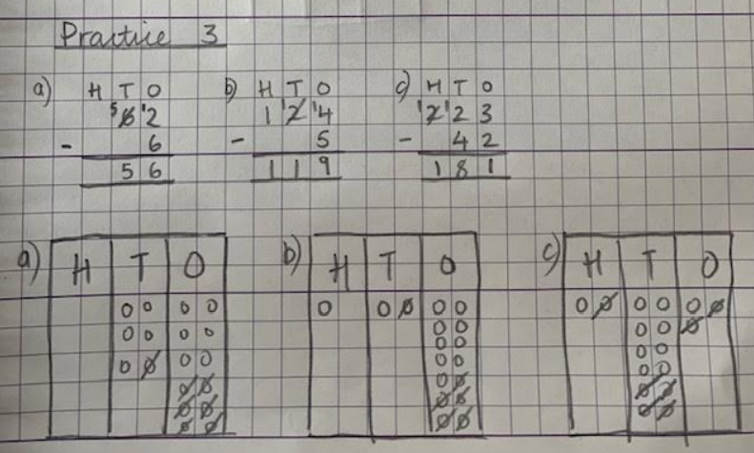
Task 2:
Written subtraction with one exchange
ANSWERS

Slide 27
Well done, you have now completed Maths Task 2
☺
Remember to complete a 5-A-Day every day (Mon – Fri) and then complete Task 3 later this week.

Slide 28
TLHT use written subtraction Task 3

Slide 29
Task 3:
Written subtraction with one exchange
Now it’s time to complete Task 3
Evidence Tasks.
Look back at slide 23 for a recap of the steps to complete written subtraction and then complete the evidence tasks.

Slide 30
SLIDE 23
Follow the steps below and if you get stuck go back to the slides and steps on the I do.
Step 1: put the first number at the top Step 2: put the next number underneath (make sure they line up) Step 3: draw the equal sign Step 4: draw the take away sign Step 5: draw out your HTO Place Value chart
Use sides
19-21 to help you with
step 7
Step 6a: draw place value discs into the ones column for the top number
Step 6b: draw place value discs into the tens column for the top number
Step 6c: draw place value discs into the hundreds column for the top number (if this is needed)
Step 7: complete subtraction in ones column first.
Exchange and rename from the tens column if needed.
Use your place value chart and whatever you do on the place value chart you MUST do on your written column method too.
Step 8:
Now complete the subtraction in the tens column

Slide 31
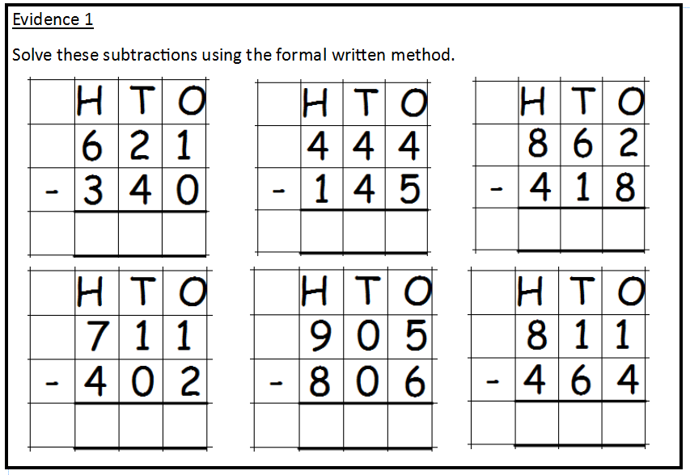
You can print this slide to complete or you can write out on squared paper.
Remember for EVERY calculation you need to draw out a place value chart and follow the steps on slide 23 OR 29.
It is very important to show your exchange and rename on the written method as well as on your place value chart.
3
1
0

Slide 32
Evidence 2
Solve these subtraction calculations.
Write them out on squared paper if you have it. Remember to use a place value chart and to write it out following the correct written method.
Show your Exchange and Rename on the place value chart and on your written method too—this is very important.
Some exchange and rename is in the ones column and some is in the tens column – look carefully!
                1) 274 - 82 =
                2) 349 - 59 =
                3) 882 - 391 =
                4) 728 - 309 =
                5) 887 - 697 =

Slide 33
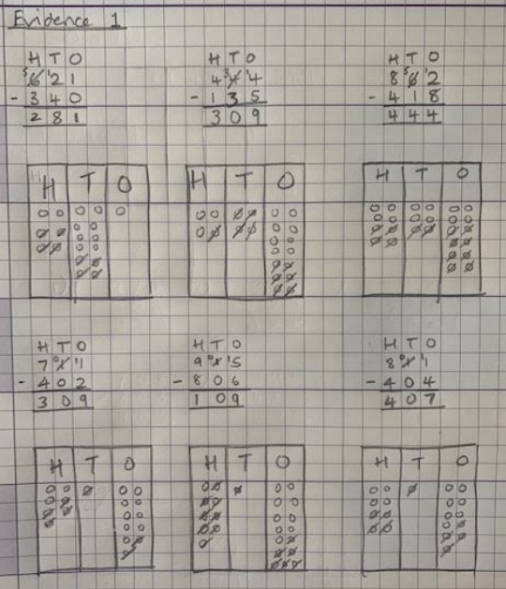
Task 3:
Written subtraction with one exchange
ANSWERS

Slide 34
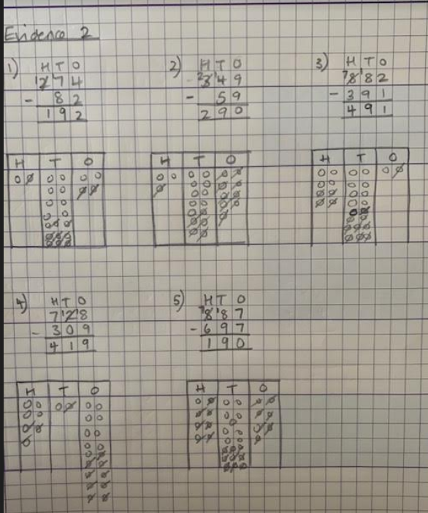
Task 3:
Written subtraction with one exchange
ANSWERS

Slide 35
Well done, you have now completed Maths Task 3
☺
You will receive the next Maths tasks and Maths 5-A-Day on the website on 20.4.20
Until then keep practising your times tables on TT Rockstars and those of you with a Doodle Maths login, you can use that too.

