Slide 1
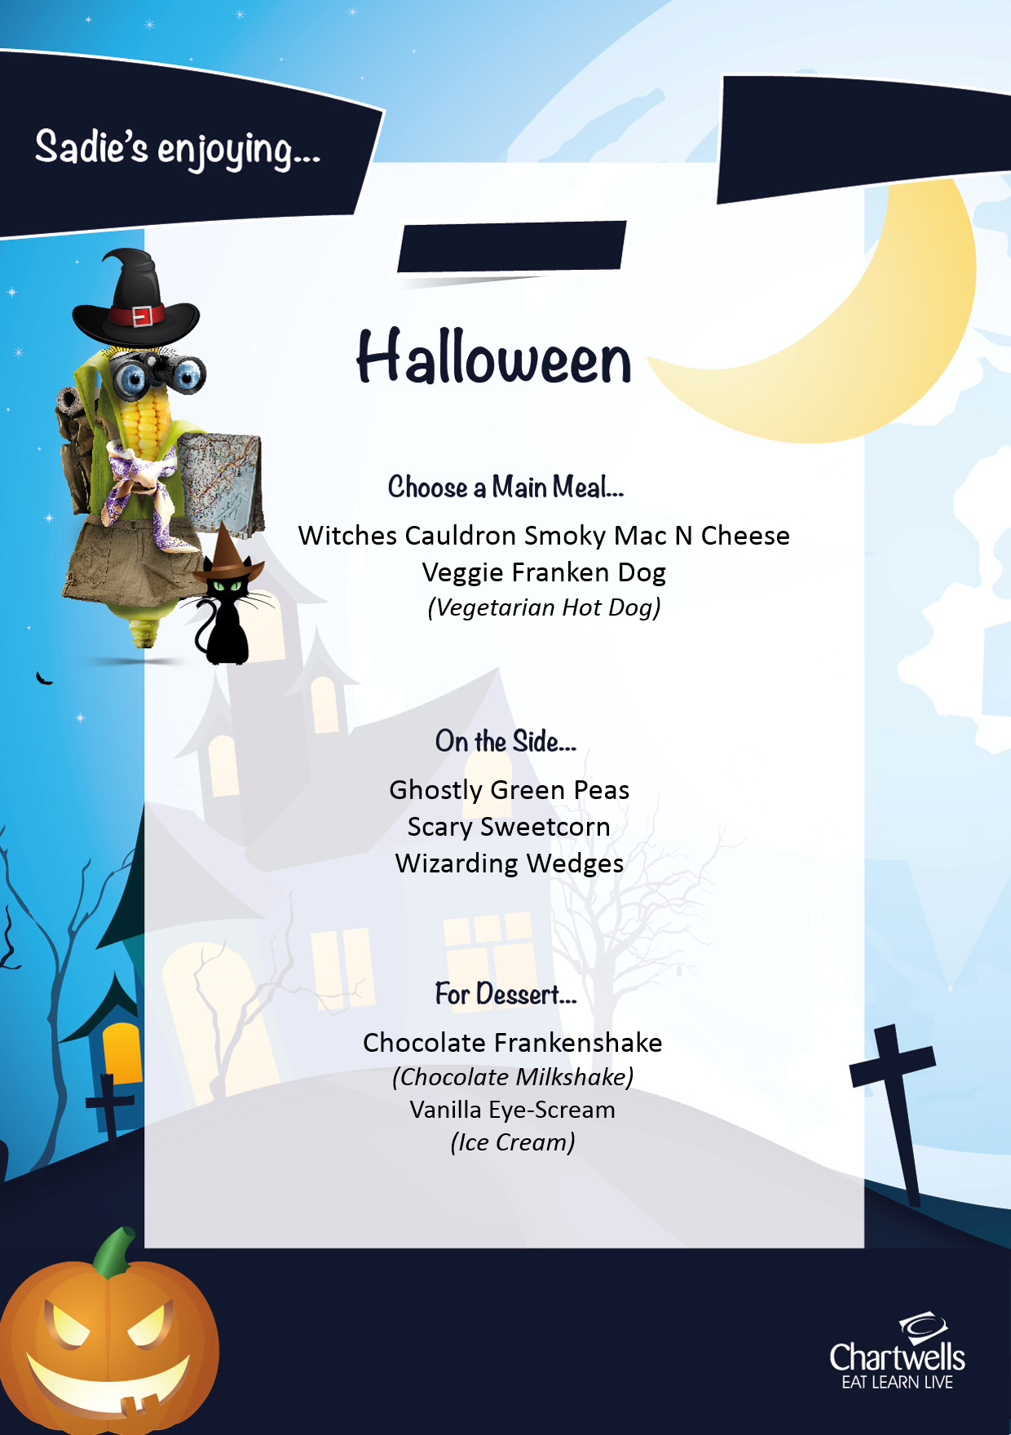
£2.25
FREE for KS1
25/10/2019
Please speak to reception to sign up today!
Don’t forget if your child is in Reception, Years 1 or 2, then you can get their packed lunch or hot meal free of charge!

